Slide 1

Open Access, the Humanities, and Early
Career Researchers
Dr Caroline Edwards
Lecturer in Modern & Contemporary Literature, Birkbeck
Director, Open Library of Humanities (OLH)
caroline.edwards@bbk.ac.uk
@the_blochian
www.drcarolineedwards.com
Image by Conrad Bakker under a CC BY-NC-SA license

Slide 2
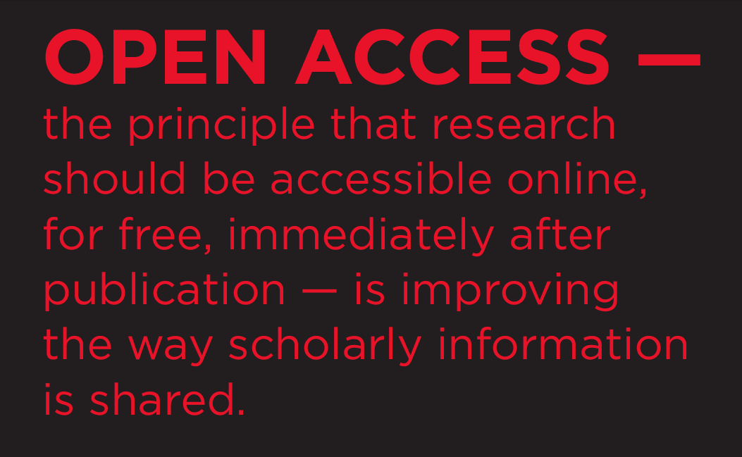

Slide 3
OA: Key Terms & Definitions
‘By “open access” to this literature, we mean its free availability on the public internet, permitting any users to read, download, copy, distribute, print, search, or link to the full texts of these articles, crawl them for indexing, pass them as data to software, or use them for any other lawful purpose, without financial, legal, or technical barriers other than those inseparable from gaining access to the internet itself.’ (Budapest Open Access Initiative, available: http://www.budapestopenaccessinitiative.org/read)
GOLD OA = immediate access to material online is free and in its final published format
GREEN OA = peer-reviewed articles are deposited in digital repositories that can be accessed for free – either after a publisher’s embargo period, or in a pre-published form (“preprint” – either prior to peer review or prior to publisher’s final formatting); or self-archived by researchers themselves (on their personal websites)

Slide 4
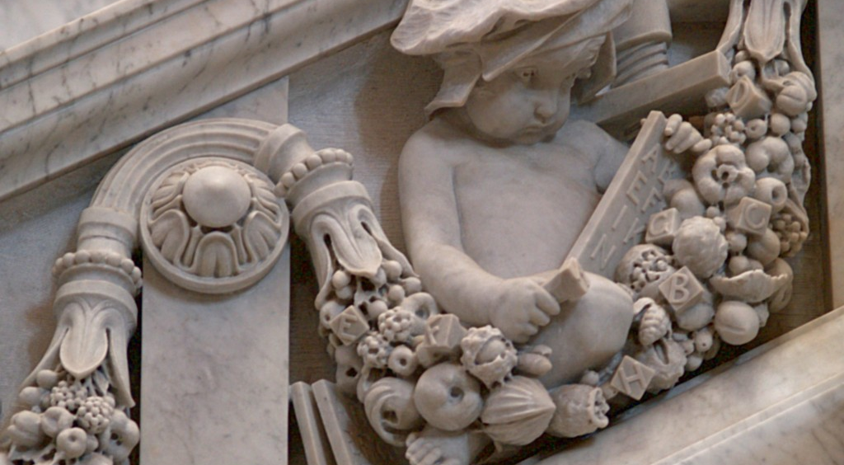
Open Access & the Humanities
How does humanities publishing differ from STEM and social sciences publishing?
The problem of academic prestige
Funding: how can OA be affordable for the humanities?
Debates concerning OA licensing – Creative Commons licenses and the importance of open licensing for digital methodologies
The future for OA monographs (e.g. OAPEN, MIT, OBH, Ubiquity, OLH)
Overlay journals – the implications of peer review as social curation

Slide 5

How do we fund open access?
Open access is not free access
Scale of open access publishing
(1) free labour & free submission
(2) advertising revenue
(3) pay on demand
(4) Article Processing Charge (APC)
(5) Library Consortia
Image by 401(k)2012 under a CC BY-SA license

Slide 6
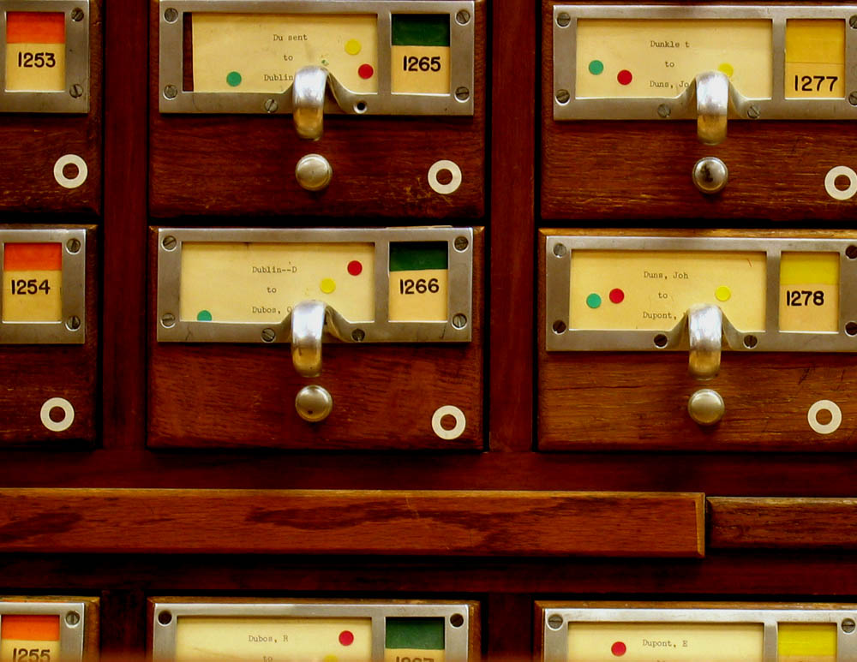
How can ECRs adopt OA practices?
Make articles green OA as soon as they are accepted for publication
Check whether your publisher allows this using the Sherpa RoMEO search engine (http://www.sherpa.ac.uk/romeo/search.php)
Adopt best practice by using an explanatory copyright cover sheet
Speak with your Subject Librarian about your institution’s Green OA repository
Set up your own website, WordPress blog, or update your Academia.edu webpage
Set up your own postgraduate journal using Open Journals Software (OJS)
Image by Cher Amio under a CC BY-NC-SA license

Slide 7
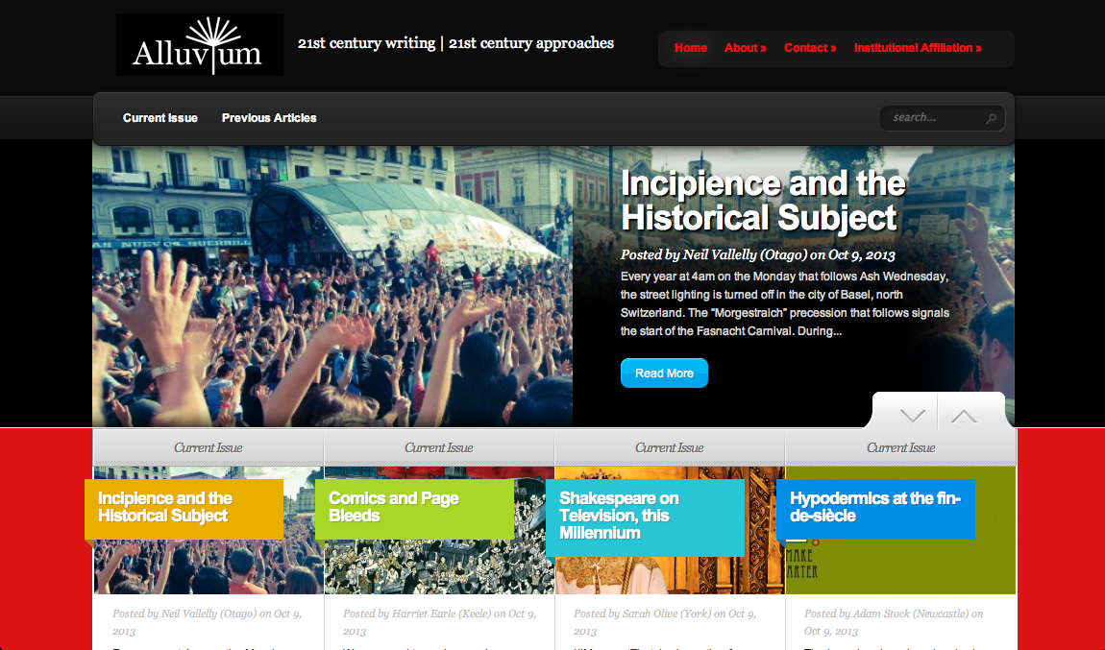
Alluvium Journal:
Open access, short form articles published through WordPress

Slide 8
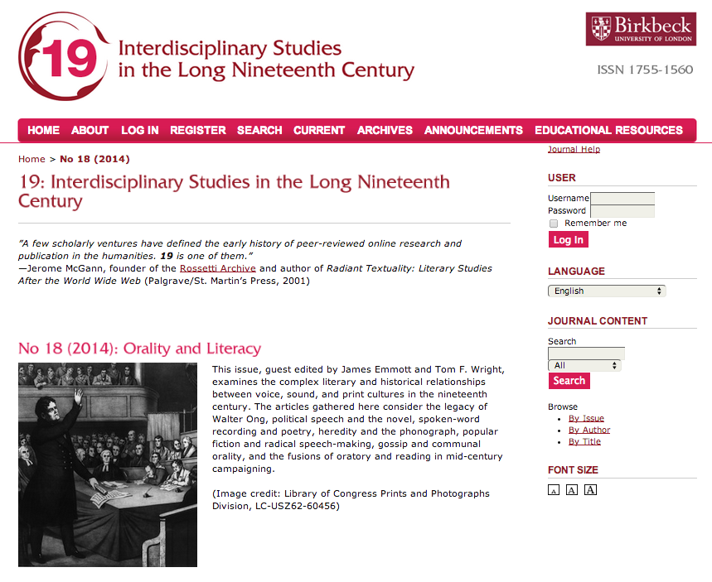

Slide 9
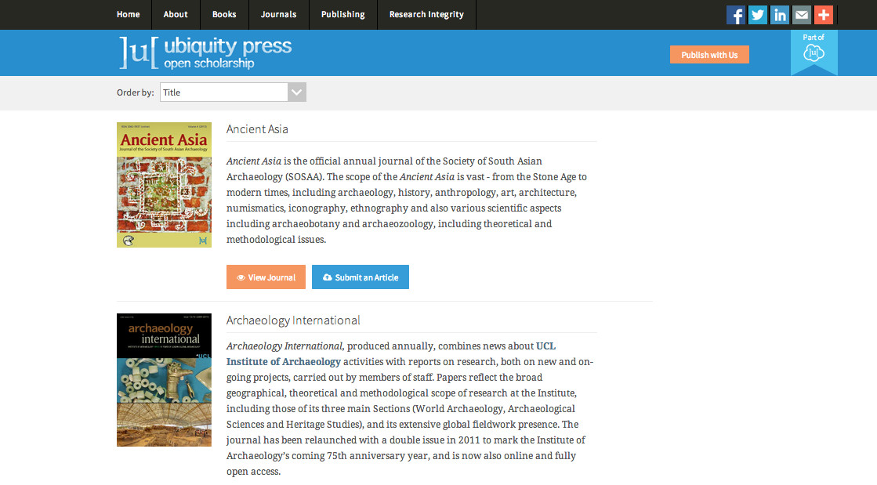
Ubiquity Press: an OA services provider for journals & monographs

Slide 10

Benefits for ECRs in OA publishing
Opening up access to your work will have a significant impact upon the number of people able to read your work, and who might contact you (invitations to publish, requests to collaborate, requests from potential PhD students etc.)
Gold OA publishing allows you to make your ideas available more quickly (at the moment at which they are published)
New annotation functionality will allow an ongoing dialogue with readers of your work
Stats allow you to see how many people are reading, citing, and sharing links to your published research
All research submitted to REF2020 must be made OA
Familiarity with OA publishing practices and research guidelines impresses potential future colleagues (e.g. at job interviews)
Improved submission systems (and back-end communication) are reducing how long it takes to receive readers’ reports and get published
Megajournal models such as the Open Library of Humanities (OLH) are fostering a rich, inter-disciplinary dialogue on an unprecedented scale in the humanities, without sacrificing niche journal “identity” or prestige

Slide 11

Innovation in Peer Review?
Artificial scarcity no longer applies in digital environment
Separate the “distinction phase” from “the publishing phase”
Are alternative modes of peer review possible?
Should peer review be “blind” (anonymous) or “open” (public)
How does peer review differ from editorial labour?
Could peer review take place post-publication?
What about peer-to-peer review?
Image by Andrew Menage under a CC BY-NC-SA license

Slide 12
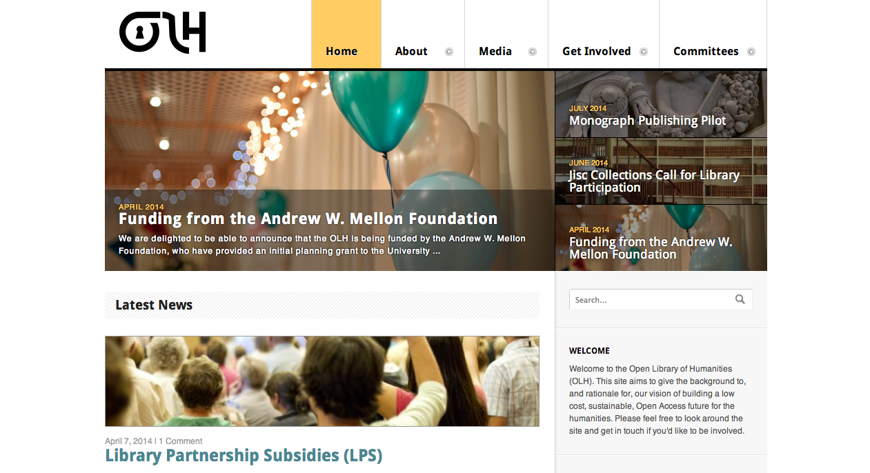
The Open Library of Humanities (OLH)
Humanities Megajournal & Monograph Pilot
https://www.openlibhums.org/

Slide 13

For more information, visit:
https://www.openlibhums.org/
Or check out our Early Career Researchers’ Forum:
https://www.openlibhums.org/committees/early-career-researchers-forum/
How you can help:
https://www.openlibhums.org/get-involved/how-you-can-help/

