Slide 1
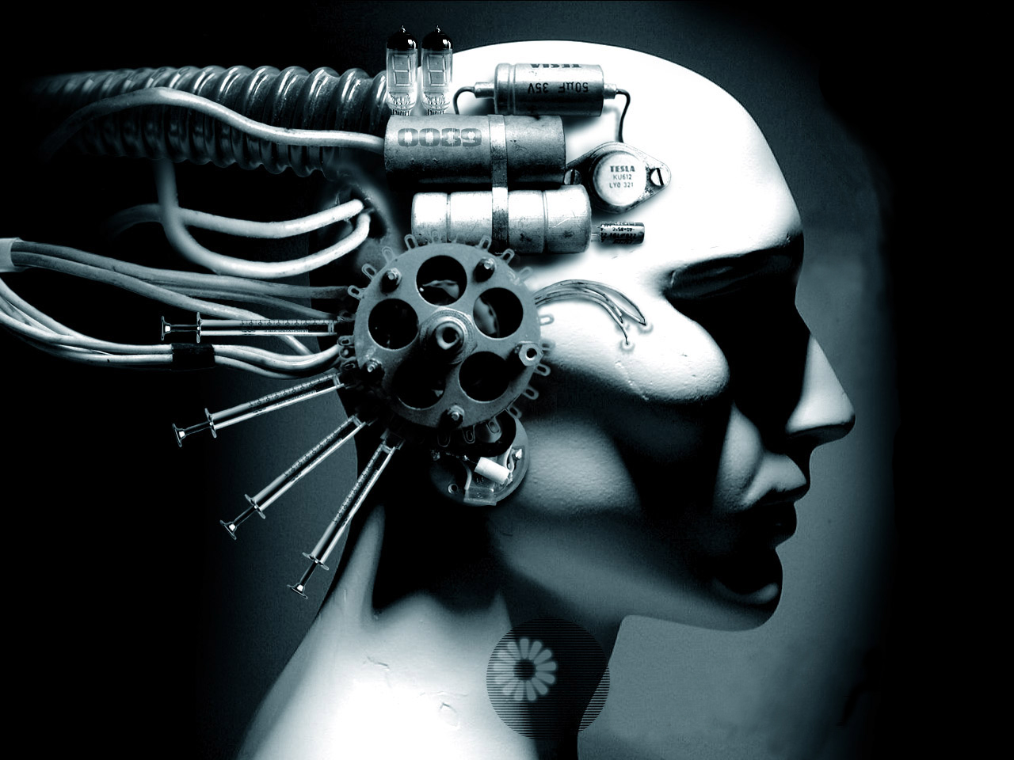
Historicising the Human-Robot Boundary
Dr Caroline Edwards
Lecturer in Modern & Contemporary Literature
Birkbeck, University of London
@the_blochian

Slide 2
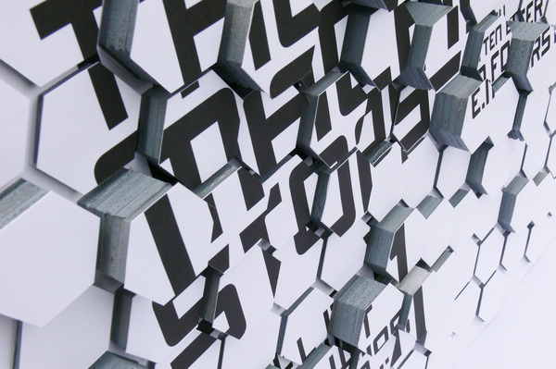
Technological Anxieties: The Cybernetic Imagination
E. M. Foster, “The Machine Stops” (1909)

Slide 3
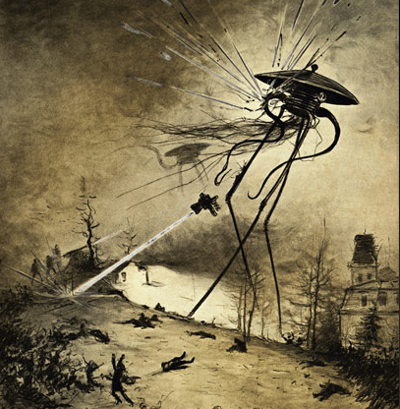
The Natural/Machinic Boundary: Edwardian Alien Invasions
H. G. Wells, The War of the Worlds (1898)

Slide 4
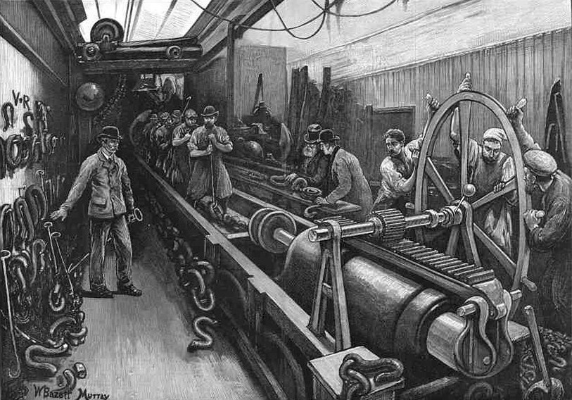
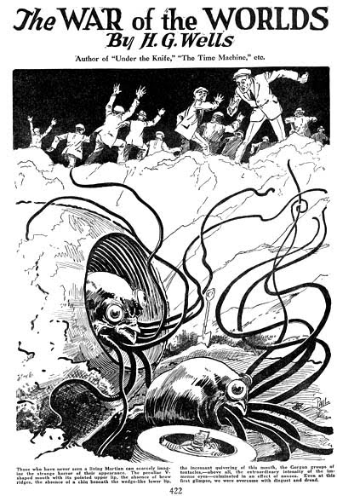
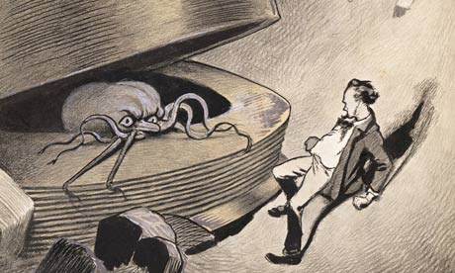
Liberal versus Mechanical Culture

Slide 5
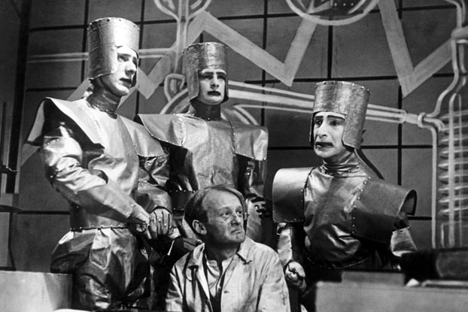
Technological Anxieties: Robot Rebellions
Karel Čapek,
R.U.R. (1920)

Slide 6
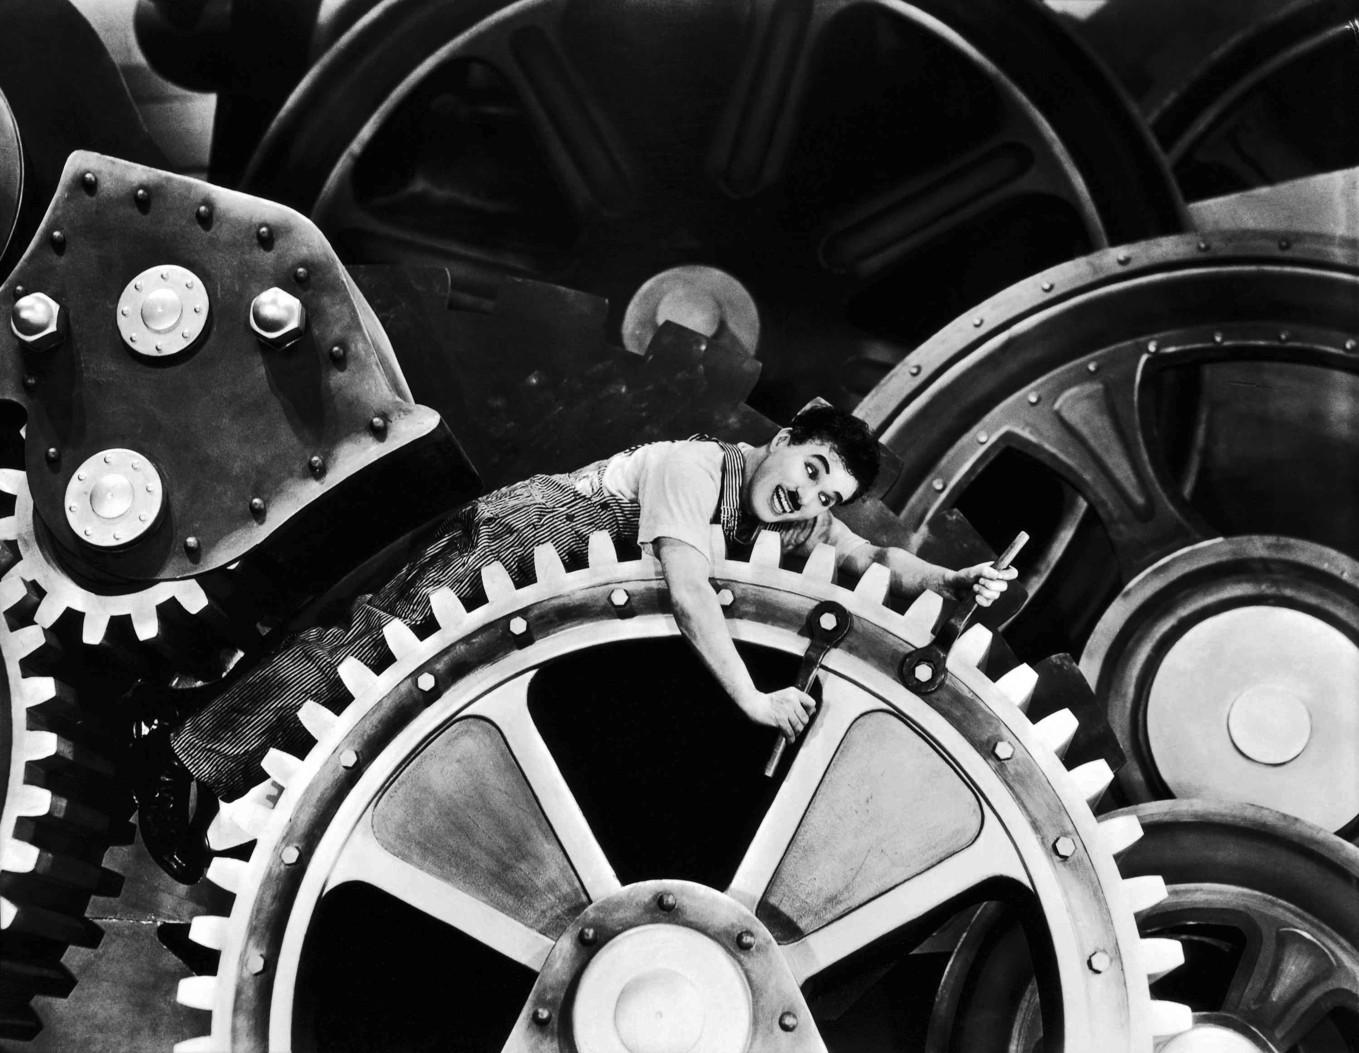
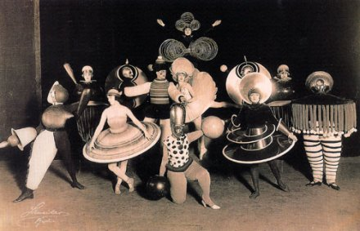
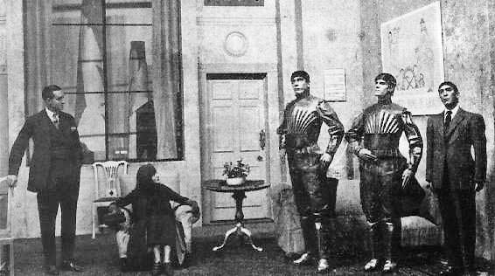
Early SF Drama

Slide 7
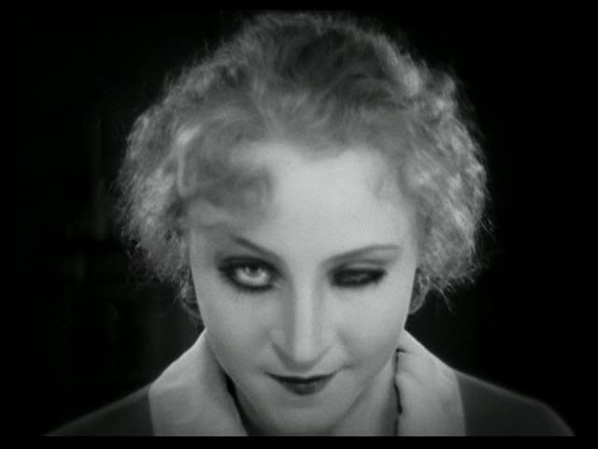
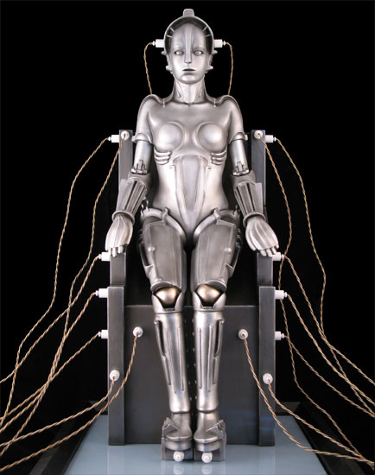
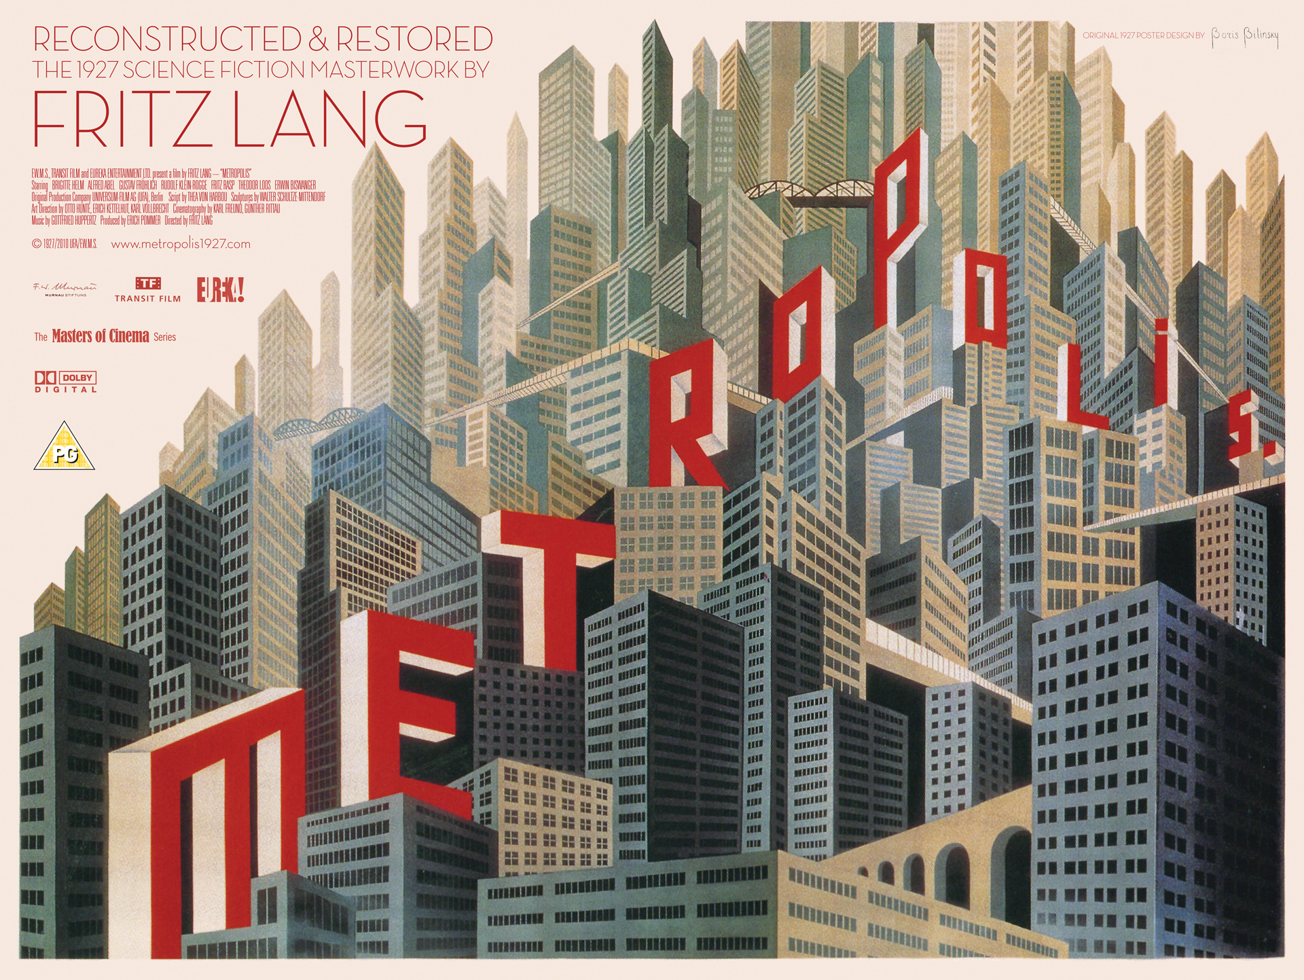
Gendered Robots:
Demonic Technology &
Female Sexuality
Metropolis (Dir. Fritz
Lang, 1927)

Slide 8
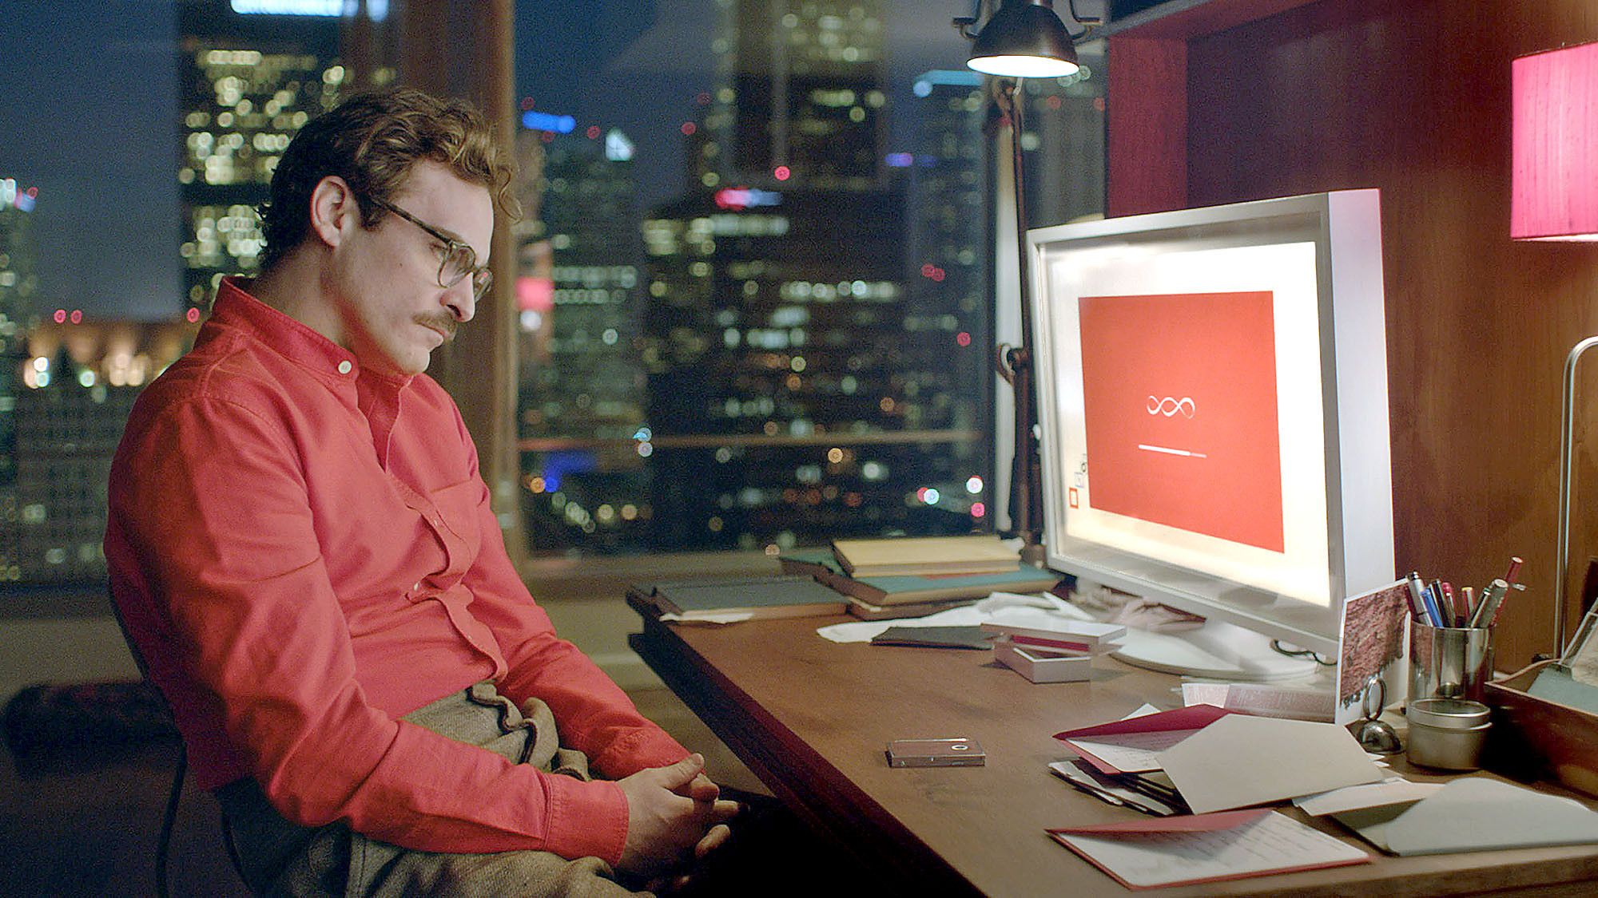
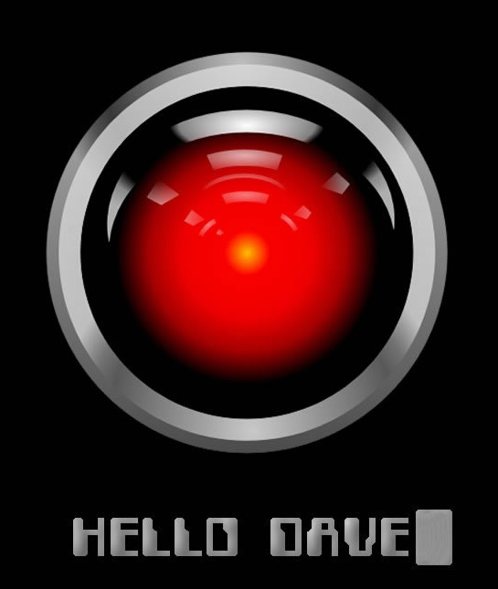
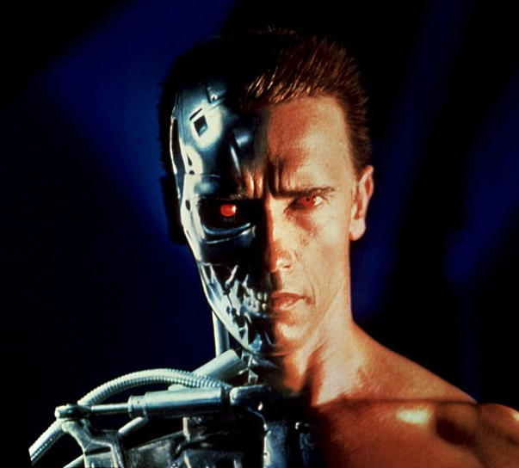
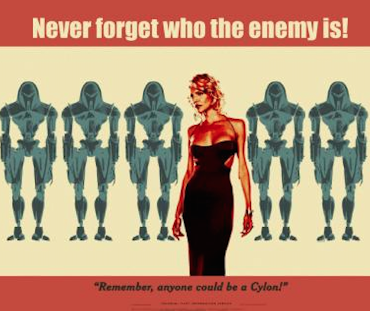
Computerized Consciousness: Androids & Other Sentient Machines

Slide 9
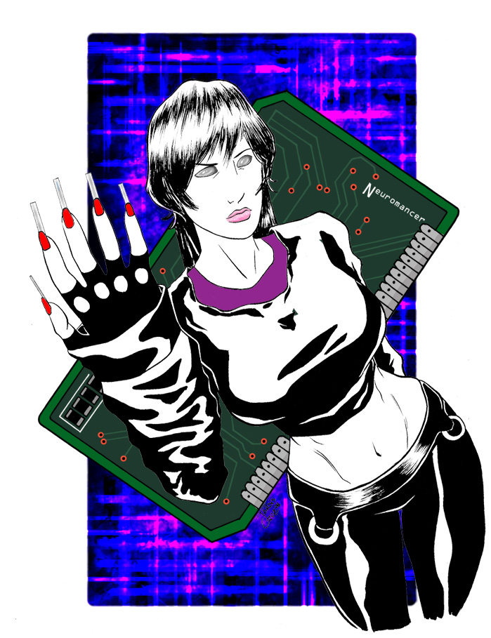
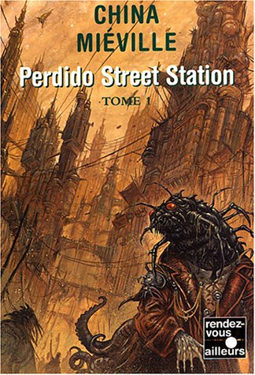
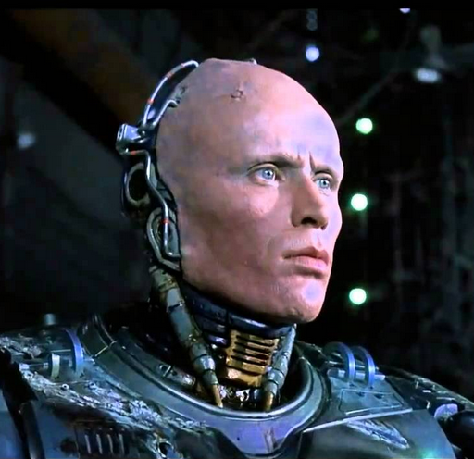
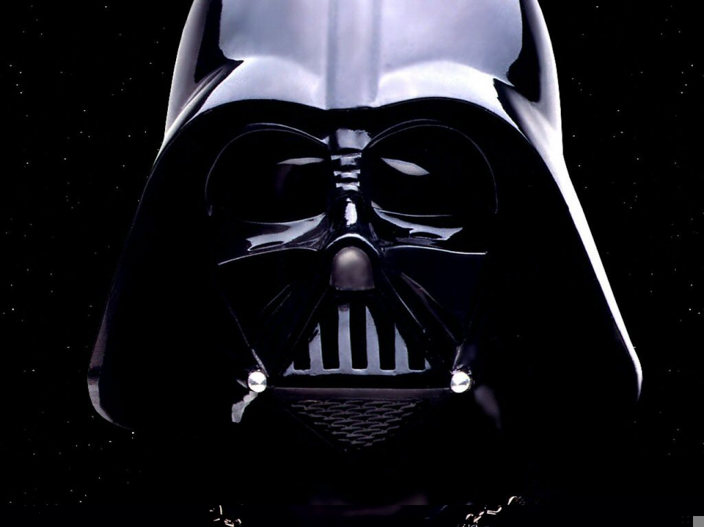
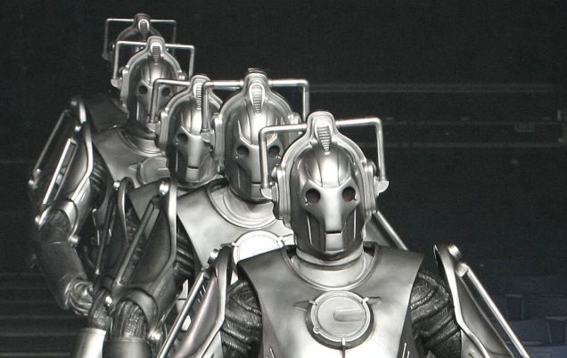
Cyborgs: The Meeting of Human & Machine

Slide 10
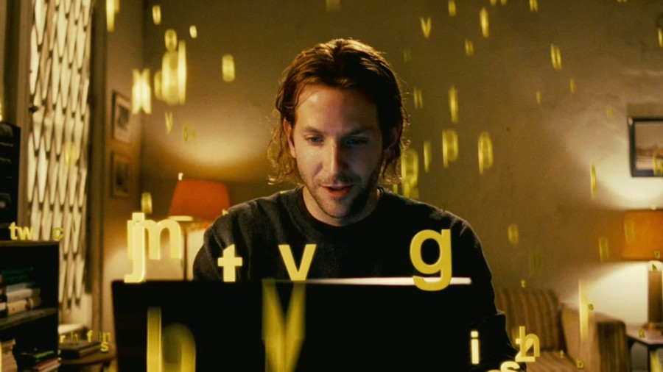
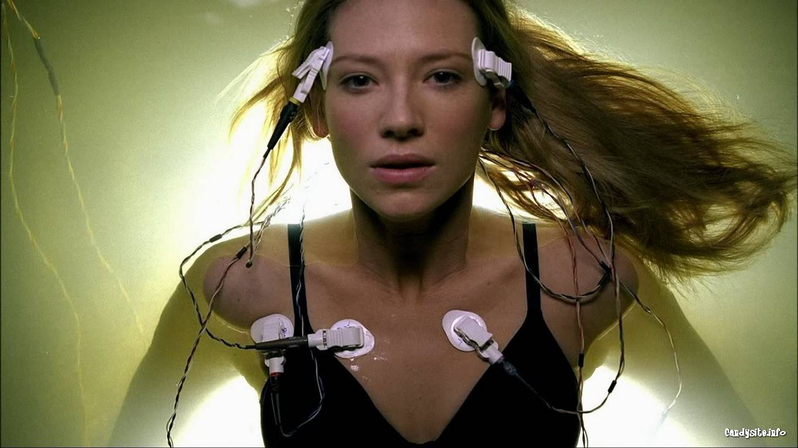
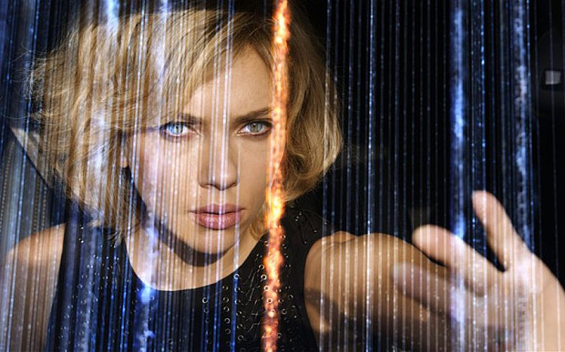
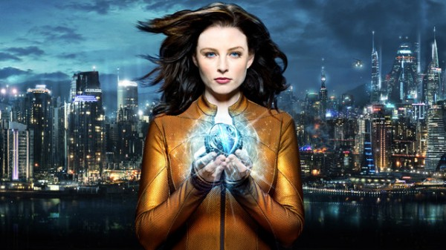
Biotechnology: Enhanced Humans
Fringe (J. J. Abrams, 2008-2013)
Limitless (Dir. Neil Burger, 2011)
Continuum (Simon Barry, 2012-)
Lucy (Dir. Luc Besson, 2014)

