Slide 1
The Deep Sea in Science Fiction
Dr Caroline Edwards
Birkbeck, University of London
caroline.edwards@bbk.ac.uk

Slide 2
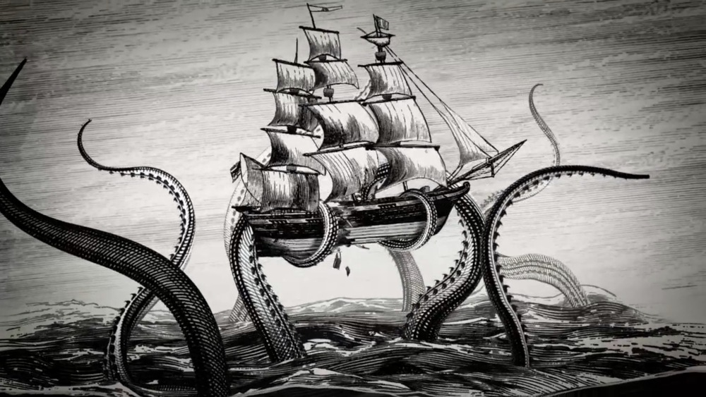
Historical Precursors
Alfred, Lord Tennyson, “The Kraken” (1830)
Thomas More,
Utopia (1516)
Daniel Defoe, Robinson Crusoe (1719)
Margaret Cavendish, The Blazing World (1666)

Slide 3
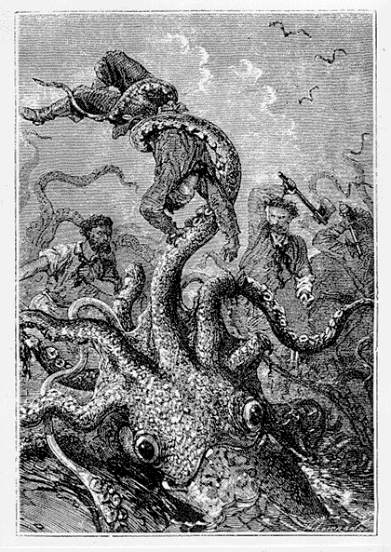
THE UNKNOWN: Voyages Extraordinaires

Slide 4
Jules Verne, 20,000 Leagues Under the Sea (1870)
“The Nautilus floated in the midst of a phosphorescent bed, which, in this obscurity, became quite dazzling. It was produced by myriads of luminous animalculae, whose brilliancy was increased as they glided over the metallic hull of the vessel. I was surprised by lightning in the midst of these luminous sheets, as though they had been rivulets of lead melted in an ardent furnace, or metallic masses brought to a white heat, so that, by force of contrast, certain portions of light appeared to cast a shade in the midst of the general ignition, from which all shade seemed banished. No; this was not the calm irradiation of our ordinary lightning. There was unusual life and vigour; this was truly living light!”

Slide 5
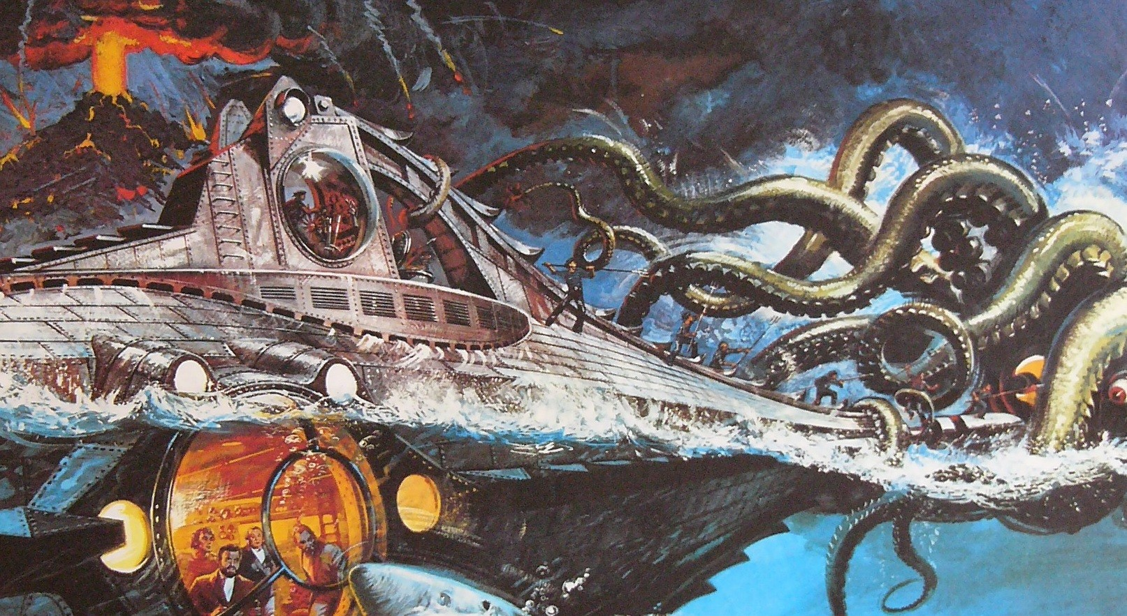
“a horrible monster, worthy to figure
in the legends of the marvellous”

Slide 6
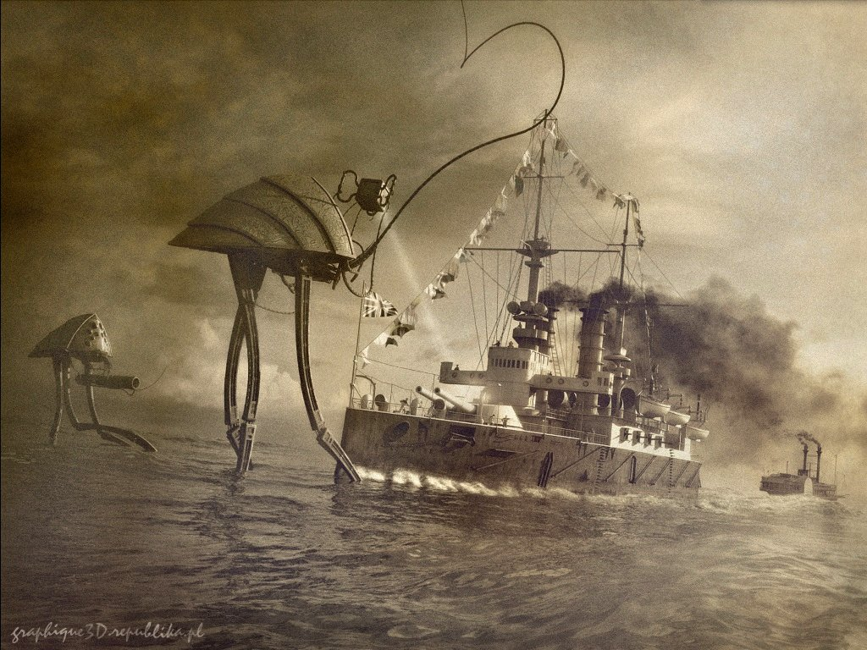
H. G. Wells’ Scientific Romances
The War of the Worlds (1898)
The Sea Lady (1902)

Slide 7
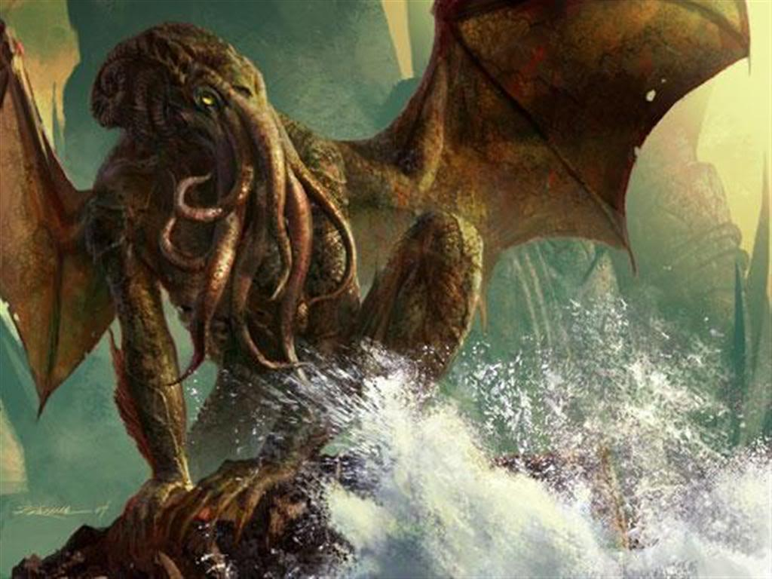
H. P. Lovecraft’s Cthulhu Mythos (1928)

Slide 8
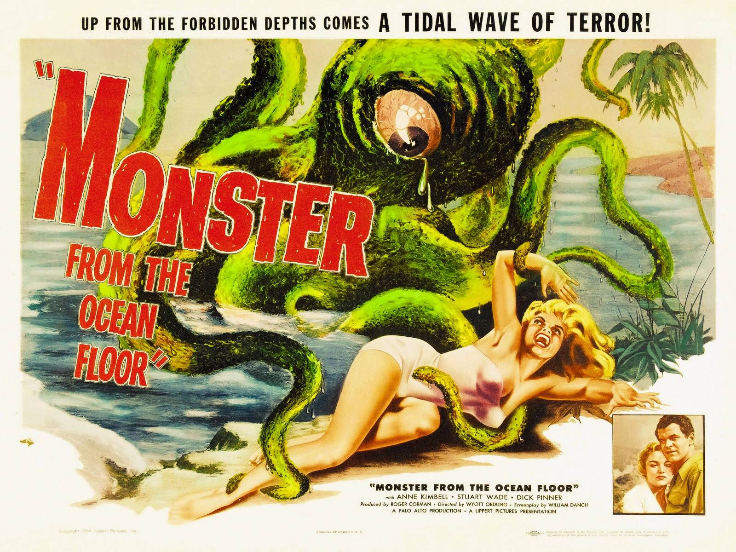
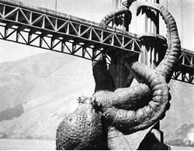
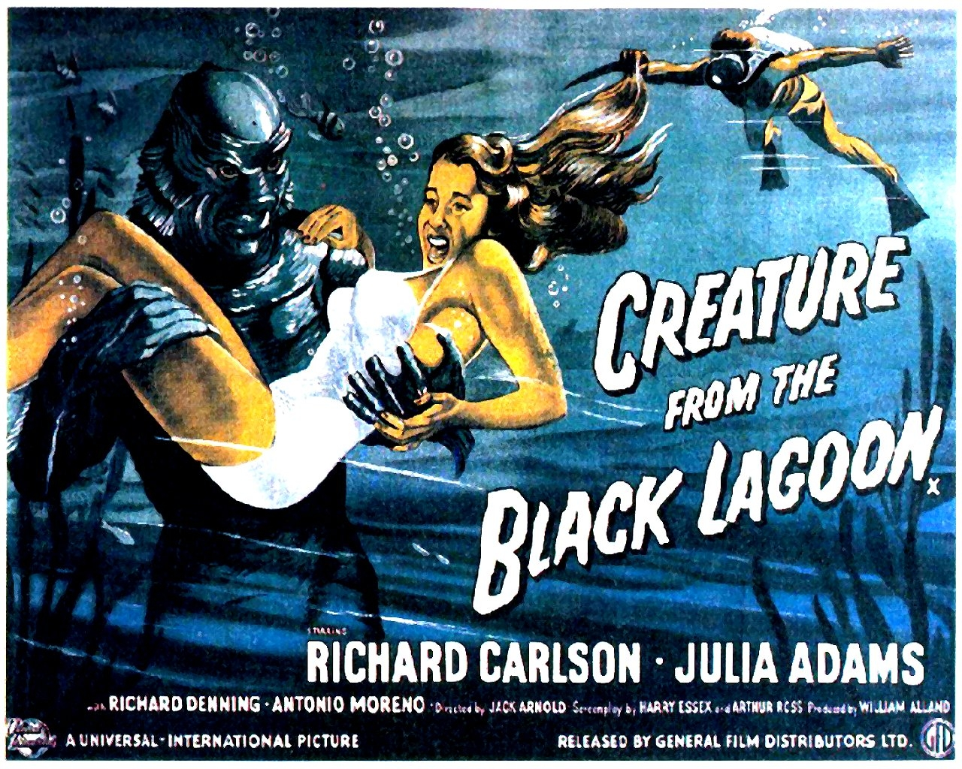
Krakens, P(o)ulps, & B Movies
It Came From Beneath the Sea (1955)
John Wyndham,
The Kraken Wakes (1953)

Slide 9
THE UNCONSCIOUS: New Wave SF

Slide 10
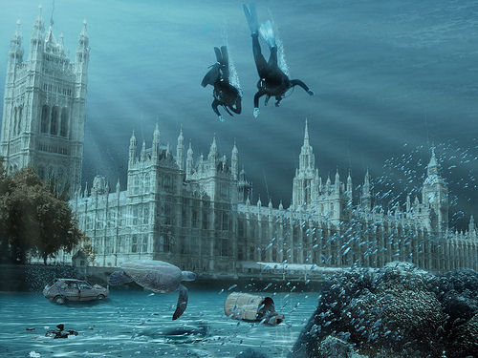
J. G. Ballard, The Drowned World (1962)

