Slide 1
Utopian Collective Futures
Dr Caroline Edwards
Lecturer in Modern & Contemporary Literature
Birkbeck, University of London

Slide 2
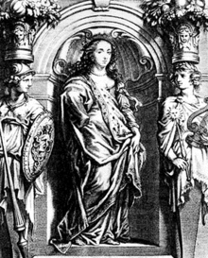
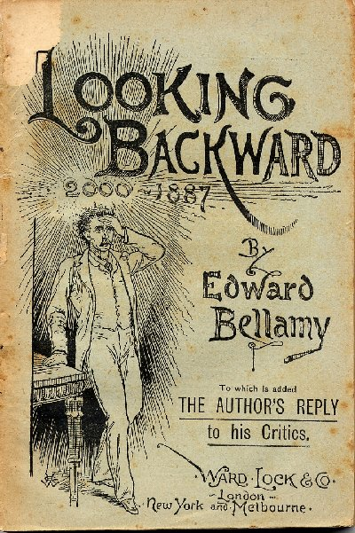
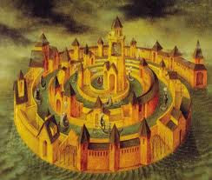
The Literary Utopia
Margaret Cavendish, The Blazing World (1666)
William Morris, News
from Nowhere (1890)
Thomas More, Utopia (1516)
Edward Bellamy,
Looking Backward (1888)
Charlotte Perkins Gilman, Herland (1915)
Tommaso Campanella, City of the Sun (1602)

Slide 3
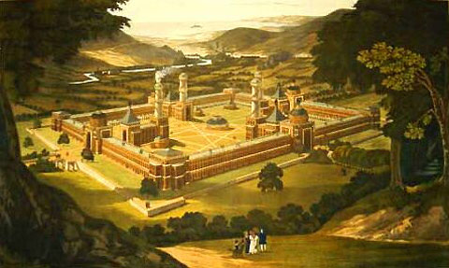
Socialism: Utopian & Scientific
Robert Owen’s New Harmony, painted by F. Bate

Slide 4
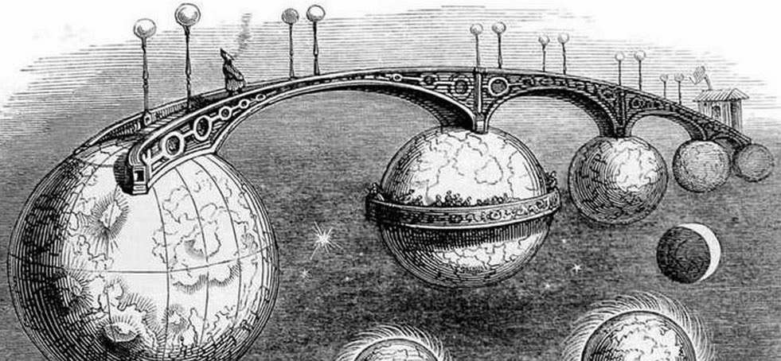
The Rebirth of the Literary Utopia: New Contradictions, New Collectivities

Slide 5
The Anti-Utopian Consensus

Slide 6
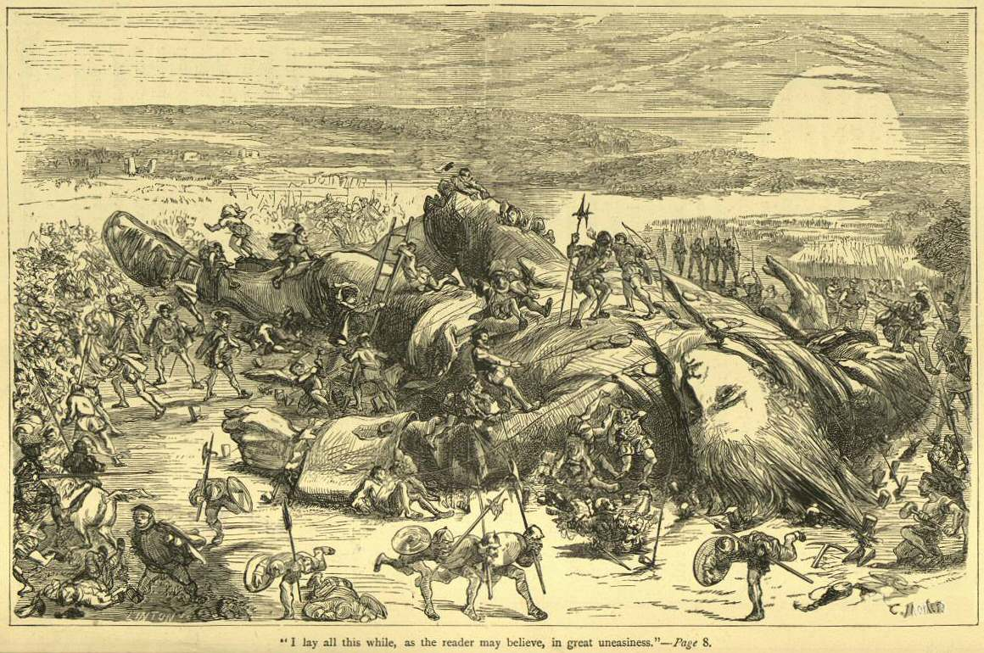
Gulliver’s Problem of Scale

Slide 7
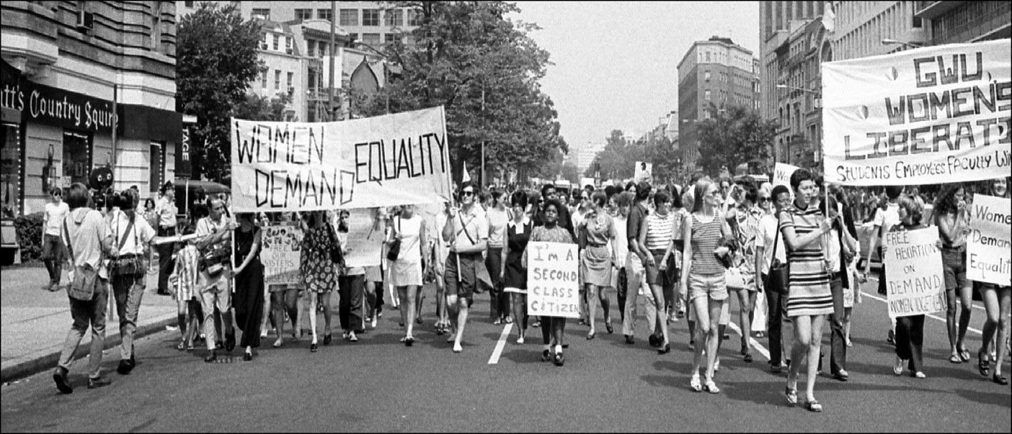
Critical Utopias: Feminism, Ecology & the New Left

Slide 8
21st-Century Microtopias

