Slide 1
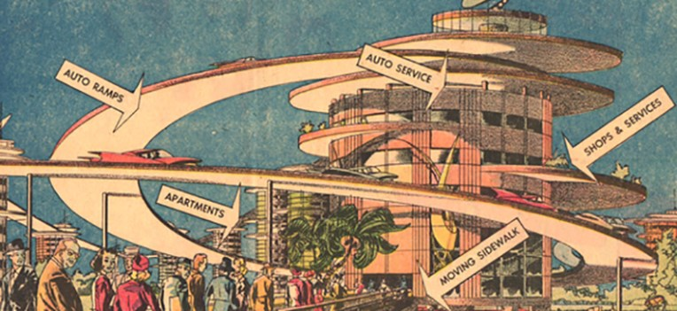
Techno-modernity: how we love it, how we fear it
Dr Caroline Edwards
Lecturer in Modern & Contemporary Literature
Birkbeck, University of London

Slide 9
Techno-modernity
the era of techno-modernity inspires a double-sided speculative response among writers:
It gives concrete form to our fear of the loss of modernity and/or civilisation that we find in so many post-apocalyptic narratives (like dystopias, these are enjoying an impressive renaissance just now) – this is why we love it;
It inspires our fear of the kind of future modernity will deliver in its final, perfected incarnation – and this is why we hate it.

Slide 10
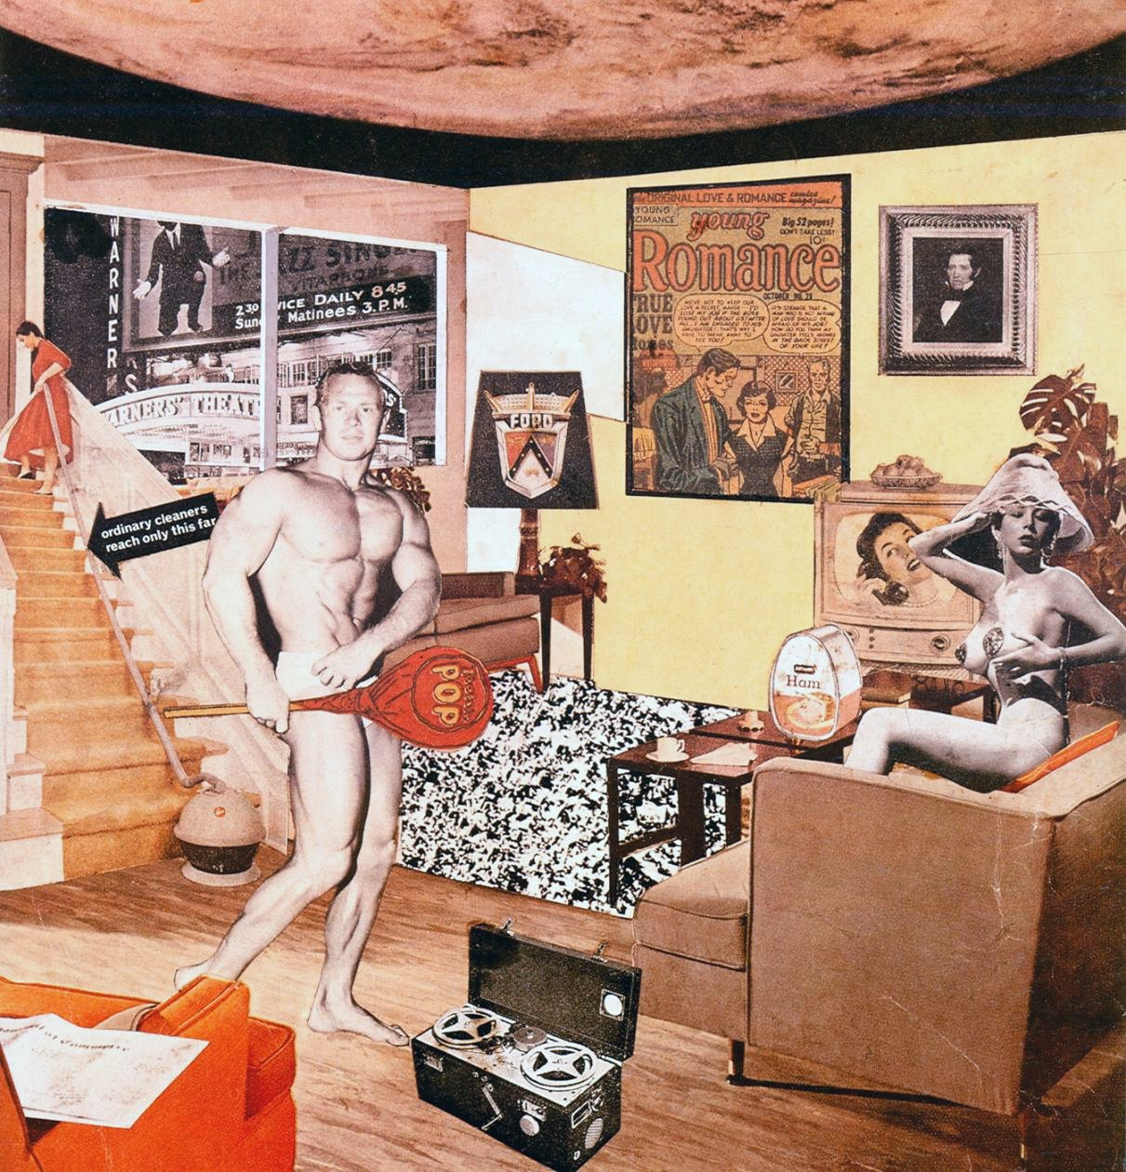
But why is everyone saying such terrible things about it?
‘Scientific management and scientific division of labor vastly increased the productivity of the economic, political, and cultural enterprise. Result: the higher standard of living. At the same time and on the same ground, this rational enterprise produced a pattern of mind and behavior which justified and absolved even the most destructive and oppressive features of the enterprise. Scientific-technical rationality and manipulation are welded together into new forms of social control.’
(Herbert Marcuse, One-Dimensional Man, 1964, p. 146).
Richard Hamilton, Just what is it that makes today’s home’s so different, so appealing? (1956)

Slide 11
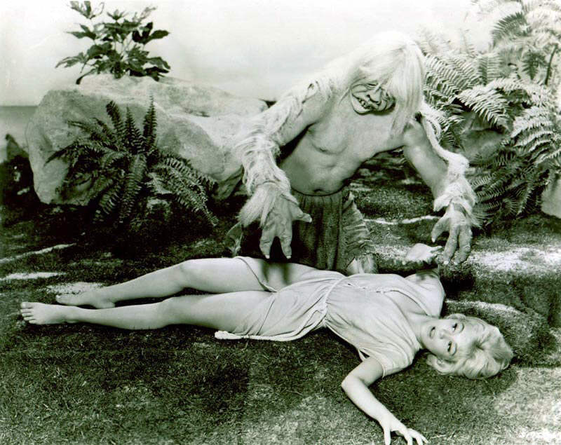
From utopian dream to dystopian nightmare

Slide 12
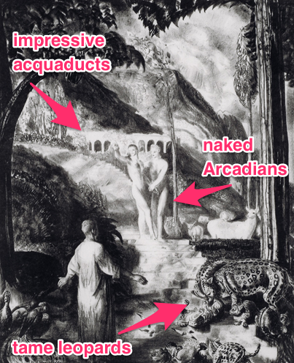
H. G. Wells, Men Like Gods (1923)
Life marched here; it was terrifying to think with what strides. Terrifying – because at the back of Mr. Barnstaple’s mind, as at the back of so many intelligent minds in our world still, had been the persuasion that presently everything would be known and the scientific process come to an end. And then we should be happy for ever after. (p. 126)

Slide 13
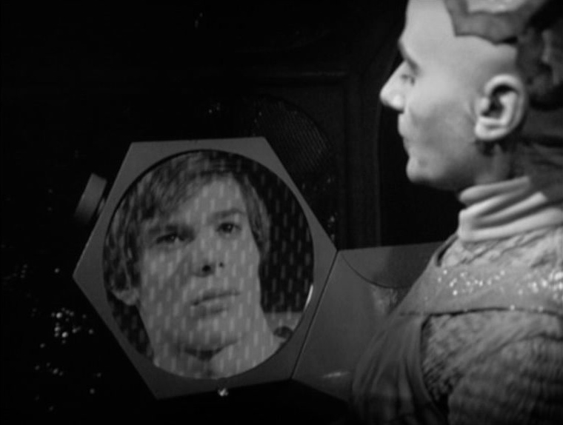
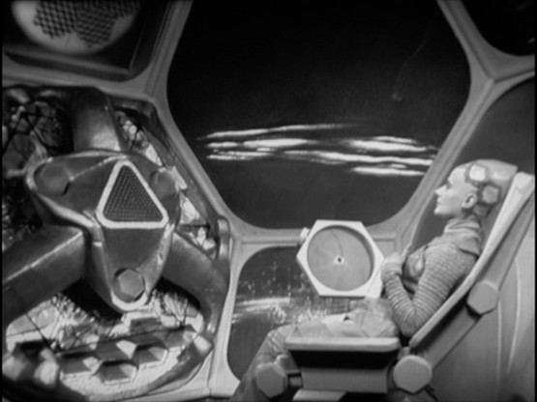
E. M. Forster, ‘The Machine Stops’ (1909)
Imagine, if you can, a small room, hexagonal in shape like the cell of a bee. It is lighted neither by window nor by lamp, yet it is filled with a soft radiance. There are no apertures for ventilation, yet the air is fresh. There are no musical instruments, and yet, at the moment that my meditation opens, this room is throbbing with melodious sounds. An arm-chair is in the centre, by its side a reading-desk – that is all the furniture. And in the arm-chair there sits a swaddled lump of flesh – a woman, about five feet high, with a face as white as a fungus. (p. 1)

Slide 14
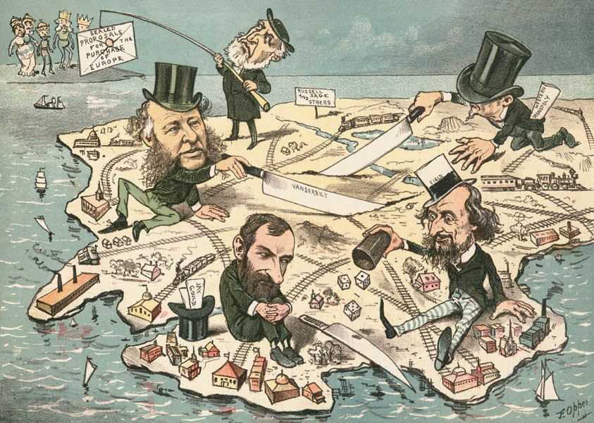
Proto-Dystopias of monopoly capitalism
Émile Souvestre, Le monde tel qu’il sera (‘The World as It Will Be’, 1846)
Ignatius Donnelly, Caesar’s Column (1890)

Slide 15
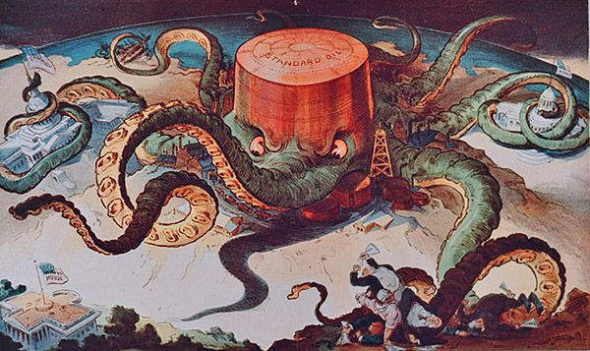
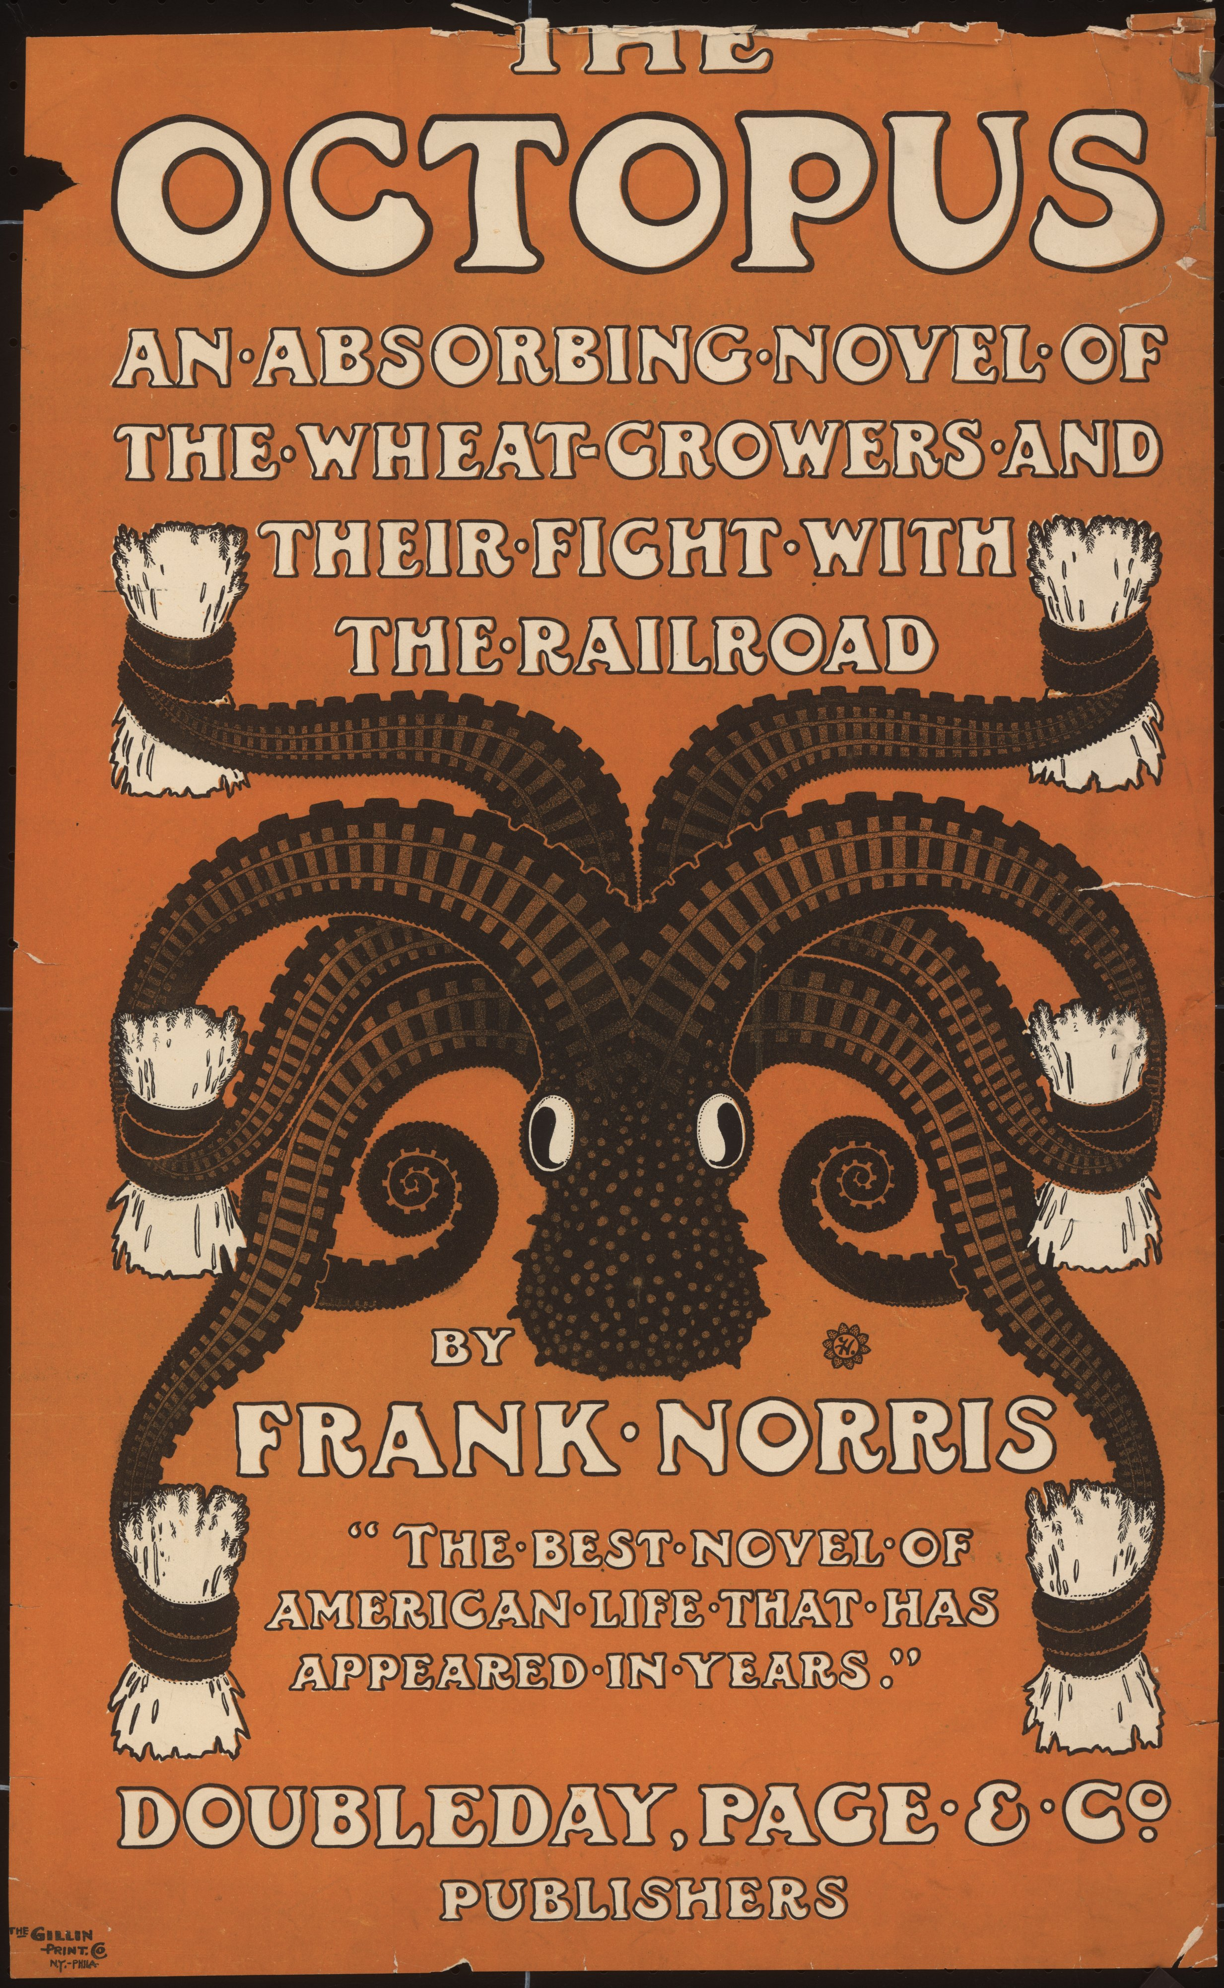

Slide 16
Jack London, The Iron Heel (1908)
Illustration for the cover of the socialist publication
The Masses, June 1914

Slide 17
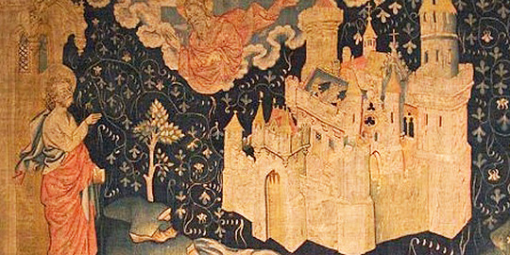
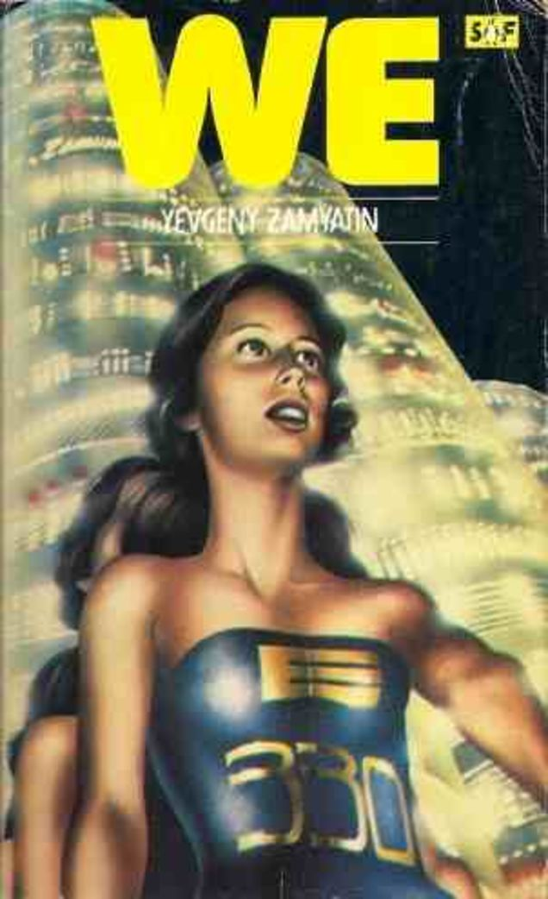
Yevgeny Zamyatin, We (1924)

Slide 18
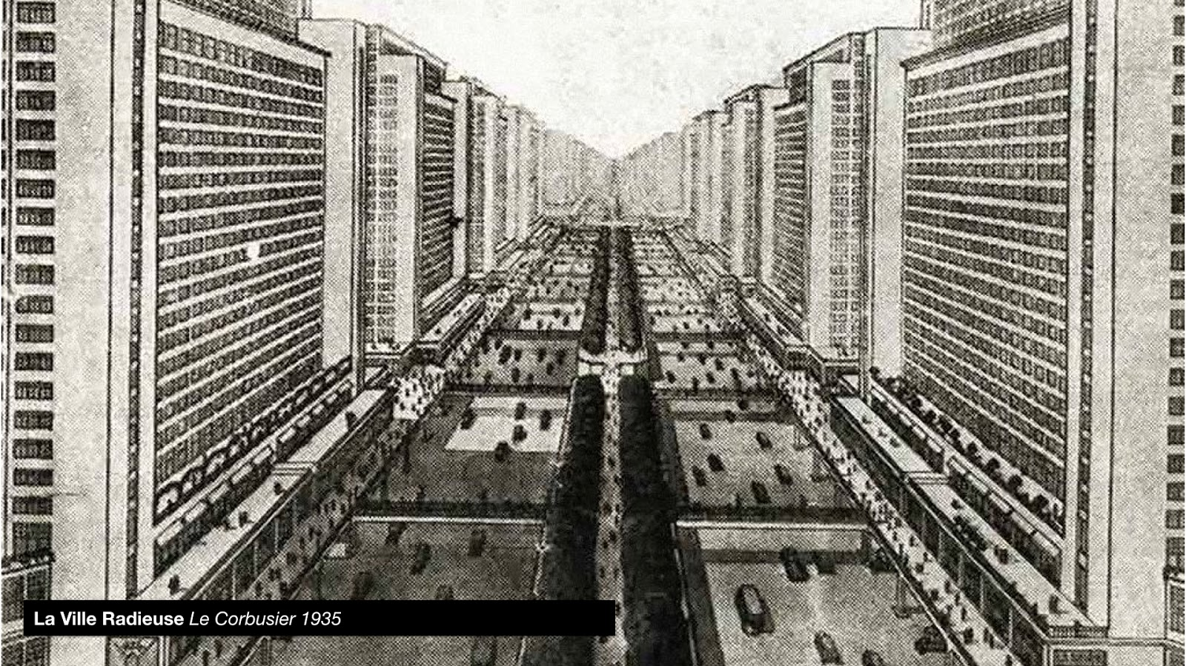

Slide 19
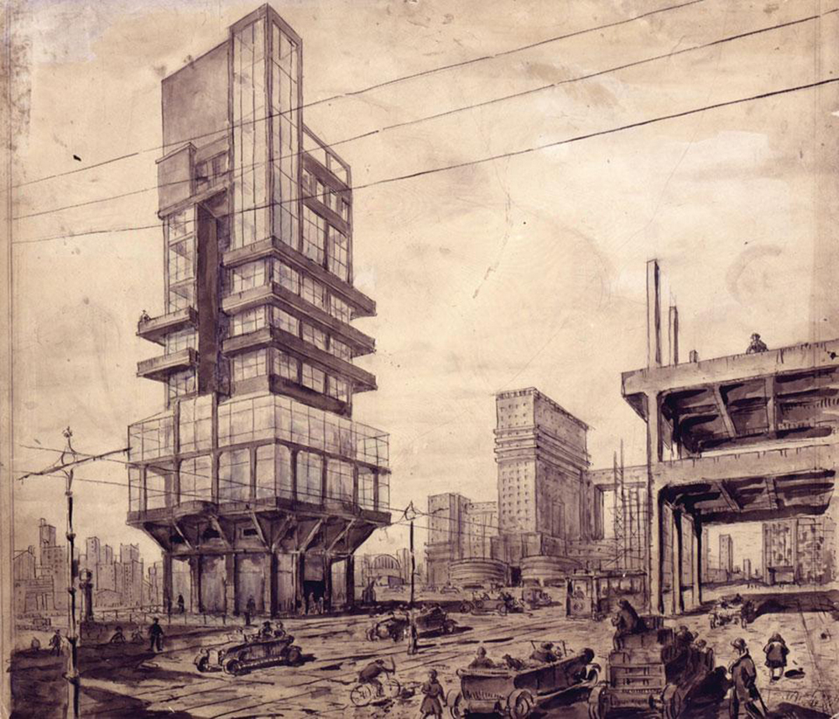
The city of the future
Lev Rudnev, City of the Future (1925)

Slide 20
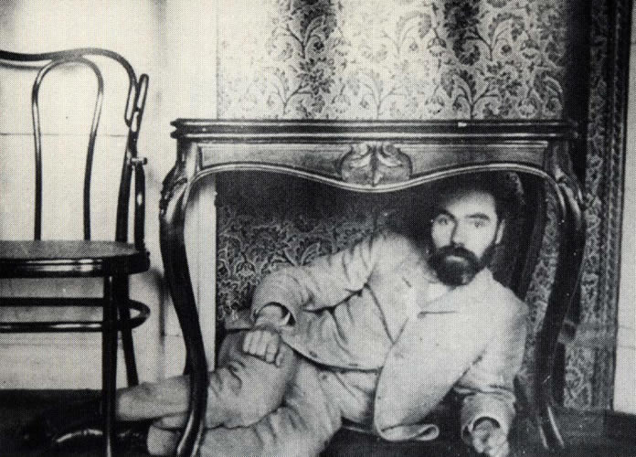
Valery Bryusov, The Republic of the Southern Cross (1907)
Bryusov under the table, c. 1900

Slide 21
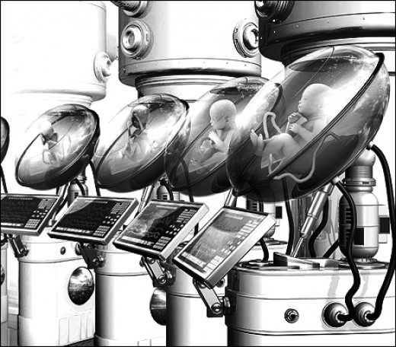
Aldous Huxley, Brave New World (1932)

Slide 22
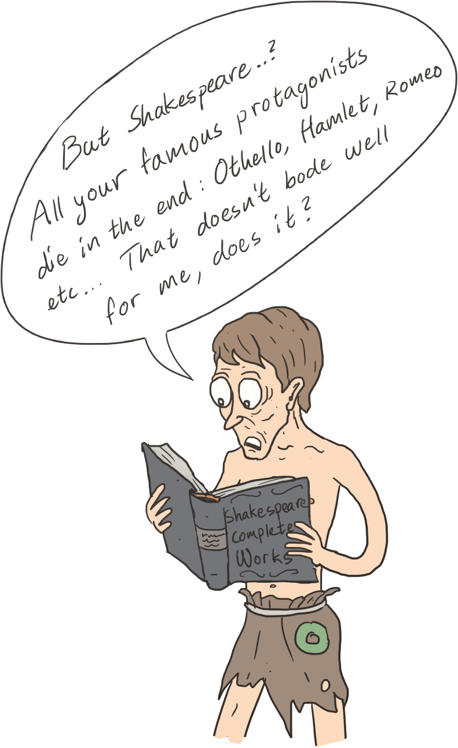

Slide 23
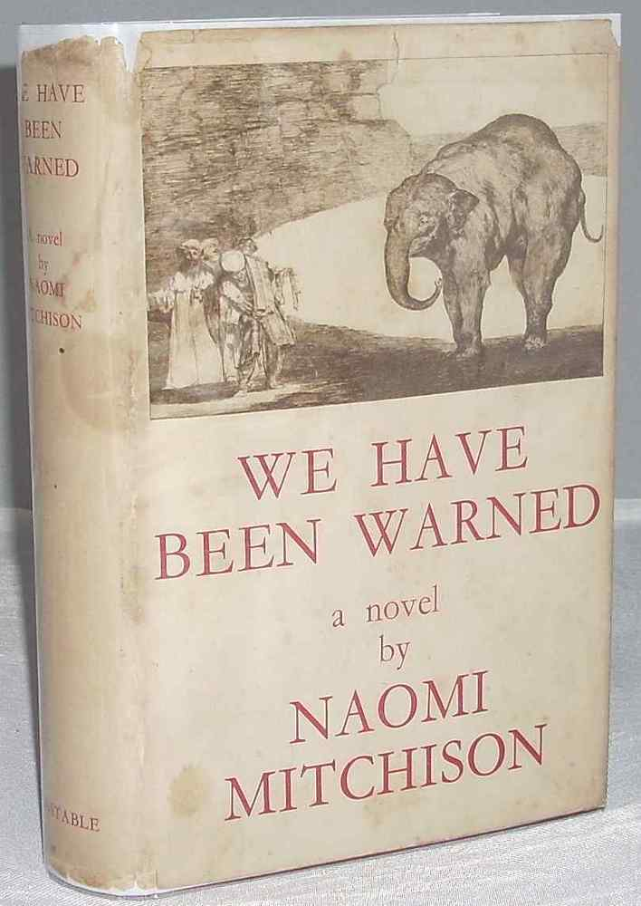
Feminist anti-fascist dystopias
Naomi Mitchison,
We Have Been Warned (1935)
Storm Jameson,
In the Second Year
(1936)
Katharine Burdekin,
Swastika Night (1937)

Slide 24
Katherine Burdekin (Murray Constantine), Swastika Night (1937)

Slide 25
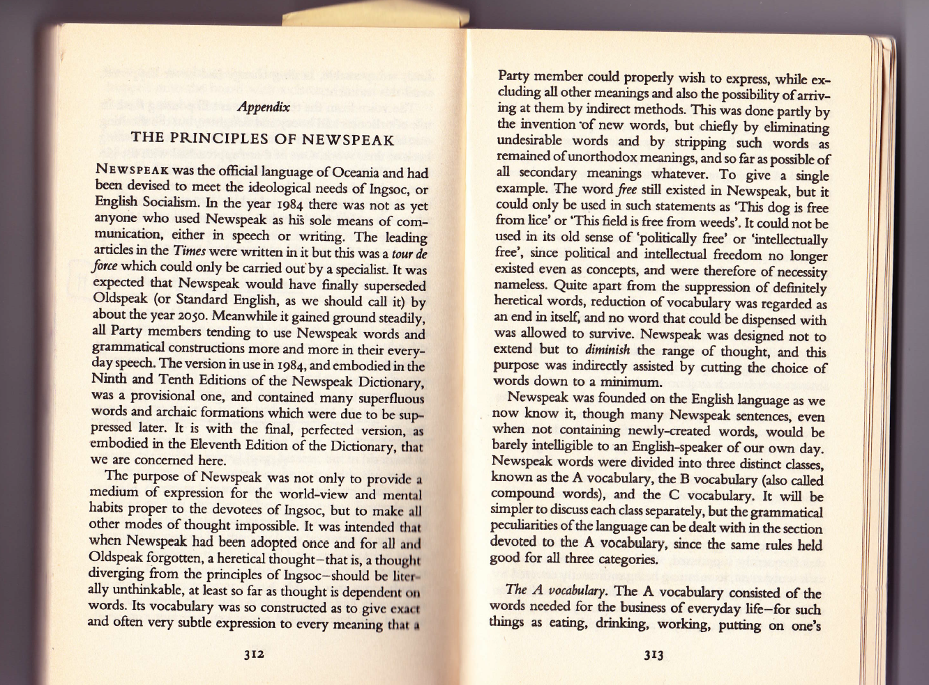
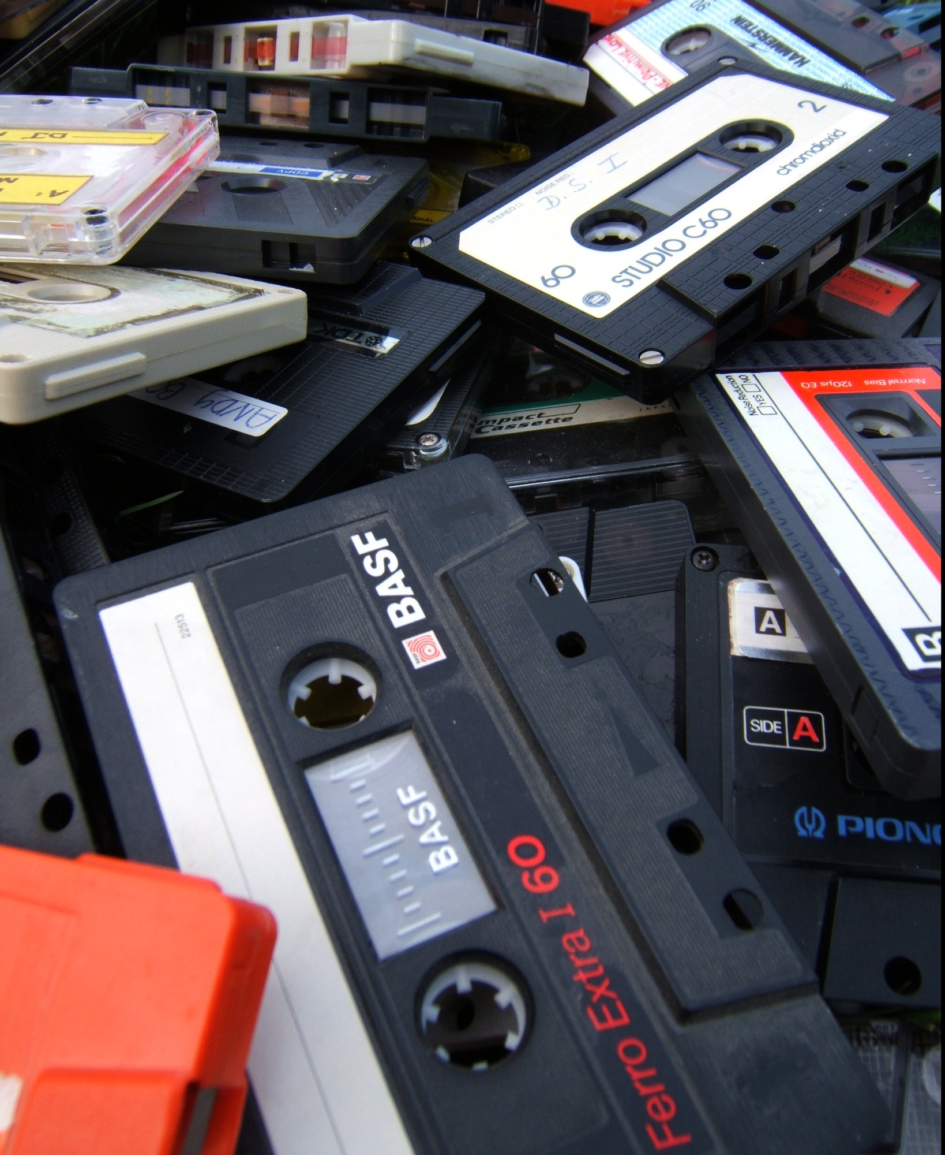
Dystopias: formal complexity and narrative structure

