Slide 1
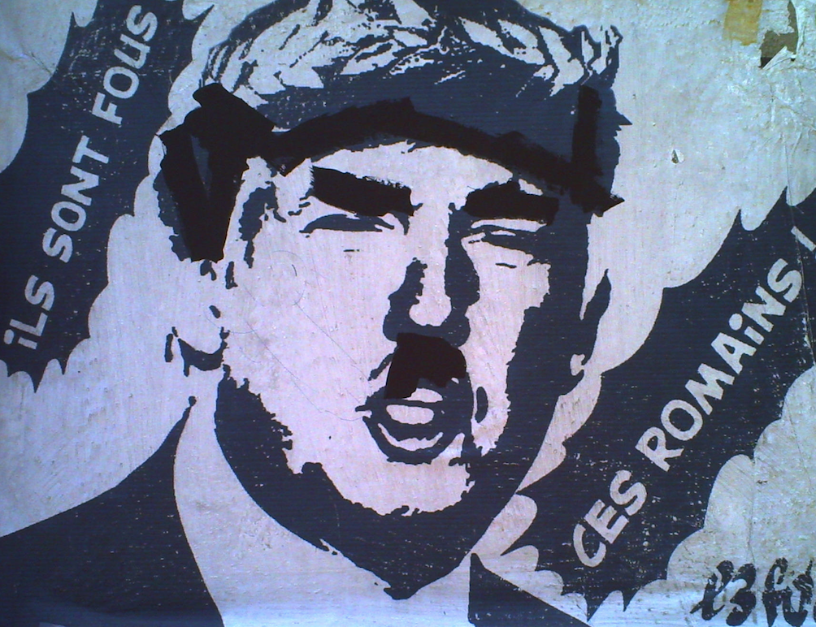
Utopia in Dark Times
Dr Caroline Edwards
Senior Lecturer in Modern & Contemporary Literature
Birkbeck, University of London

Slide 3
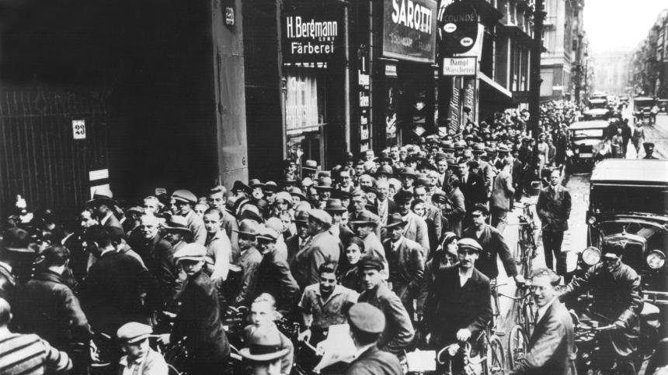
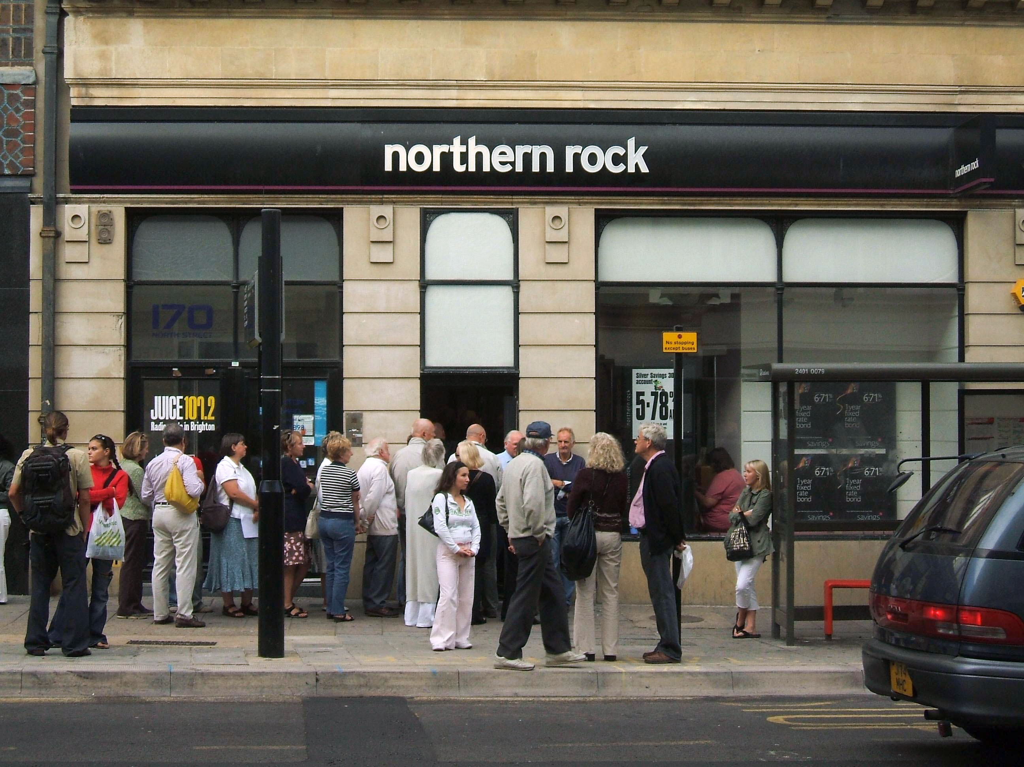
People line up outside the Postscheckamt in Berlin to withdraw their deposits in July 1931. (Source: Der Spiegel)
Northern Rock, the first British bank to suffer a bank run in 150 years, in October 2008

Slide 5
Creeping fascism in the 21st century
In Creeping Fascism: Brexit, Trump, and the Rise of the Far Right (2017), Neil Faulkner contrasts the first-wave “sledgehammer fascism of the interwar period” with our own second-wave of “creeping fascism”
In the “hollowed-out spaces of neoliberal dystopia,” fascists can attract a mass following quickly from what Faulkner calls “the human dust” of disconnected individuals
Ernst Bloch’s early 1930s analysis of fascism described Nazi ideology as an accretion of “dust” (Der Staub), “staleness” or “mustiness.” “No one,” he writes, “believes it could be done to them.”

Slide 6
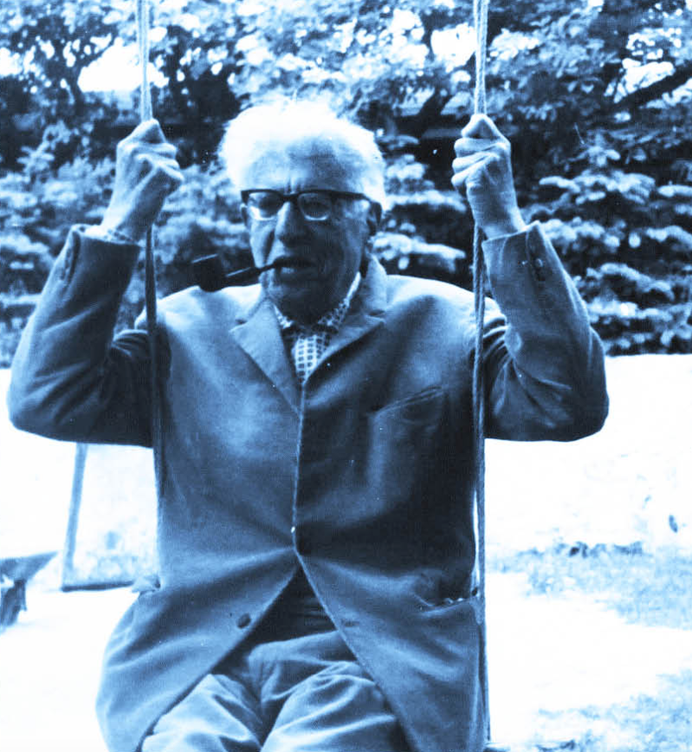
Ernst Bloch, philosopher of utopia
Born to a Jewish family in 1885 in the industrial town of Ludwigshafen, Germany
Studied philosophy and brought Marxist class analysis into contact with Jewish messianic thinking
Pacifist during WWI
Fled the Nazis in 1934, travelling through Switzerland, Austria, France, Czechoslovakia, to the United States; part of a diaspora of leftist Jewish intellectuals
Returned to East Germany in 1949 after WWII, appointed to the University of Leipzig
1949-55 publishes his major works; influential within the GDR as well as West Germany; Stalinist regime opposed him
1961 Bloch and family escaped to West Germany; Bloch taught at Tübingen until his death in 1977.

Slide 7
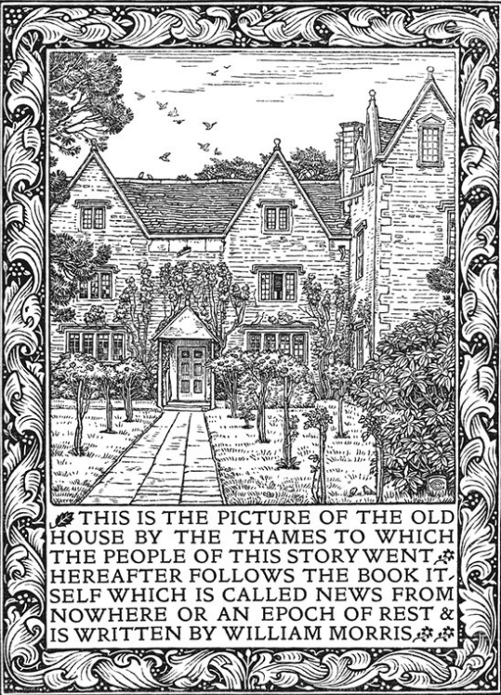
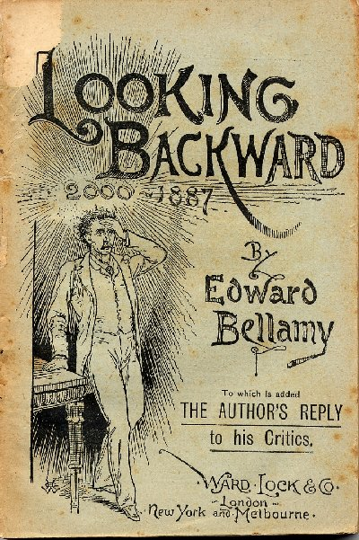
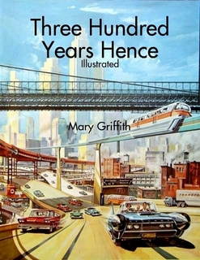
Utopia as time machine 1: visions of the future
Mary Griffith,
Three Hundred Years Hence (1836)
William Morris,
News From Nowhere (1890)
Edward Bellamy,
Looking Backward: 2000-1887 (1888)

Slide 8
Utopia as time machine 2: the philosophy of time

Slide 9
The utopian Noch Nicht: between presence and absence
“This sentence [‘Something’s missing’], which is in Mahagonny, is one of the most profound sentences that Brecht ever wrote, and it is in two words. What is this ‘something’? If it is not allowed to be cast in a picture, then I shall portray it as in the process of being. But one should not be allowed to eliminate it as if it really did not exist.”
(Ernst Bloch, The Utopian Function of Art and Literature, p. 15)

Slide 10
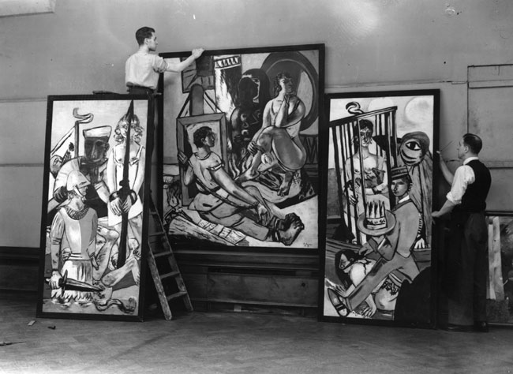
Expressionism and fascism
Preparing for the ‘Degenerate Art” exhibition organised by the Nazi Party in Munich, 1937

Slide 11
Franz Marc, “The Large Blue Horses” (1911)

Slide 12
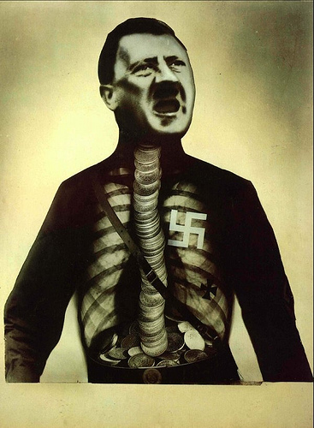
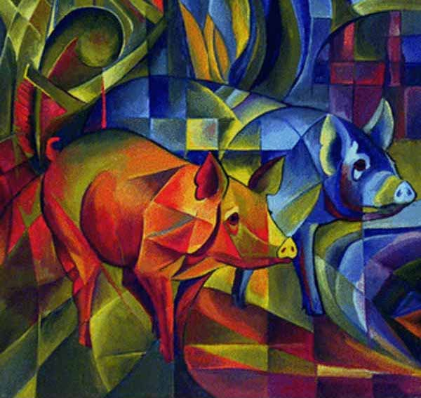
On the problem of “folk-closeness”
John Heartfield,
Adolf, El Superman (1932)
Franz Marc,
Piggies (c. 1910-1916)

Slide 13
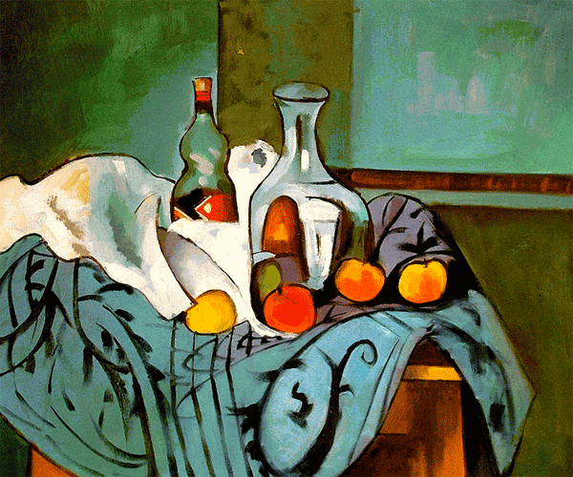
Images of “utopian uncovering”
Paul Cézanne,
Still Life with Peppermint Bottle (1890-4)
Pablo Picasso,
Weeping Woman (1937)

Slide 14
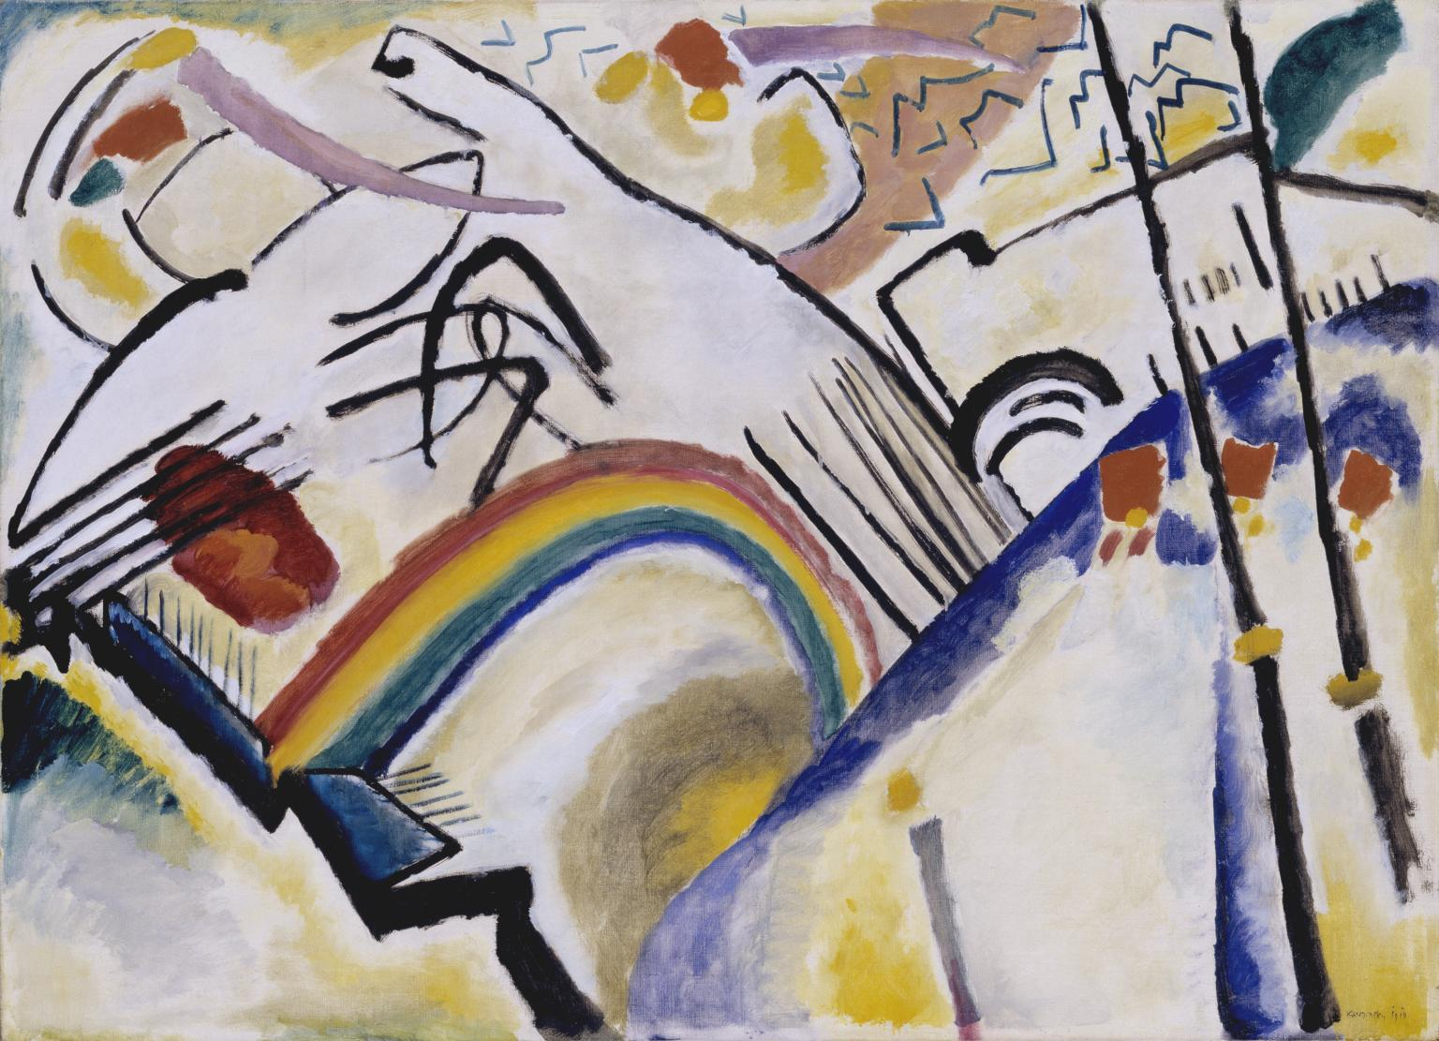
Aesthetic confusion or the “light of the future”?
[Expressionism] definitively contained anti-capitalism, subjectively unequivocal, objectively still unclear. It contained objectively archaic shadows, revolutionary lights all mixed up, dark sides from a subjectivistically unmastered underworld, light sides from the future, wealth and undistractedness of human expression. […] The pictures themselves were in fact … hauled up with a mixture which is only possible in Germany … from archaic and utopian material simultaneously, without one being able to say precisely where the primeval dream stopped, the light of the future began.
(Bloch, Heritage of Our Times, p. 236)
Wassily Kandinsky,
Cossacks (1910-11)

Slide 15
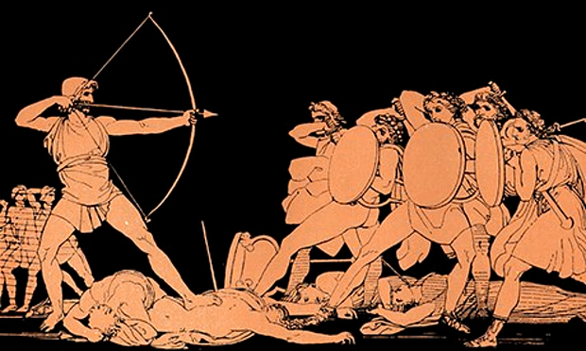
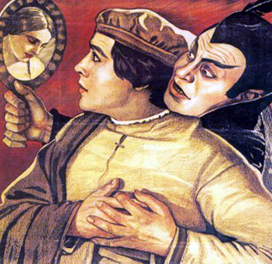
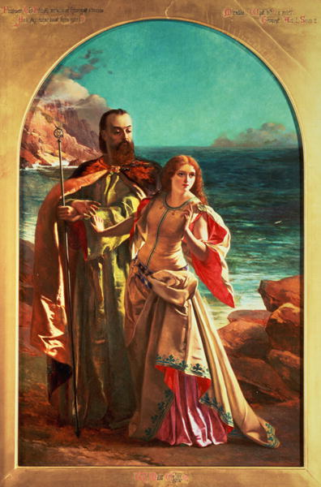
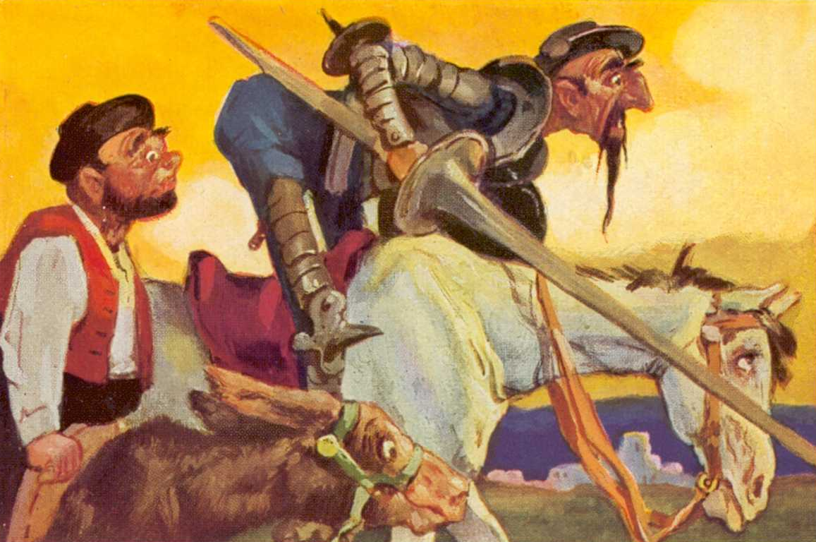
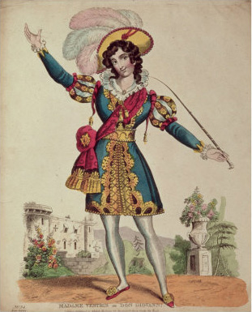
Venturers Beyond the Limits
Odysseus, from Homer’s epic poem
Faust, from Goethe’s two-part tragic play, 1808
Prospero, from Shakespeare’s The Tempest (1611)
Don Giovanni, from Mozart’s 1787 opera
Don Quixote, from Miguel de Cervantes’s 1605 chivalric romance

Slide 16
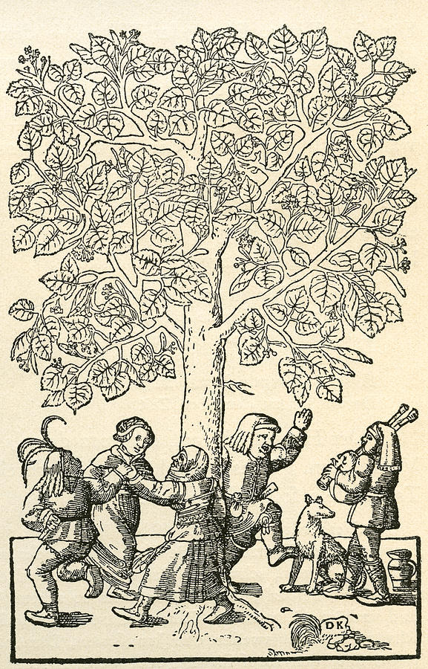
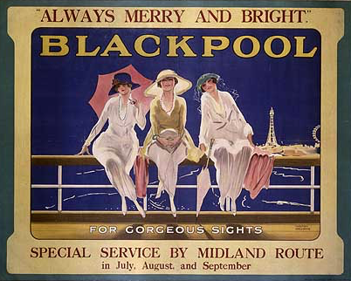
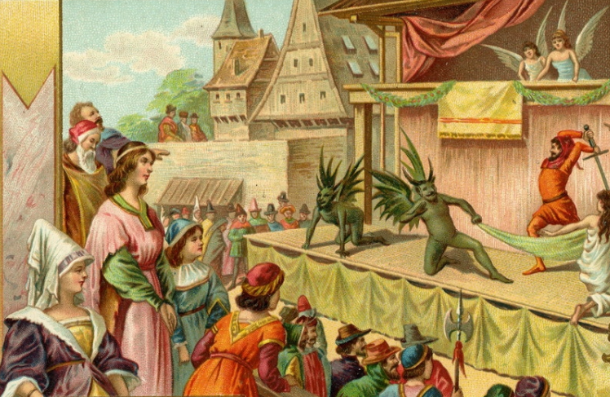
The new or the old?
“Under the Village Linden Tree,” 16th century engraving by Kandel
Medieval mystery plays

Slide 17
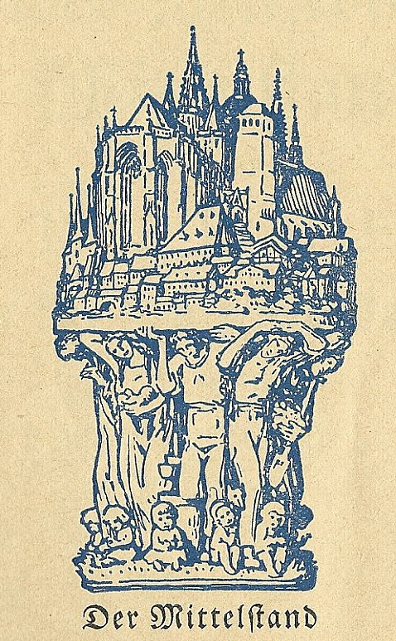
Non-contemporaneity
Ungleichzeitigkeit, translated as “simultaneous uncontemporaneities,” “non-simultaneity” or “non-contemporaneity” – developed in Heritage of Our Times (1935), a series of essays that examined the Weimar Republic’s “Golden Twenties” and the emergence of fascism
Peasant consciousness ignored by the Left, which considered the agricultural labourers and newly urbanized petit-bourgeois shopkeepers of the Weimar Republic to be irrational and anachronistic to progressive politics
German Mittelstand (middle class) maintained a strong connection with their rural backgrounds, folk culture, and pre-industrial heritage
This class epitomized Bloch’s concept of Ungleichzeitigkeit, composed as it was of modern, capitalist, as well as traditional, precapitalist elements.

