Slide 1
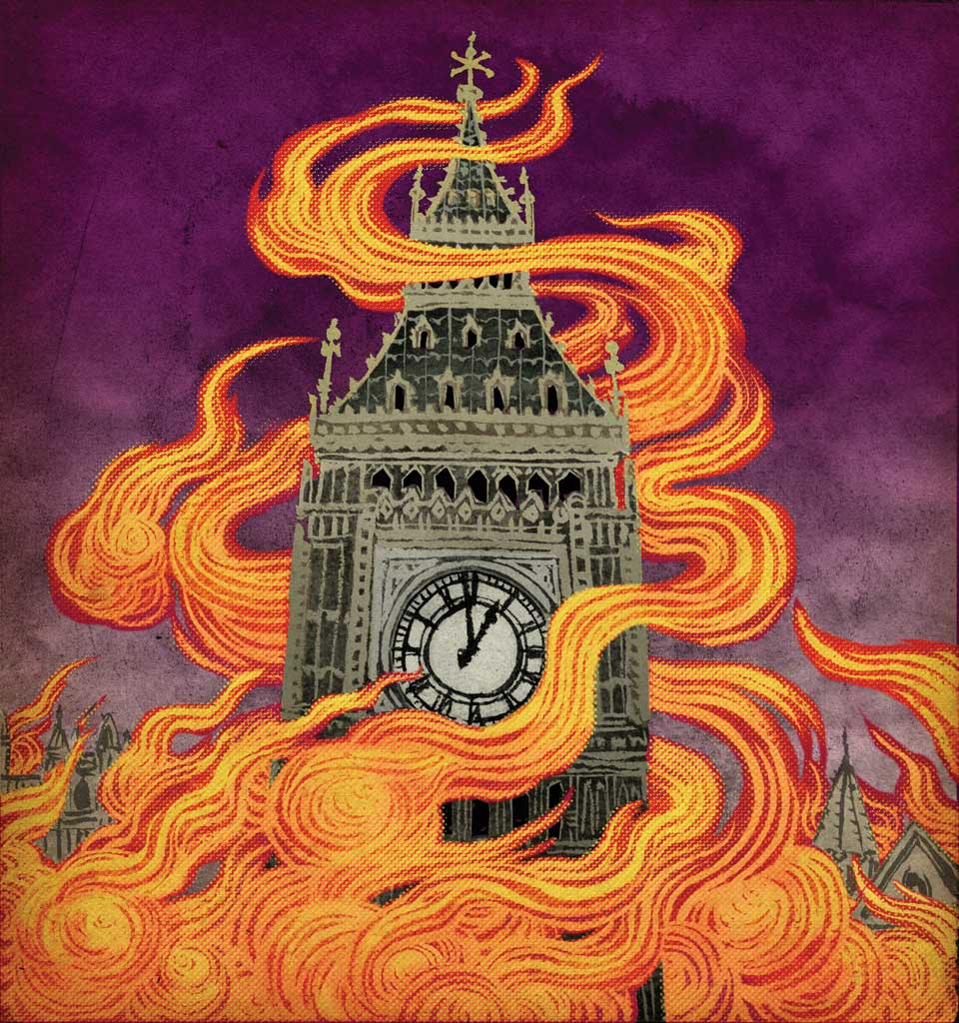
Armchair Apocalypse, or, Why Destroying London in Speculative Literature is So Enjoyable
Dr Caroline Edwards
Birkbeck, University of London
caroline.edwards@bbk.ac.uk

Slide 2
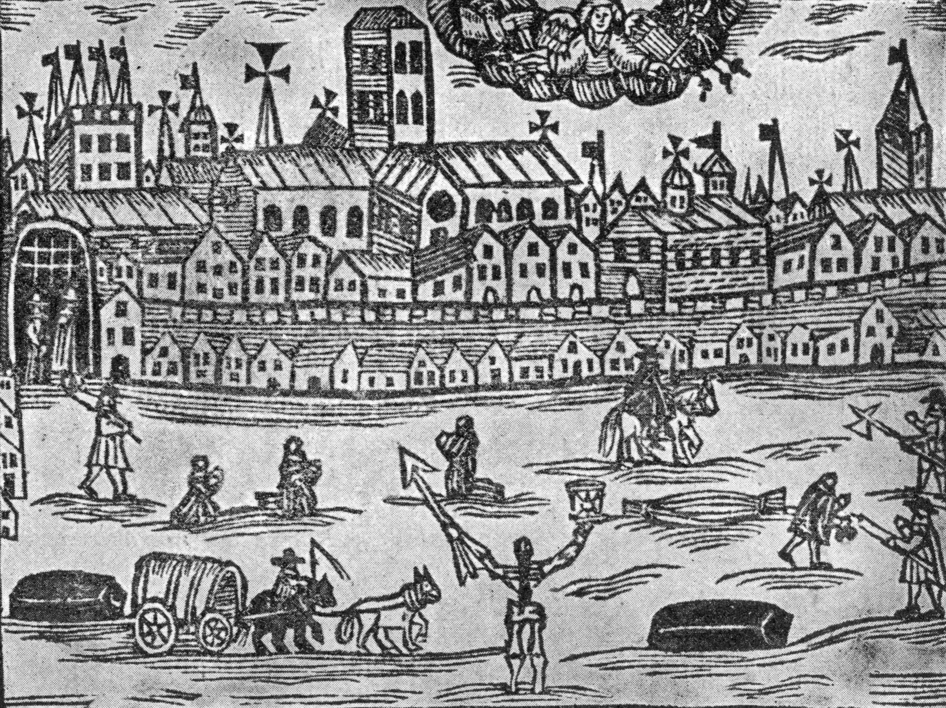
London’s apocalyptic tradition
apocalypse (n.)
14thc., “revelation, disclosure,” from Church Latin apocalypsis
Derives from Ancient Greek: ἀποκάλυψις [apokálypsis], meaning a lifting of the veil or revelation.
But the use of apocalypse to mean “a cataclysmic event” is modern.
The angel of death presides over London during the Great Plague of 1665–66

Slide 3
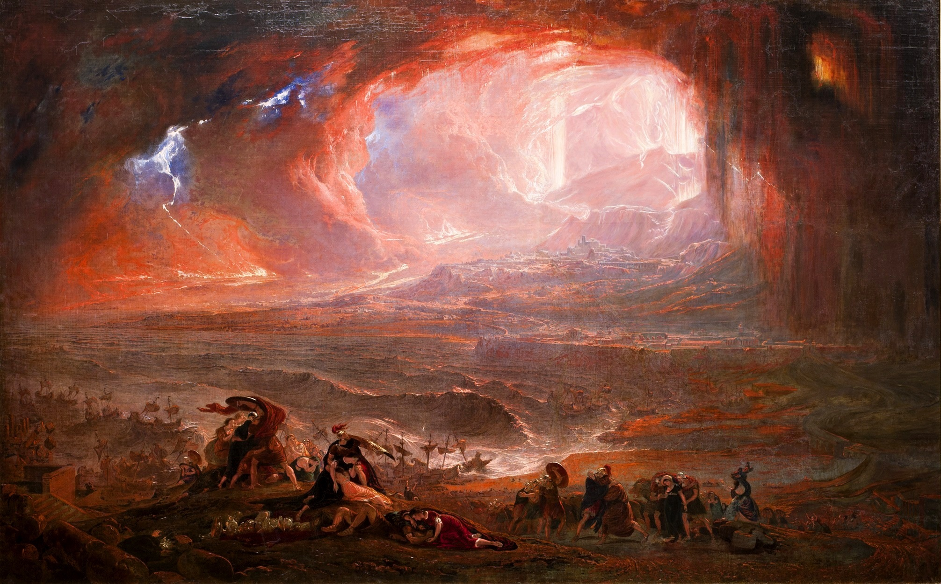
John Martin, The Destruction of Pompeii and Herculaneum (1822)

Slide 4
The armchair apocalypse
Borrows from Brian Aldiss’ categorisation of the “cosy catastrophe,” which as SF writer Jo Walton notes, includes:
The catastrophes are British and primarily written in the postwar period of 1951-1977.
Writers of cosy catastrophes do not concern themselves with issues of plausibility.
Nothing really happens in the cosy catastrophe.
Despite being written during the Cold War, nuclear weapons are “quite specifically a banned topic.”
The narratives focus on a small group of people.
The catastrophe itself is rarely the main focus of the narrative.
But extends this sub-genre to consider questions of the reader’s participation in narratives of London’s apocalyptic destruction. Are we supposed to enjoy these fictions, or does our enjoyment become complicated in a game of recognition, implication, and, subsequently, of uncomfortable realisation that like the protagonists we, the readers, are similarly responsible for the crises that we’re enjoying reading about so much?

Slide 5
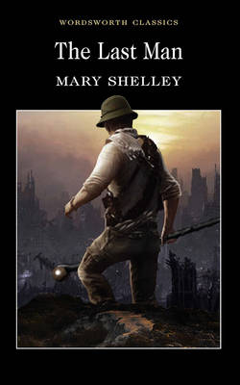
Mary Shelley, The Last Man (1826)
Some from among the family of man must survive, and these should be among the survivors; that should be my task—to accomplish it my own life were a small sacrifice. There then in that castle—in Windsor Castle … should be the haven and retreat for the wrecked bark of human society. Its forest should be our world—its garden afford us food; within its walls I would establish the shaken throne of health. (Chp. VII)
It would be needless to narrate those disastrous occurrences, for which a parallel might be found in any slighter visitation of our gigantic calamity. Does the reader wish to hear of the pest-houses, where death is the comforter—of the mournful passage of the death-cart—of the insensibility of the worthless, and the anguish of the loving heart—of harrowing shrieks and silence dire—of the variety of disease, desertion, famine, despair, and death? There are many books which can feed the appetite craving for these things; let them turn to the accounts of Boccaccio, De Foe, and Browne. (Chp. VIII)

Slide 6
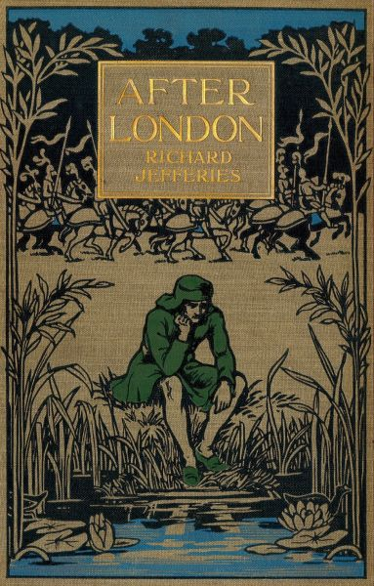
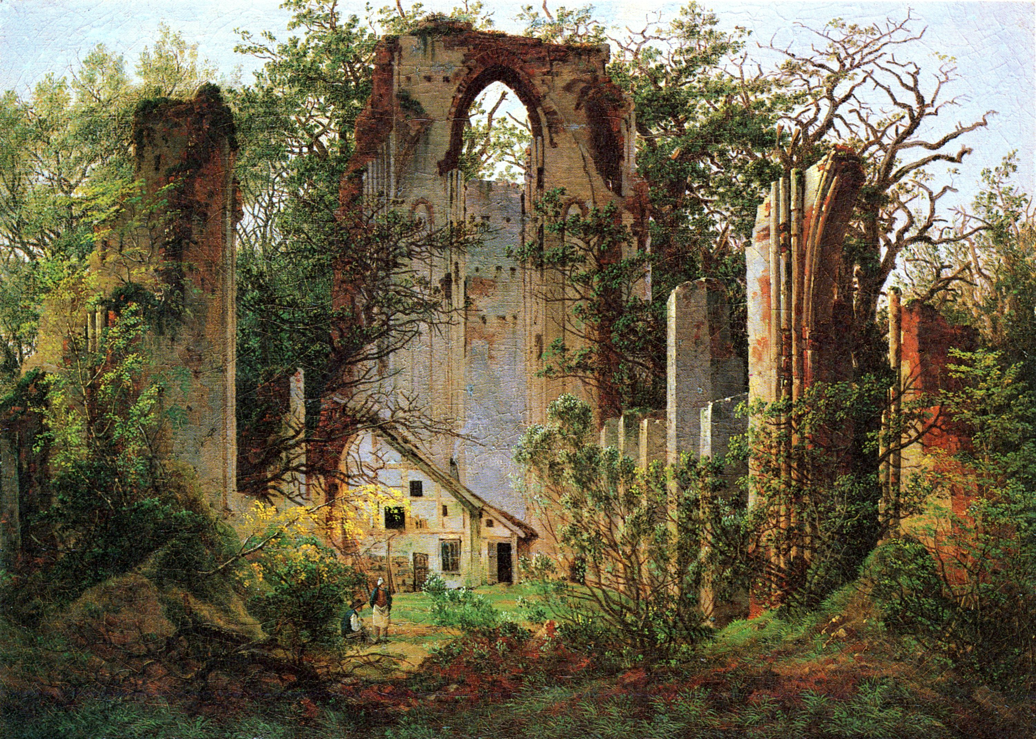
Richard Jefferies, After London, or, Wild England (1885)
Caspar David Friedrich, Klosterruine Eldena (c.1825)

Slide 7
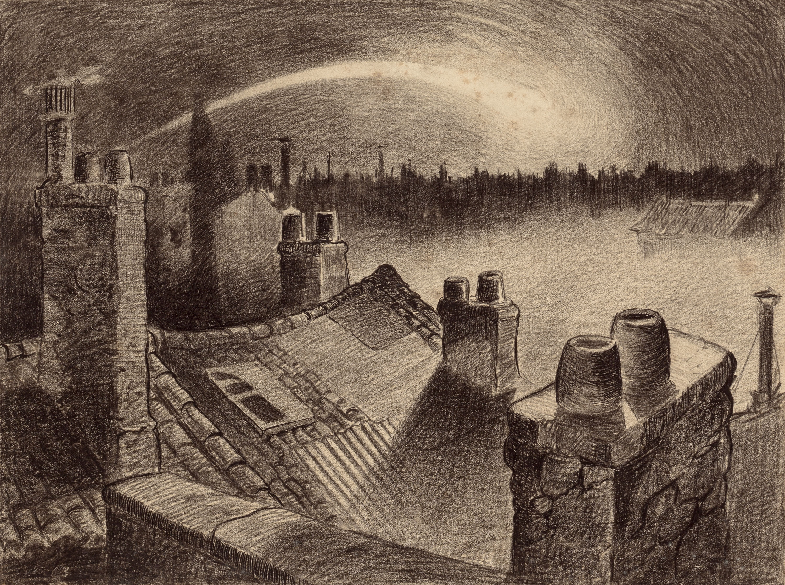
H. G. Wells, The War of the Worlds (1898)
Henrique Alvim Corrêa, “Falling Star” from the 1906 Belgian special illustrated edition of The War of the Worlds

Slide 8
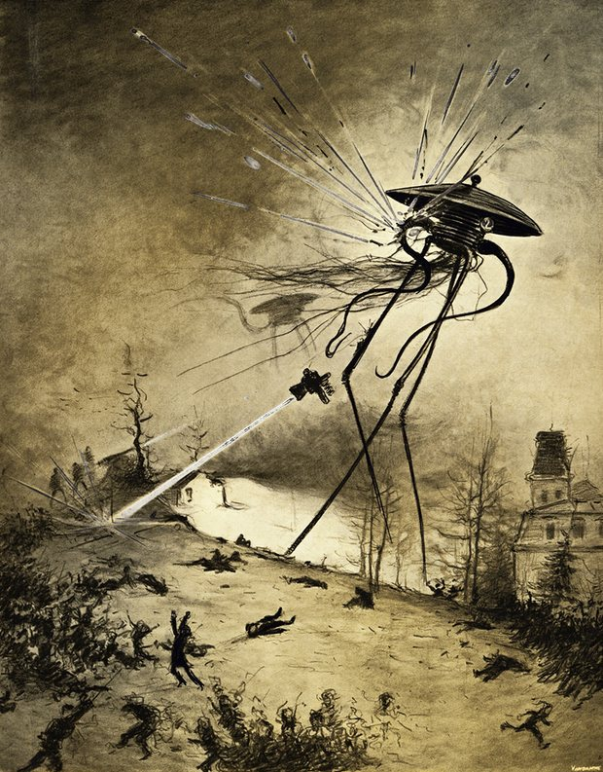
And this Thing I saw! How can I describe it? A monstrous tripod, higher than many houses, striding over the young pine-trees, and smashing them aside in its career; a walking engine of glittering metal, striding now across the heather; articulate ropes of steel dangling from it, and the clattering tumult of its passage mingling with the riot of the thunder. (p. 46)
Horsell Common, Surrey

Slide 9
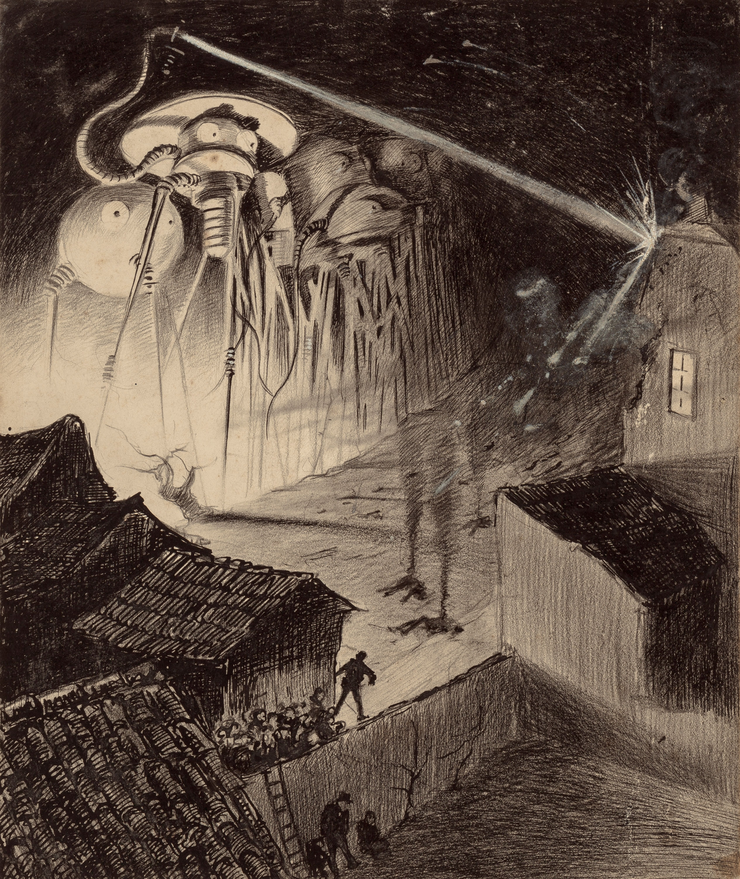
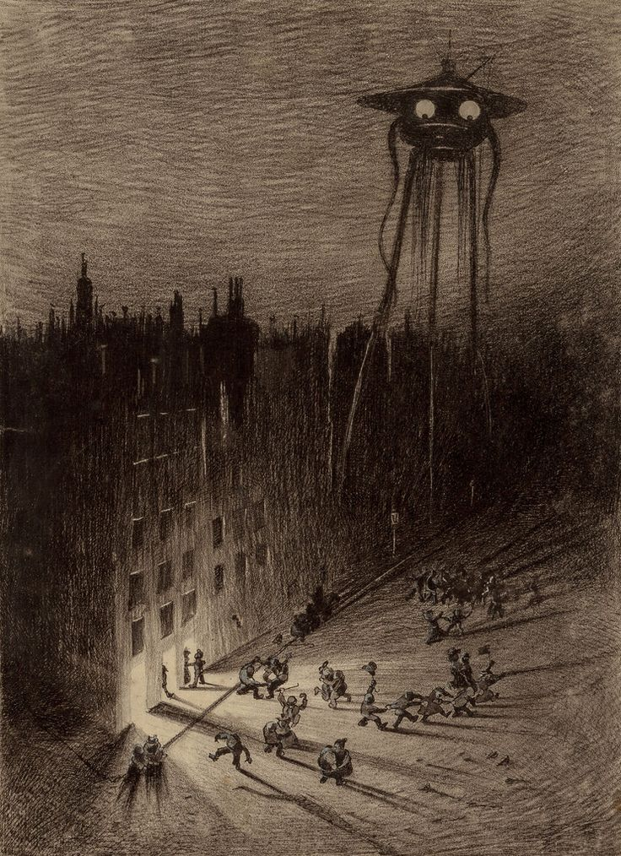
The Exodus from London

Slide 10
M. P. Shiel, The Purple Cloud (1901)
Looking directly south … I could recline at ease in the red-velvet easy-chair, and see. […] Soon after midnight there was a sudden and very visible increase in the conflagration. On all hands I began to see blazing structures soar, with grand hurrahs, on high. In fives and tens, in twenties and thirties, all between me and the remote limit of my vision, they leapt, they lingered long, they fell. My spirit more and more felt, and danced – deeper mysteries of sensation, sweeter thrills. I sipped exquisitely, I drew out enjoyment leisurely. (p. 141)
Yuko Shimizu’s cover for the 2012 edition of M. P. Shiel, The Purple Cloud (1901)

Slide 11
Apocalyptic pleasures
What kind of pleasure do we experience as readers of Shiel’s The Purple Cloud?
Classical reader response / reception theory defines the reader’s experience of aesthetic pleasure as “in a state of balance between disinterested contemplation and testing participation” (Hans Robert Jauss)
Jauss differentiates two hermeneutic levels of aesthetic pleasure: (1) the language-critical (style, syntax, form); and (2) the cosmological (the trext’s broader significance within cultural history)
This can help us identify two levels of the armchair apocalypse: (1) the level of the story itself (Jefferson’s mad orgiastic pleasure); and (2) our “armchair” subject position as readers, enjoying this fiction of apocalypse

Slide 12
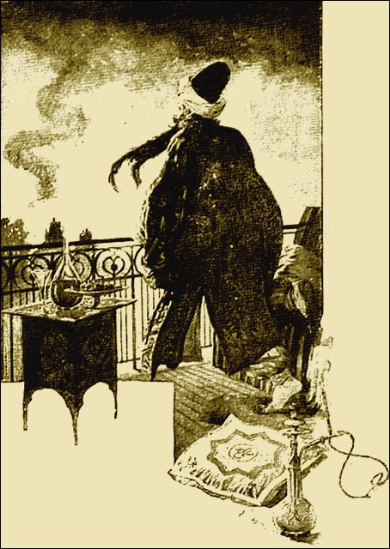

Slide 13
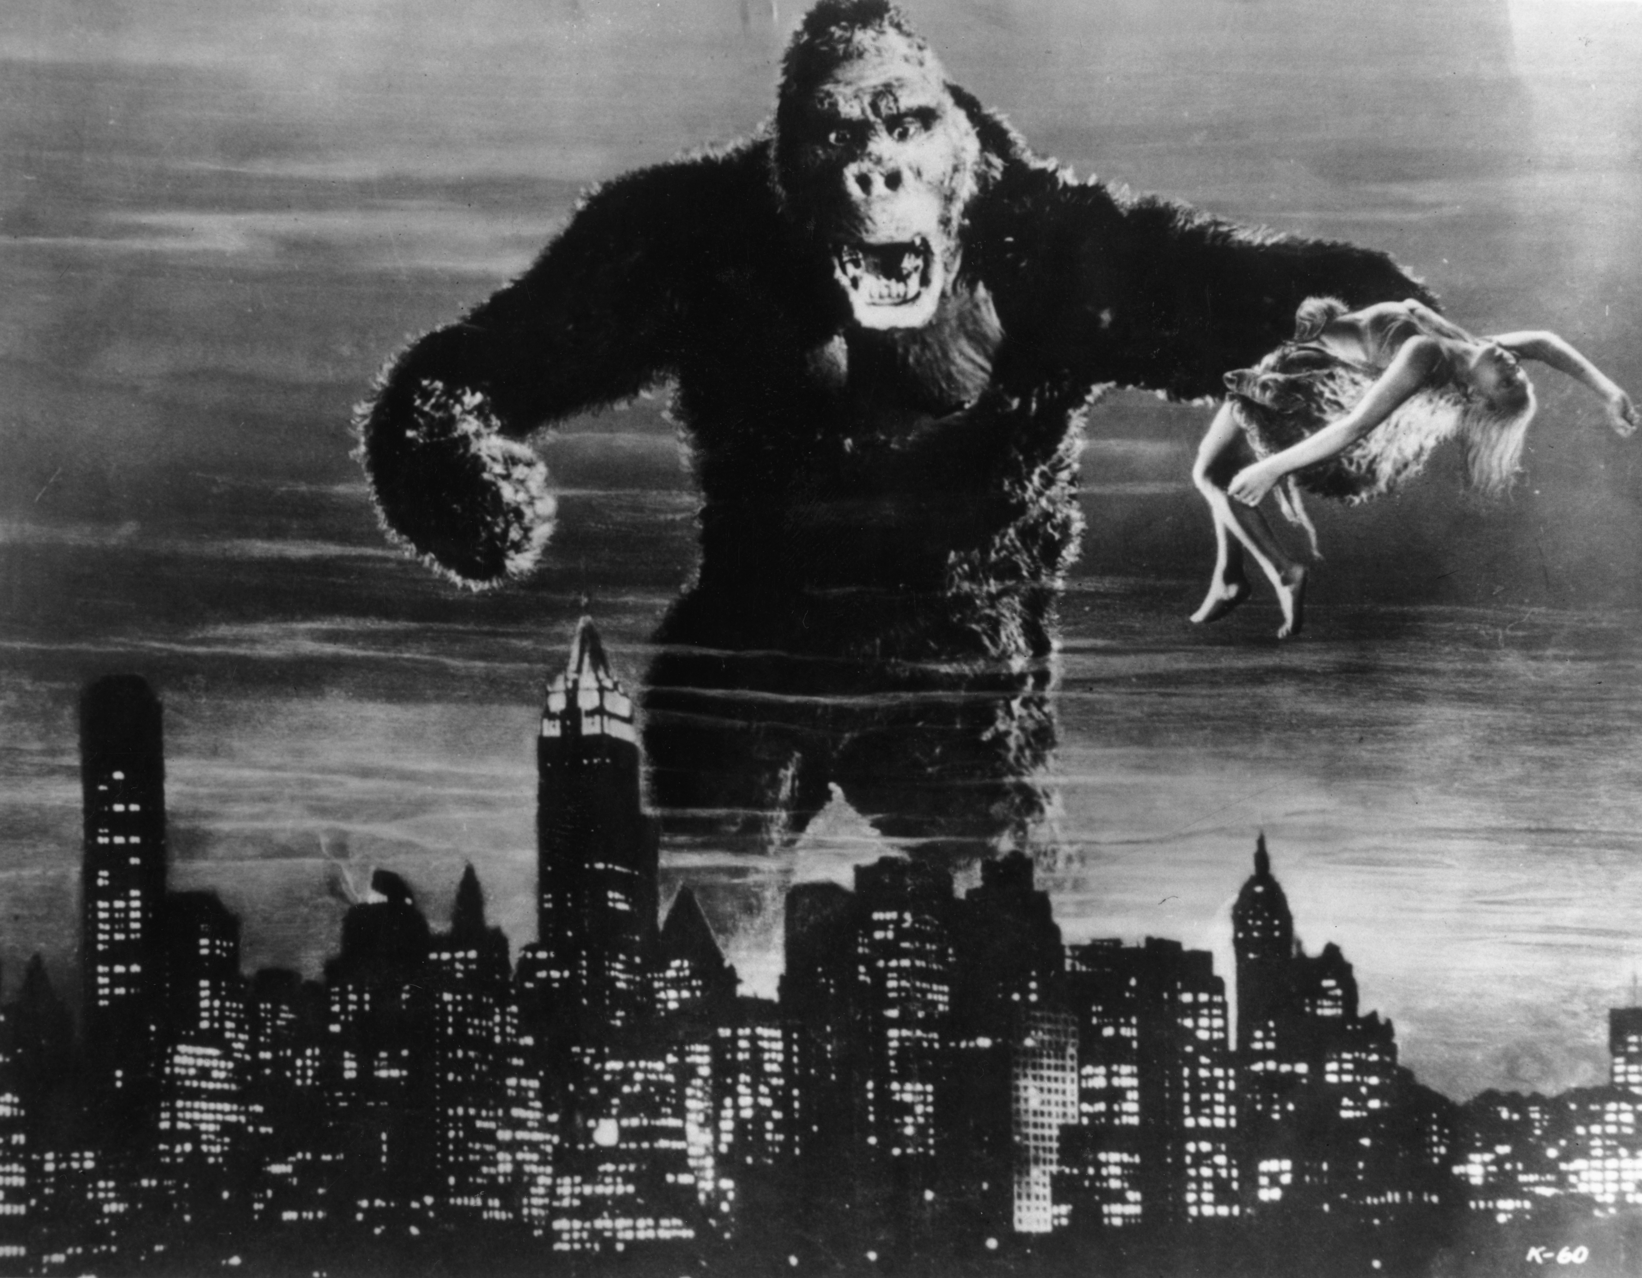
The imagination of disaster

Slide 14
Looking directly south … I could recline at ease in the red-velvet easy-chair, and see. […] Soon after midnight there was a sudden and very visible increase in the conflagration. On all hands I began to see blazing structures soar, with grand hurrahs, on high. In fives and tens, in twenties and thirties, all between me and the remote limit of my vision, they leapt, they lingered long, they fell. My spirit more and more felt, and danced – deeper mysteries of sensation, sweeter thrills. I sipped exquisitely, I drew out enjoyment leisurely. (p. 141)

Slide 15
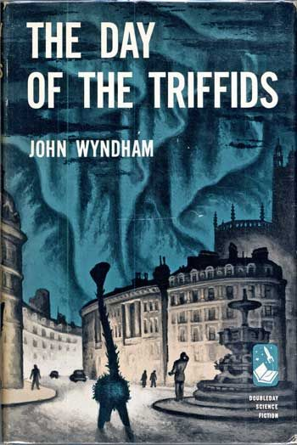
The collapsing world of the cosy catastrophe
[London] still contrived to give the impression that a touch of a magic wand would bring it to life again, though many of the vehicles in the streets were beginning to turn rusty. A year later the change was more noticeable. Large patches of plaster detached from housefronts had begun to litter the pavements. Dislodged tiles and chimney-pots could be found in the streets. (p. 197)
Once – not that year, nor the next, but later on – I stood in Piccadilly Circus again, looking round at the desolation, and trying to recreate in my mind’s eye the crowds that once swarmed there. I could no longer do it. Even in my memory they lacked reality. There was no tincture of them now. They had become as much a backcloth of history as the audiences in the Roman Colosseum or the army of the Assyrians, and somehow, just as far removed. (p. 198)

Slide 16
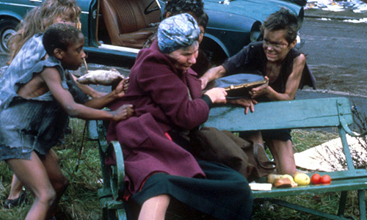
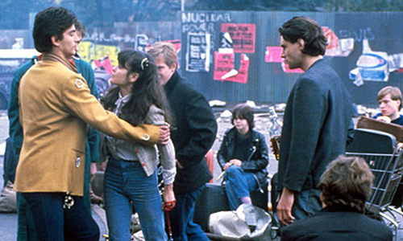
Does apocalypse improve the world?

Slide 17
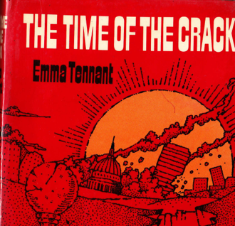
The comic apocalypse

Slide 18
Hyde Park Corner was, of course, unrecognizable. The twisted metal of crashed cars lay scattered at the base of the great earth mound that had gone up like a gigantic molehill. Picking their way carefully through the debris, the doctors led their charges to the roofless hospital that once had been St George’s.
‘Perfectly all right for a few hours,’ Thirsk said briskly. He shepherded his charges into the abandoned casualty ward, stepping with care over the stretched bodies of recent car-crash victims. ‘Pity we’ve got no toys for them though,’ he added looking round. ‘The fives and over aren’t going to like it much here.’
‘We’re in the middle of a disaster, man,’ Harcourt snapped. ‘Good for the creative process anyway, to have a period without toys. I thought we’d been through that.’
A man with a bandaged head stirred and groaned loudly at the disturbance. Thirsk went over and peered down at him.
‘Look at this,’ he chortled. ‘The unsevered umbilical cord and its consequences, eh, Harcourt?’
By the side of the patient lay a white-gowned anaesthetist. His hand still firmly clasped the needle which protruded from the patient’s arm. Harcourt’s worried expression vanished for a moment.
‘The death of non-separation,’ he agreed. ‘This will serve as a lesson to the children.’
The analysts, tiptoeing like two Father Christmases leaving the nursery, left the hospital and struck off in the direction of Westminster. Although some of the buildings seemed to have lost their roofs, the disaster had been less complete here and Piccadilly, if you didn’t count the fallen trees in Green Park and the strange new elongated shape of the Ritz, was much as before.
Thirsk and Harcourt strode along at a good speed. ‘We’re in luck,’ Thirsk remarked, ‘if you look at the situation objectively. This is just the kind of traumatic shock this society needs to jolt it out of its complacency.’ (pp. 25-6)

Slide 19
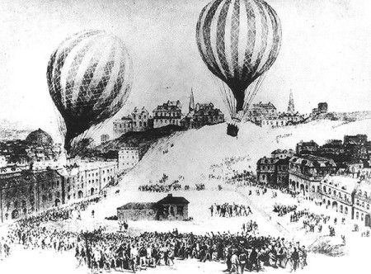
But how should we read the comic apocalypse?

Slide 20
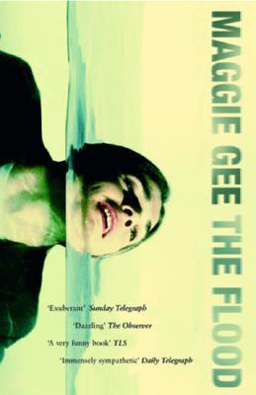
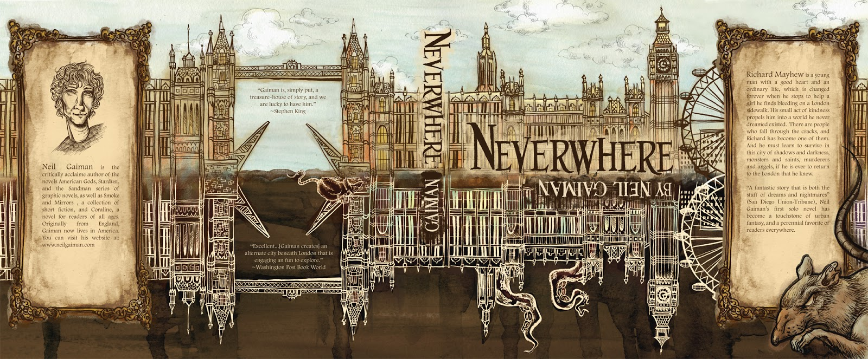
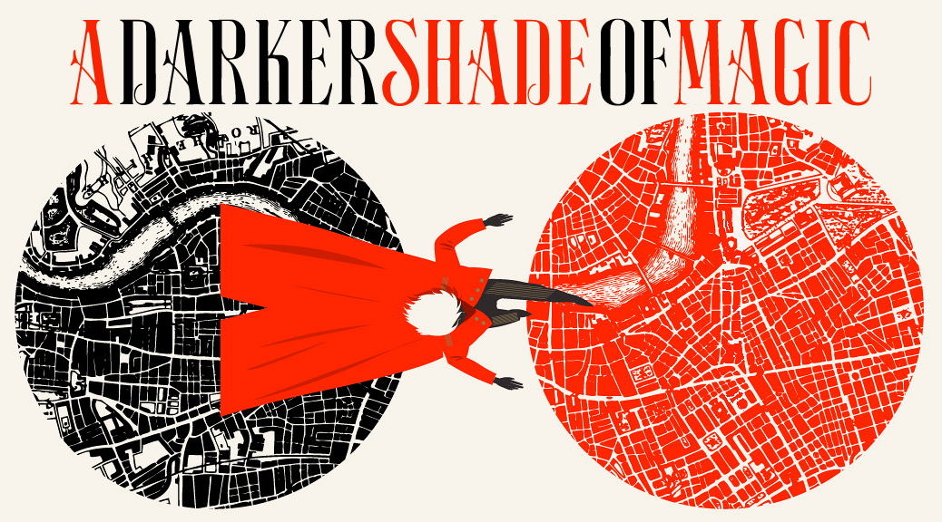
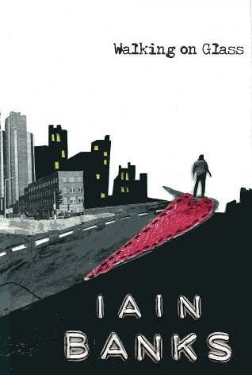
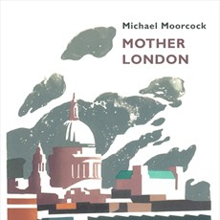
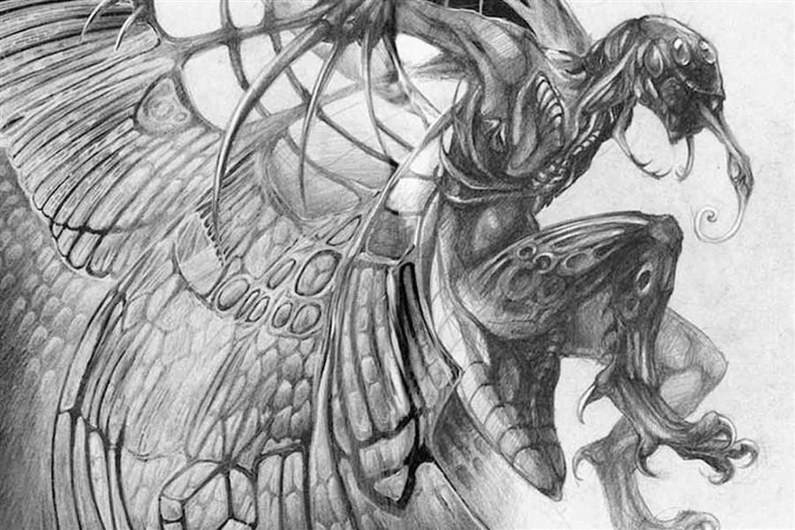
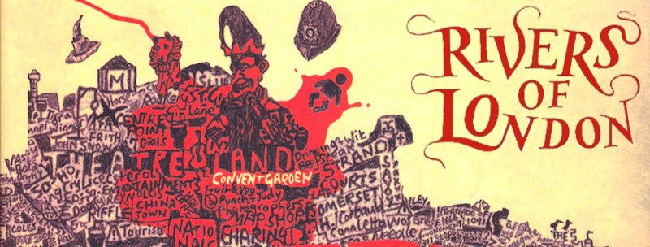
Apocalyptic London now
Neil Gaiman, Neverwhere (1996)
Victoria Schwab,
A Darker Shade of Magic (2015)
Maggie Gee, The Flood (2004)
Ben Aaronovitch, Rivers of London (2011)
China Miéville, Perdido Street Station (2000)

Slide 21
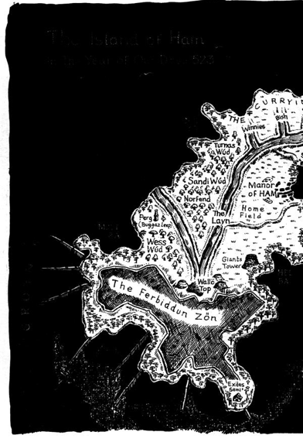
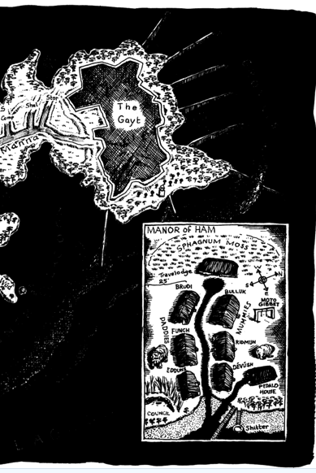
Apocalyptic satire: Will Self, The Book of Dave (2006)

Slide 22
Urban Visionary Satire
Novelistic discourse produced throughout European modernity reflects the city’s heterogeneous, palimpsestic character; late twentieth-century fiction foregrounds these aspects of the fictional form in order to investigate the relationship between language and place and to reimagine the textual representation of urban environments. In London, the last two decades of the twentieth century witnessed the emergence of a new type of fiction that draws on the interconnected traditions of realist, satirical, and fantastic writing to produce a generic hybrid: urban visionary satire. While rejecting the methods of classical realist representation in favour of imaginative, fantastic departures, visionary-satirical novels retain the desire to portray the personal and collective experience of their subjects, with the goal of offering an iconoclastic, satirical critique of the contemporary metropolis (Magdalena Maczynska 58) [my italics].

Slide 23
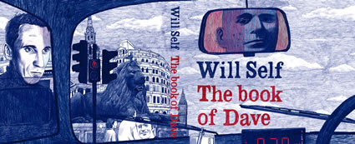
Kenton and Kingsbury, Kingston and Knightsbridge. He didn’t know the name of this canal, or any other, only that it was oozing south […] The city was a nameless conurbation, its street and shop signs, its plaques and placards, plucked then torn away by a tsunami of meltwater that dashed up the estuary. He saw this as clearly as he’d ever seen anything in his life. The screen had been removed from his eyes, the mirror cast away, and he was privileged with a second sight into deep time. (p. 404)

Slide 24
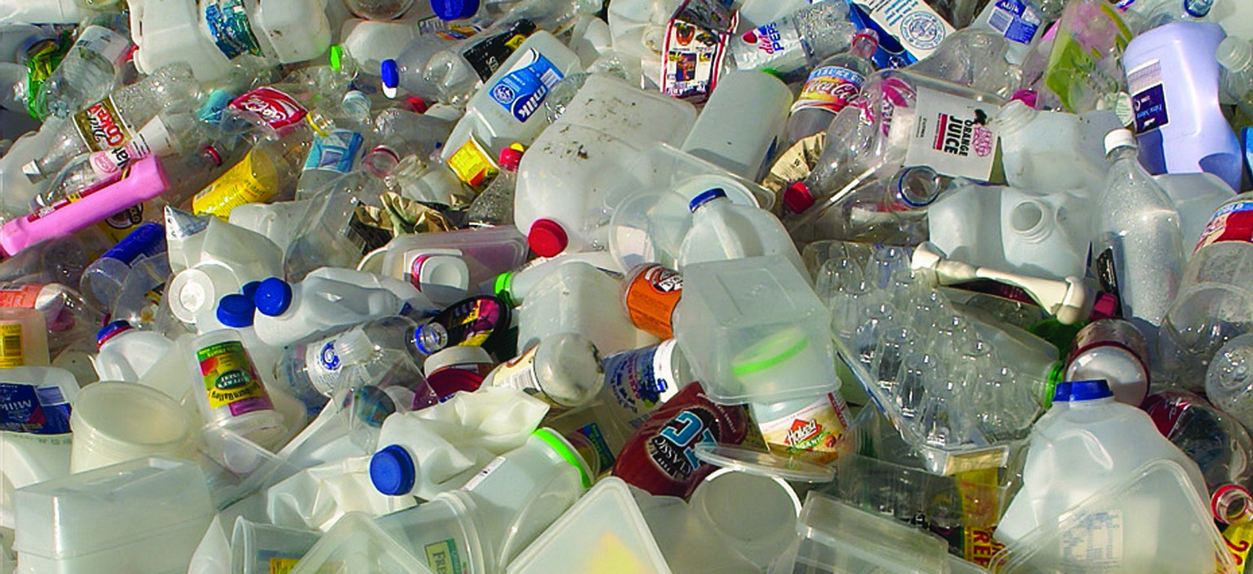
The great wave came on, thrusting before it a scurf of beakers, stirrers, spigots, tubes, toy soldiers, disposable razors, computer-disc cases, pill bottles, swizzle sticks, tongue depressors, hypodermic syringes, tin-can webbing, pallet tape, clips, clasps, brackets, plugs, bungs, stoppers, toothbrushes, dentures, Evian bottles, film canisters, widgets, detergent bottles, disposable lighters, poseable figurines of superheroes, cutlery, hubcaps, knick-knacks, mountings, hair grips, combs, earphones, Tupperware containers, streetlight protectors – and a myriad other bits of moulded plastic, which minutes later washed up against the hills of Hampstead, Highgate, Harrow and Epping…” (pp. 404-5).

Slide 25
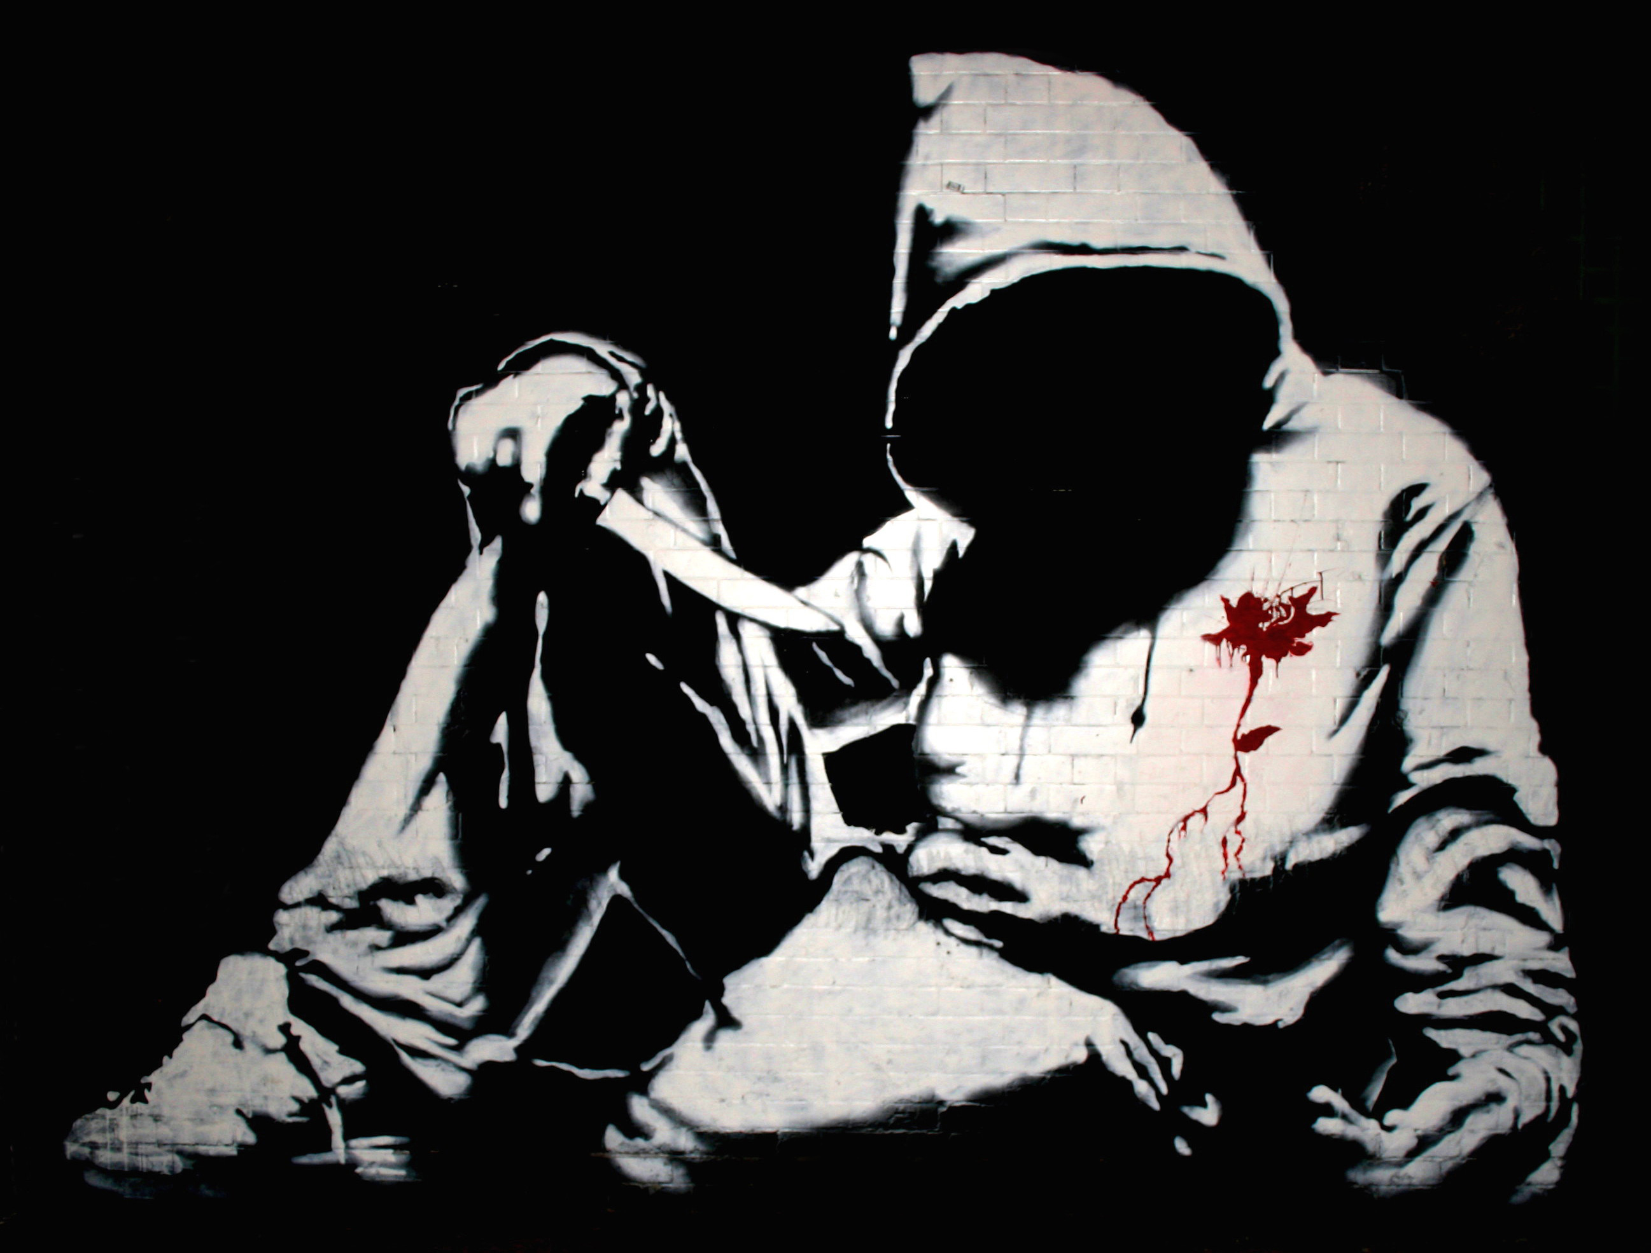
London’s overthrow?
THIS IS AN era of CGI end-times porn, but London’s destructions, dreamed-up and real, started a long time ago. It’s been drowned, ruined by war, overgrown, burned up, split in two, filled with hungry dead. Endlessly emptied.
(China Miéville, London’s Overthrow [2012], p. 10)
Graffiti attributed to Bansky

