Slide 1
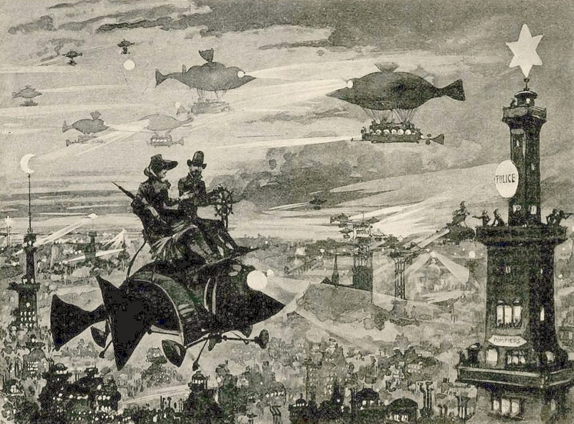
Mapping Imaginary Topographies & Times: Literary Utopias from the Renaissance to the Present
Dr Caroline Edwards
Senior Lecturer in Modern & Contemporary Literature
Birkbeck, University of London

Slide 2
The literary utopia: social and political critique
The abolition of private property and redistribution of wealth (often, the abolition of money); although not always the abolition of class and social hierarchy
Technological advancement, particularly the automation of labour
Equality among the sexes and women’s suffrage
Alternative pedagogies and methods of schooling or education
Sources of abundant energy (electricity, galvanism, clean energy, hydro-electric power)
Enlightenment rationalism (importance of science and secularism, use of the empirical method, application of logic)
Attention to aesthetics (beautiful architecture, interior design, refined aesthetic sensibility)
Beautiful people, perfect health, longevity
Industrialised development (rationalised system of production, elimination of wasted resources and duplication of labour)
Elimination of war and international/global federacy (signifying a new evolutionary stage of historical development)

Slide 3
The island as utopian locus classicus
Thomas More, Utopia (1516)
Richard Bernard, The Isle of Man (1620)
Francis Bacon, New Atlantis (1624)
Phineas Fletcher, The Purple Island, or the Isle of Man (1633)
Bishop Godwin, Man in the Moone (1638)
Henry Neville, The Isle of Pines (1668)
Denis Vairasse d’Alais, The History of the Severambians (1677)

Slide 4
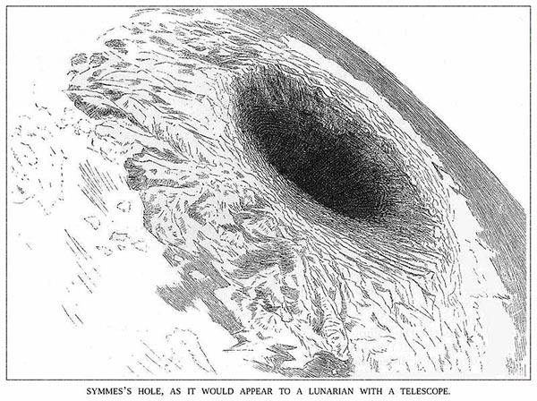
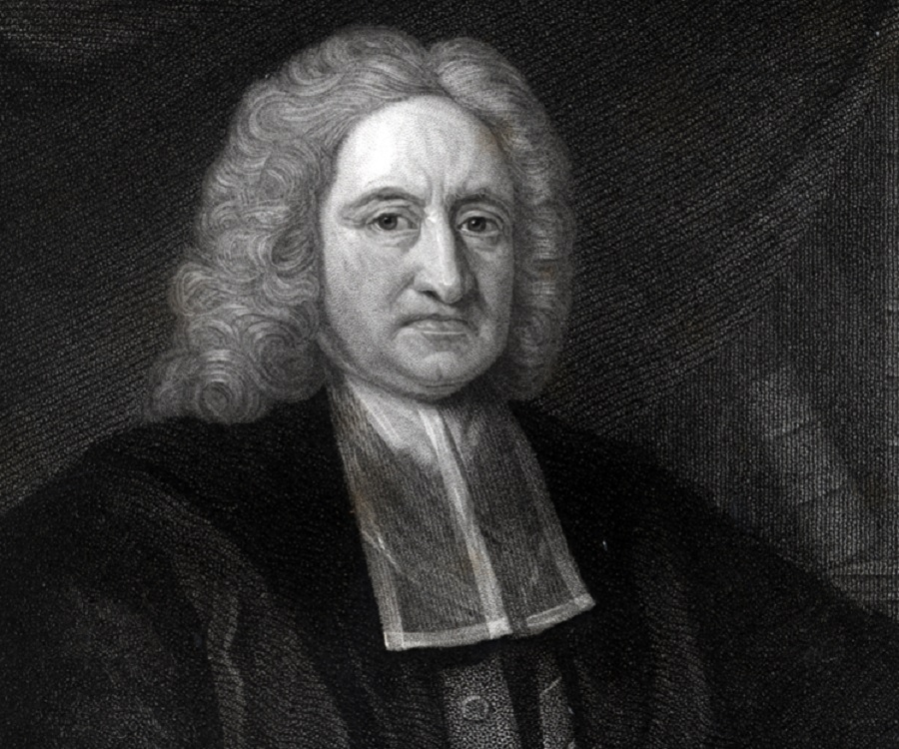
Swiss cheese utopias: subterranean worlds

Slide 5
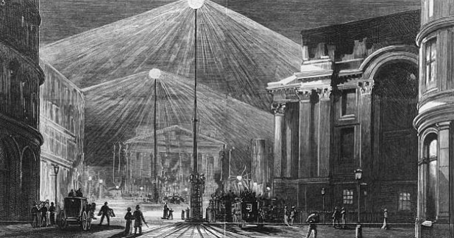
Edward Bulwer-Lytton, The Coming Race (1871)
…whatever our dreams of perfectibility, our restless aspirations towards a better, and higher, and calmer, sphere of being, we, the mortals of the upper world, are not trained or fitted to enjoy for long the very happiness of which we dream or to which we aspire. (CR, 117)

Slide 6
Mizora: the first feminist separatist utopia

Slide 7
Early French euchronias
Illustration from Albert Robida, Le Vingtième siècle: La vie électrique [The Twentieth Century] (1882)

Slide 8
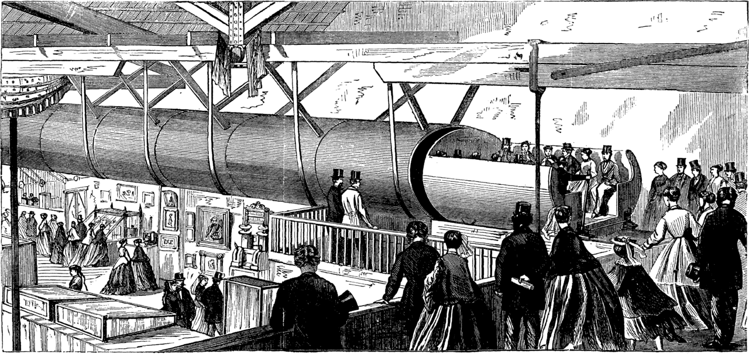
Edward Bellamy, Looking Backward, 2000–1887 (1888)
Alfred Ely Beach, “The Pneumatic Dispatch” (1868)

Slide 9
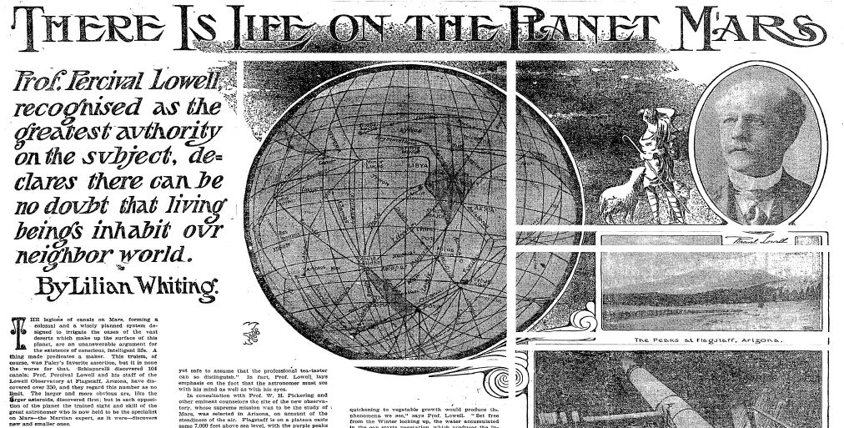
Red planet, red flag: Martian utopias

Slide 10
Red planet, red flag: Martian utopias

Slide 11
Evolution on an interplanetary scale

Slide 12
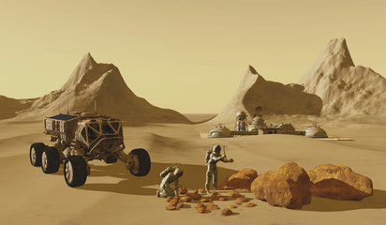
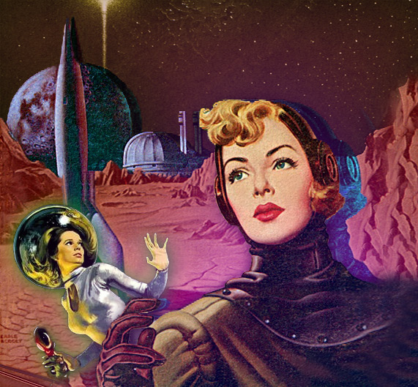
Reconceiving gender relations on Mars
“Mars was rich enough to maintain all his children in comfort and even luxury, – that none need hunger, or thirst, or go naked or houseless … so they sought out and cultivated within themselves corresponding resources, those fit to meet the new era of material prosperity; namely, generosity and brotherly love.”
Alice Ilgenfritz Jones and Ella Merchant, Unveiling a Parallel: A Romance (1893), pp.
72-3.
Photo illustration by Juliana Jiménez Jaramillo

Slide 13
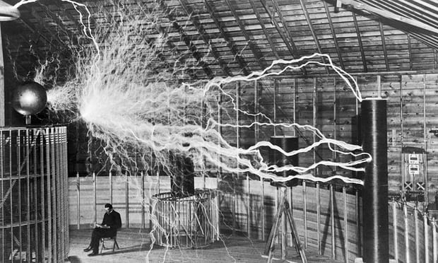
Visions of abundant energy
Electrical engineer Nikola Tesla in his lab in 1901. Photograph: Wellcome Collection

Slide 14
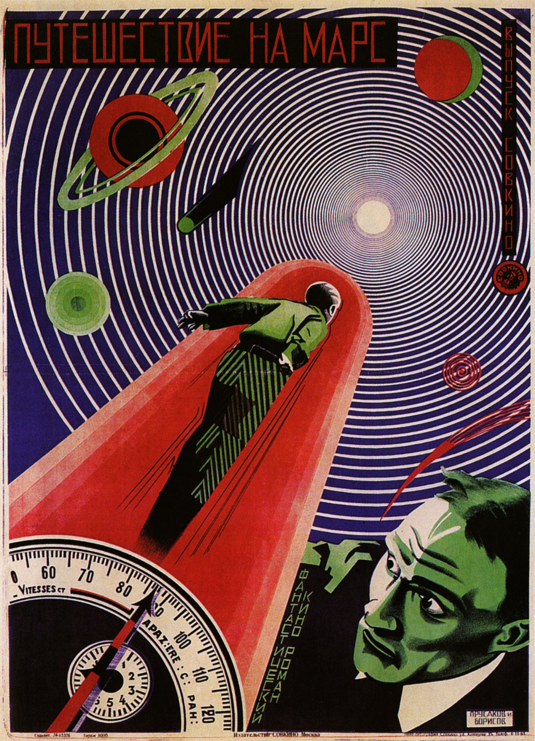
Early Bolshevik utopias
Alexander Bogdanov, Red Star (Krasnaya zvezda) (1908)
Alexei Tolstoy, Aelita (1922)
Adapted for cinematic release by Yakov Protazanov in 1924 under the title of Aelita: Queen of Mars (Aelita: koroleva marsa)
Film poster by Prusakov and Borisov for A Journey to Mars (1919)

Slide 15
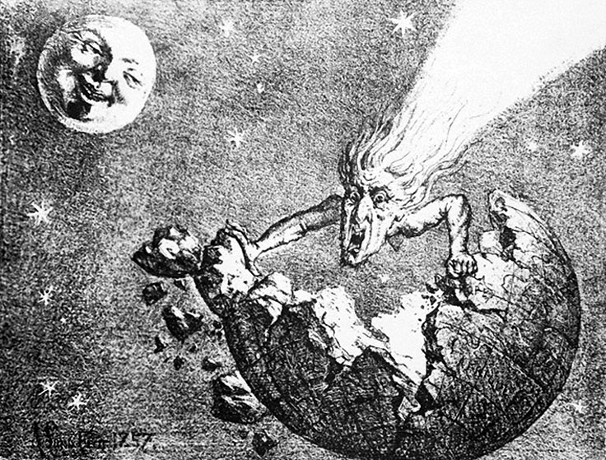
Utopia by comet collision
“I looked up and saw a fading trail of greenish light still hanging in the sky. And after that there was a shiver and whispering in the air, a stronger throbbing in one’s arteries, a sense of refreshment, a renewal of purpose. […] How beautiful it was! how still and beautiful! Peace! peace! – the peace that passeth understanding, robed in light descending!”
H. G. Wells, In the Days of the Comet (1906), p. 69.
A. Lund, illustration from an 1857 pamphlet of a comet destroying the Earth

Slide 16
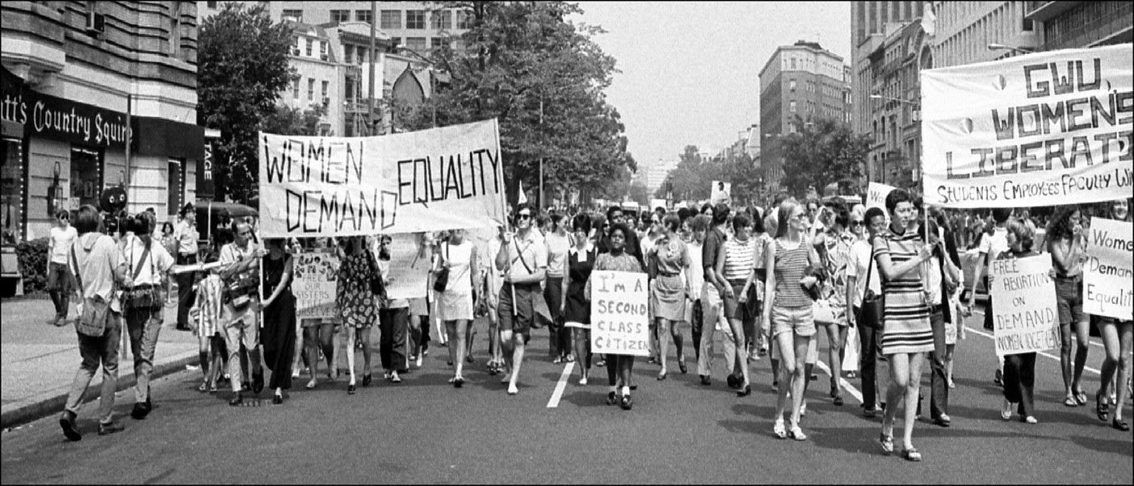
Critical Utopias: Feminism, Ecology & the New Left
“The Utopia of a modern dreamer must needs differ in one fundamental aspect from the Nowheres and Utopias men planned before Darwin quickened the thought of the world. Those were all perfect and static States, a balance of happiness won for ever against the forces of unrest and disorder that inhere in things. […] But the Modern Utopia must not be static but kinetic, must shape not as a permanent state but as a hopeful stage leading to a long ascent of stages.”
H. G. Wells, A Modern Utopia (1905), p. 11
In our present situation [in 1986], wherein utopian expression has been instrumentally confined in the false promises of post-industrial capitalism, the form of utopia itself must be exposed and transcended so that it can be revived as a practice of radical opposition. It cannot be left in its traditional form, for then it will either be coopted or ignored. It must be negated to insure the future-bearing impulse.”
Tom Moylan, Demand the Impossible: Science Fiction and the Utopian Imagination (1986), p. 194

Slide 17
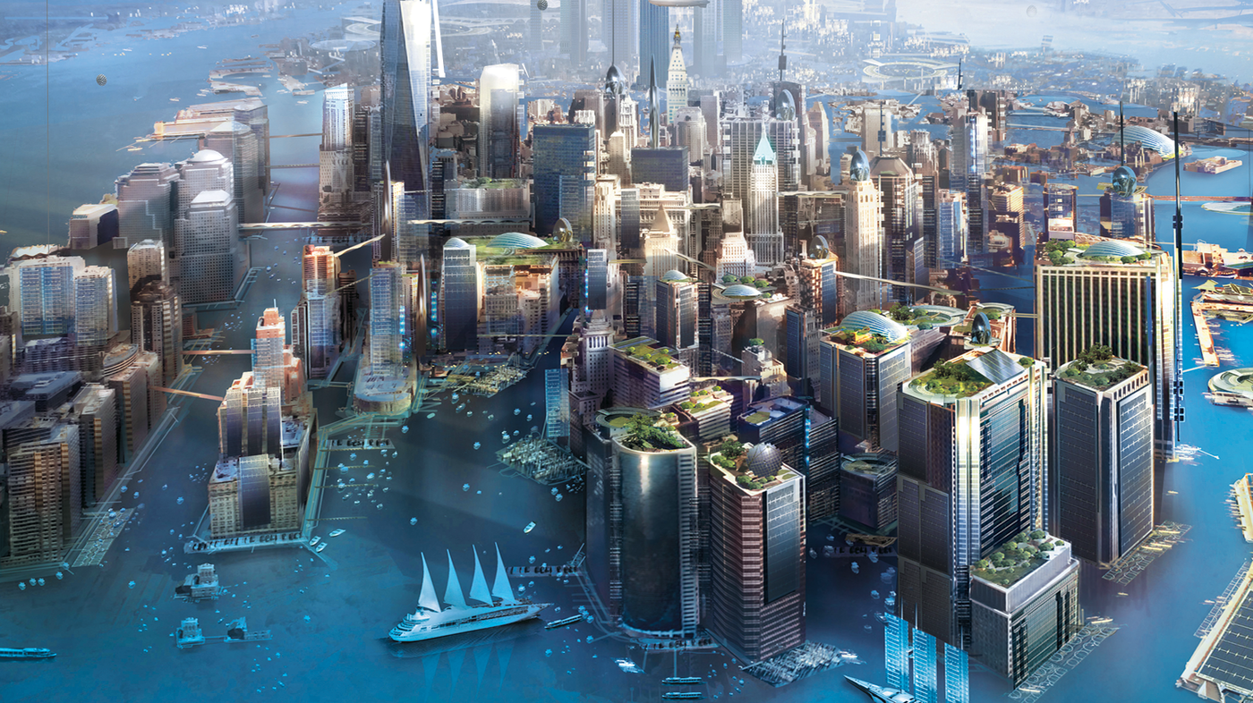
Flood fictions and utopian futures
Illustration from the cover of Kim Stanley Robinson, New York: 2140 (2017)

Slide 18
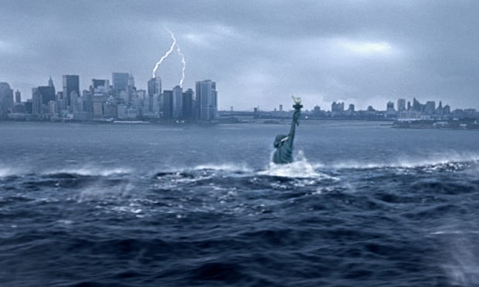
Apocalypse-by-water: the end we start from?

