Slide 1
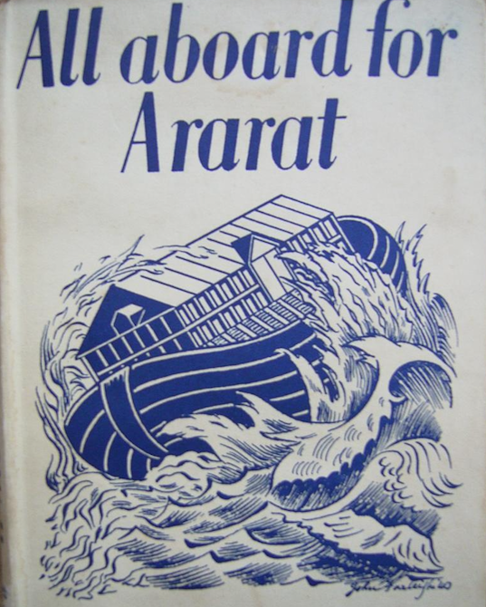
The Deliquescence of Clock-Time in Contemporary Apocalyptic Flood Fictions
Dr Caroline Edwards
Senior Lecturer in Modern & Contemporary Literature
Birkbeck, University of London

Slide 2
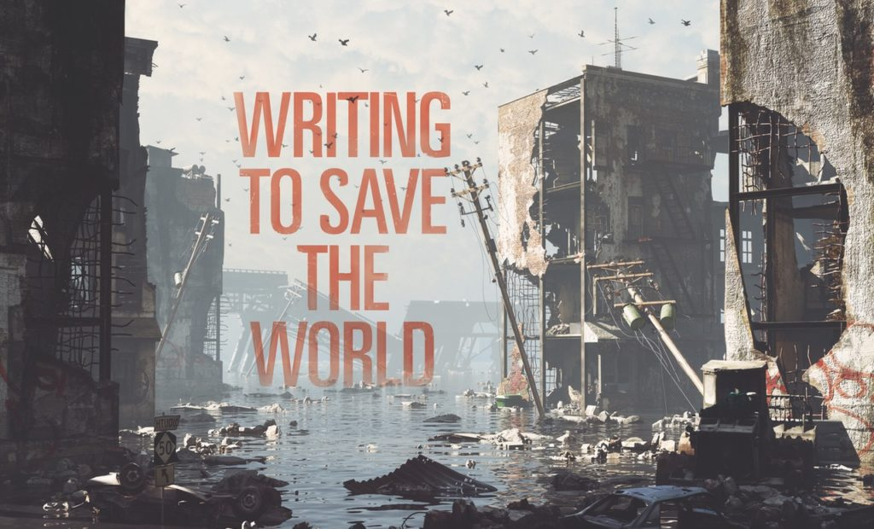
Apocalypse and climate change fiction
Image credit: “The rising tide of ‘cli-fi,’ or climate fiction,” The Writer, 11 April 2018: https://www.writermag.com/2018/04/11/cli-fi/

Slide 3
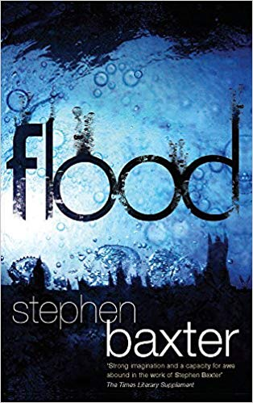
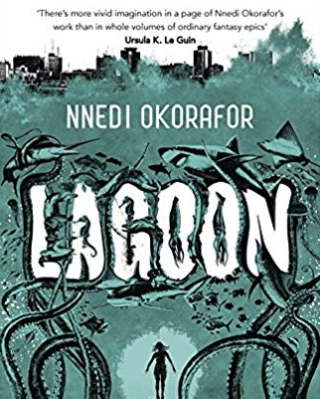
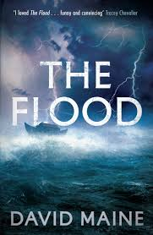
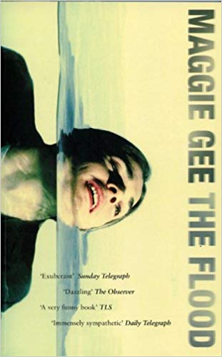
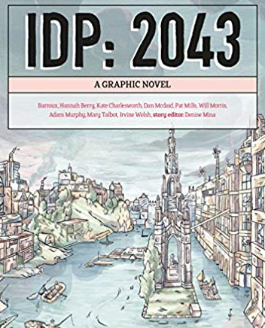
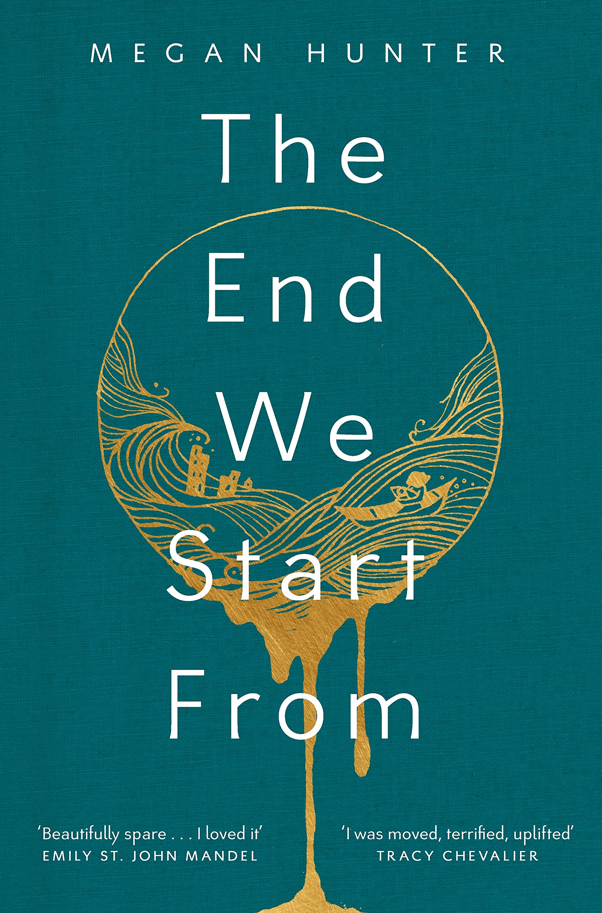
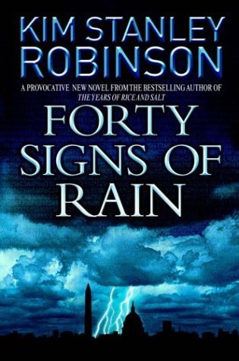
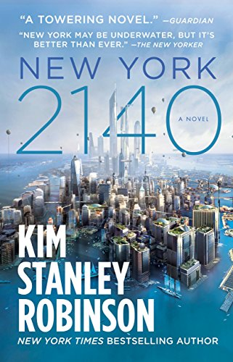
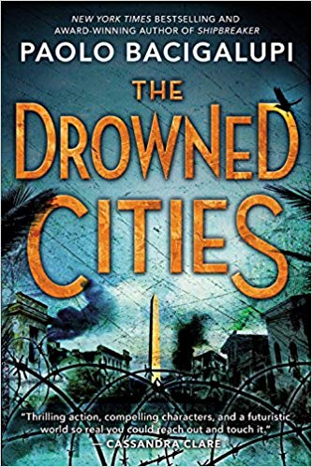
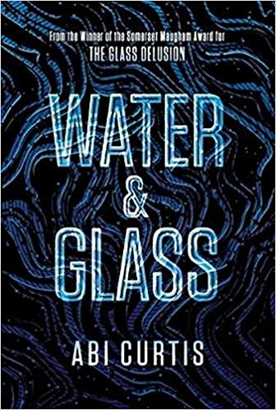
Flood fictions

Slide 4
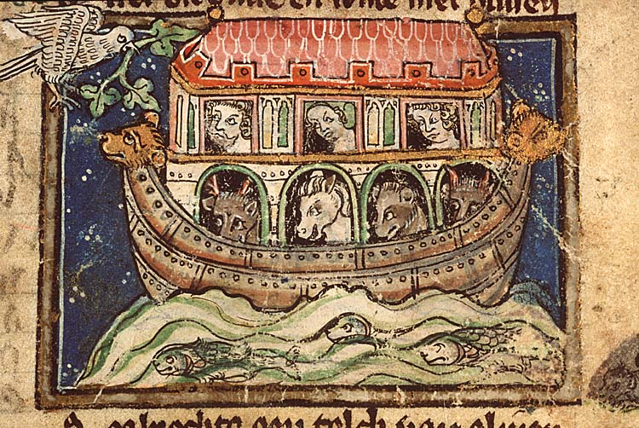
What comes after the flood?
The dove returns to the Noah’s Ark with and olive branch. Jacob van Maerlant, Spiegel historiael (c.1350).

Slide 5
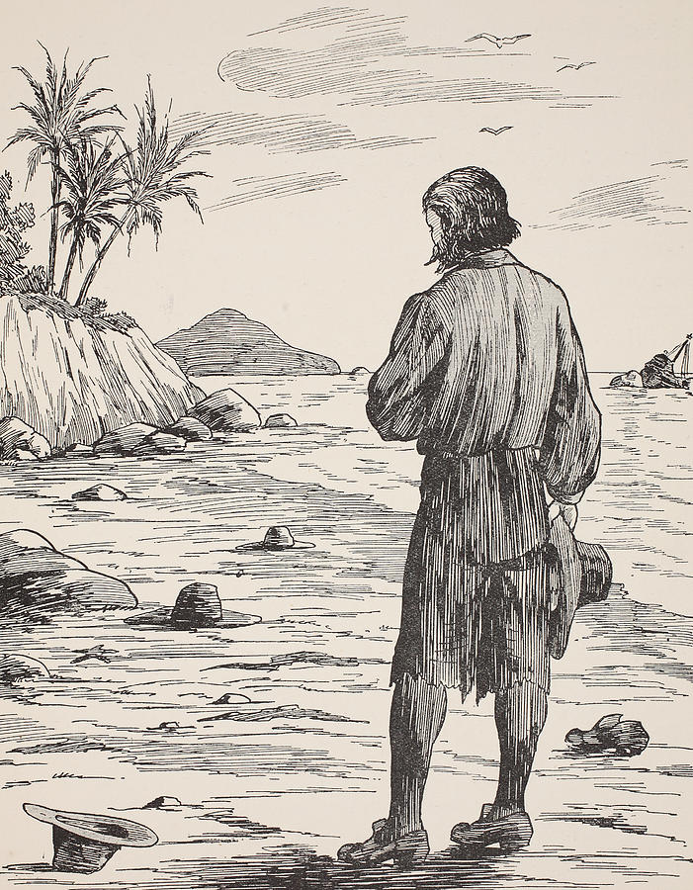
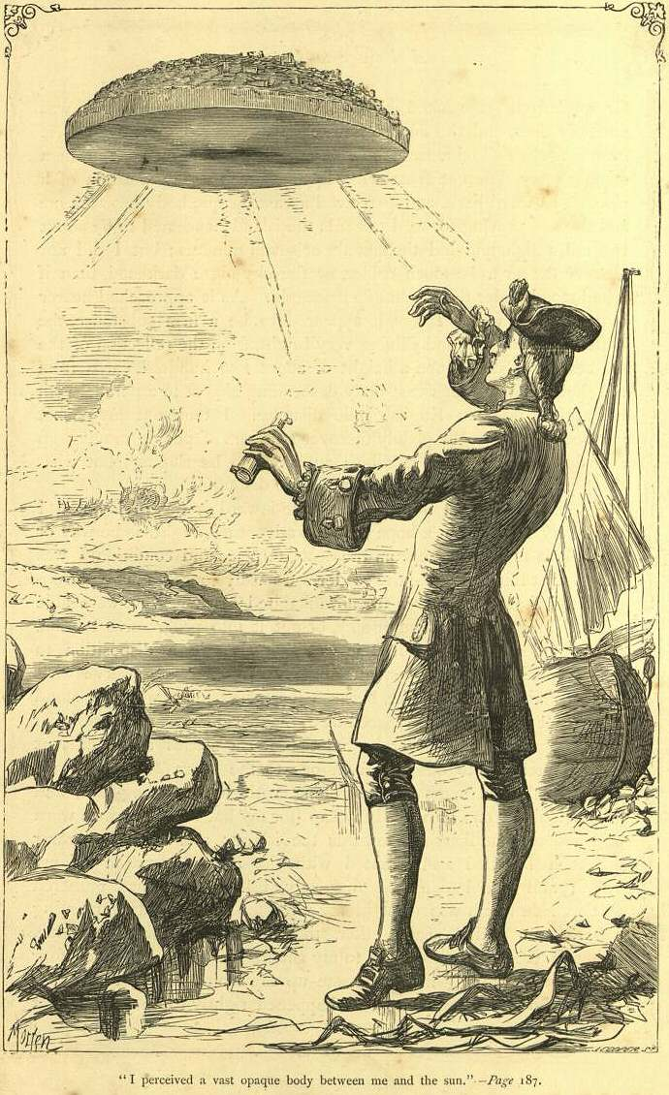
The island and the rise of the novel
Arriving at his island
Daniel Defoe, Robinson Crusoe (1719)
Gulliver sees the flying island of Laputa
Jonathan Swift, Gulliver’s Travels (1726)

Slide 6
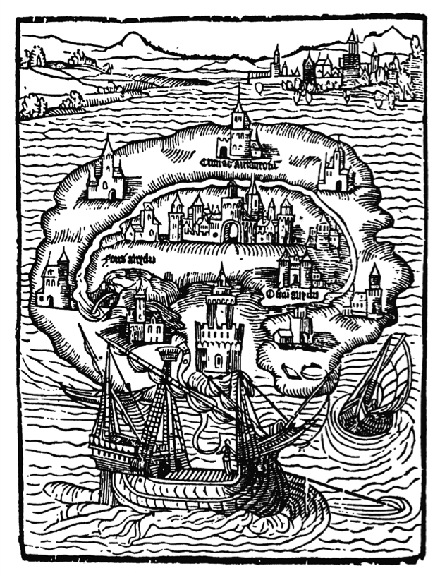
The island as utopian locus classicus
Thomas More, Utopia (1516)
Richard Bernard, The Isle of Man (1620)
Francis Bacon, New Atlantis (1624)
Phineas Fletcher, The Purple Island, or the Isle of Man (1633)
Bishop Godwin, Man in the Moone (1638)
Henry Neville, The Isle of Pines (1668)
Denis Vairasse d’Alais, The History of the Severambians (1677)
Utopiae Insulae Figura. Woodcut by Ambrosius Holbein from 1516.

Slide 7
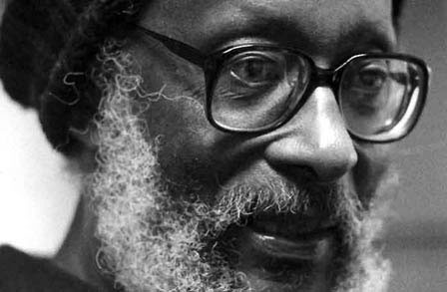
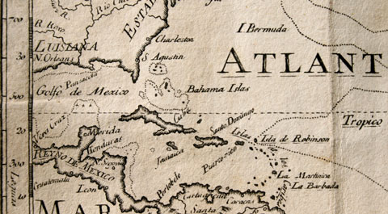
Islandology and non-linear history
“instead of the notion of one-two-three Hegelian, I am now more interested in the movement of the water backwards and forwards as a kind of cyclic, I suppose, motion, rather than linear.”
(qtd in Marc Shell, Islandology, p. 20).
“The islands that we inhabit are in fact the sunken tops of a mountain chain and the people who inhabit them have an echo of that catastrophe in their memory.”
(qtd in Bill Ashcroft, Utopianism in Postcolonial Literatures, p. 146.
Kamau Brathwaite

Slide 8
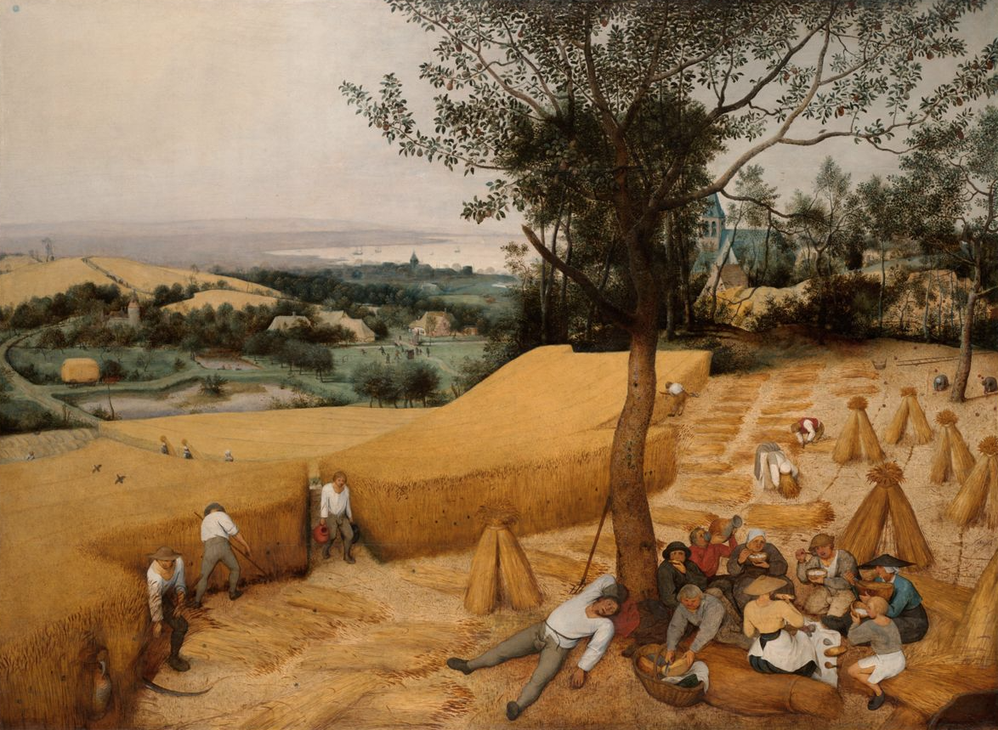
Repressive clock-time and industrial capitalism
“Three points may be proposed about task-orientation. First, there is a sense in which it is more humanly comprehensible than timed labour. The peasant or labourer appears to attend upon what is an observed necessity. Second, a community in which task-orientation is common appears to show least demarcation between ‘work’ and ‘life’. Social intercourse and labour are intermingled – the working-day lengthens or contracts according to the task – and there is no great sense of conflict between labour and ‘passing the time of day’. Third, to men accustomed to labour timed by the clock, this attitude to labour appears to be wasteful and lacking in urgency.”
E. P. Thompson “Time, Work-Discipline and Industrial Capitalism” (1967)
Pieter Bruegel the Elder, “The Harvesters” (1565)

Slide 9
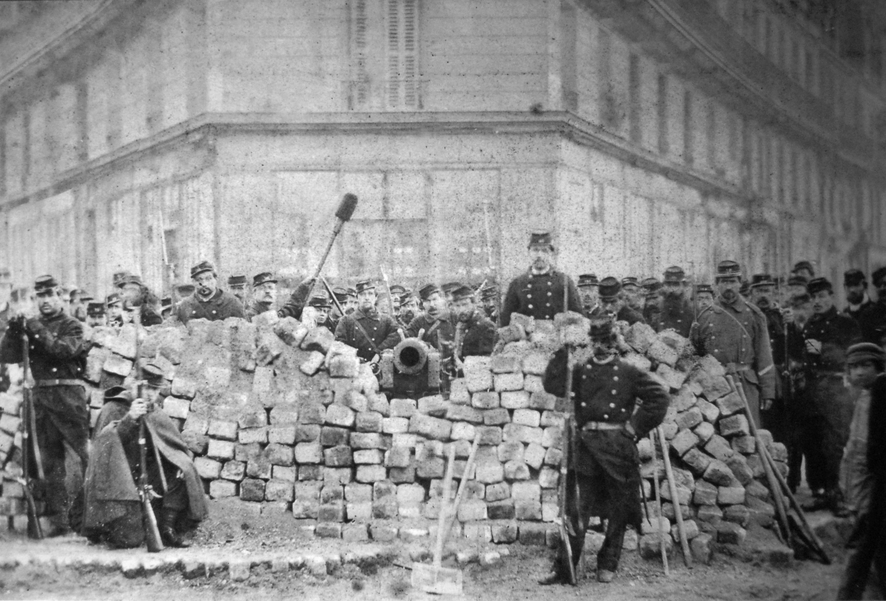
Utopian alternatives to clock-time
“Man exists only part-time, during the working days, as an instrument of alienated performance; the rest of the time he is free for himself. (If the average working day, including preparation and travel to and from work, amounts to ten hours, and if the biological needs for sleep and nourishment require another ten hours, the free time would be four out of each twenty-four hours throughout the greater part of the individual’s life.) This free time would be potentially available for pleasure.”
Herbert Marcuse, Eros and Civilisation: A Philosophical Inquiry into Freud (London: Ark Paperbacks, 1987), p. 153.

Slide 10
Will Self, The Book of Dave (2006)
Narrative timescales:
contemporary London, features a misogynistic taxi driver called Dave;
26th century (500AD, or “After Dave”), a post-apocalyptic flooded world in which Ing (what’s left of England) is reduced to a small archipelago of islands.

Slide 11
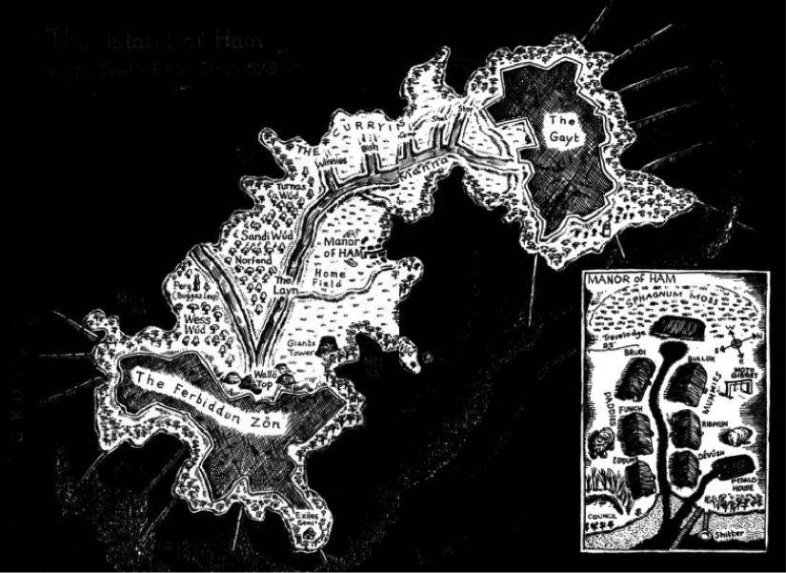
Ham: an “island of the blessed”?
“The island was a tapestry of naming, worked over again and again by the thousands of generations who had trod its leafy lanes and grassy paths. Anthonë Böm, with his inquiring mind, set himself to map the foetus-shaped island, from the long groynes that projected from the northeastern shores of the Gayt, to the hidden coves and gull-haunted strands beneath the Ferbiddun Zön to the south.” (BD 302)

Slide 12
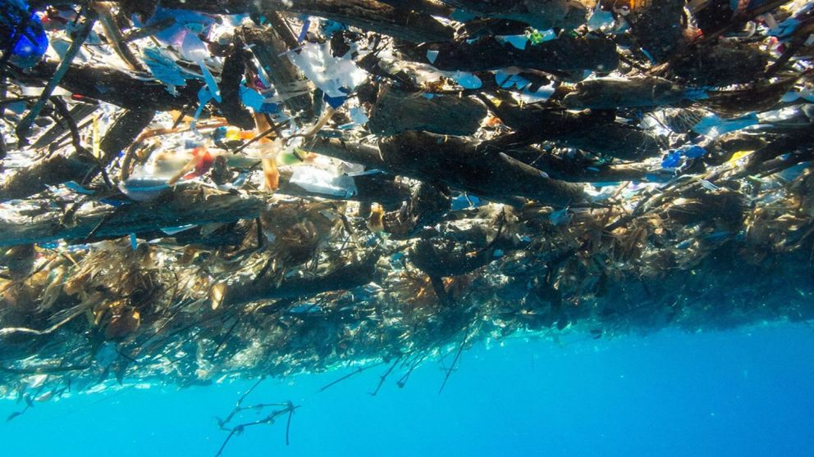
Deep, fluvial time: the great wave
“The great wave came on, thrusting before it a scurf of beakers, stirrers, spigots, tubes, toy soldiers, disposable razors, computer-disc cases, pill bottles, swizzle sticks, tongue depressors, hypodermic syringes, tin-can webbing, pallet tape, clips, clasps, brackets, plugs, bungs, stoppers, toothbrushes, dentures, Evian bottles…” (BD 404-5)
The “sea of plastic” near the island of Roatan, near Honduras in the Caribbean. Pic: Caroline Power Photography

Slide 13
Reaching the New Jerusalem: Megan Hunter’s The End We Start From
“In the ancient times, the ocean rose until it covered everything in sight. It covered the trees and the beasts and even the mountains, and ice drifted over their tops” (TE 17).
“The water rose and rose, and they could not recognize each other in the torrent, in the endless rain from above.” (TE 23)
“Every beast perished, every moving thing. Only one man and one woman survived on the waters, their bodies kept in a wooden box.” (TE 26)
“The fifth world is a place you cannot imagine, reached through the bubbles of the first lake. We will all be led there – not yet, but tomorrow.” (TE 59)

Slide 14
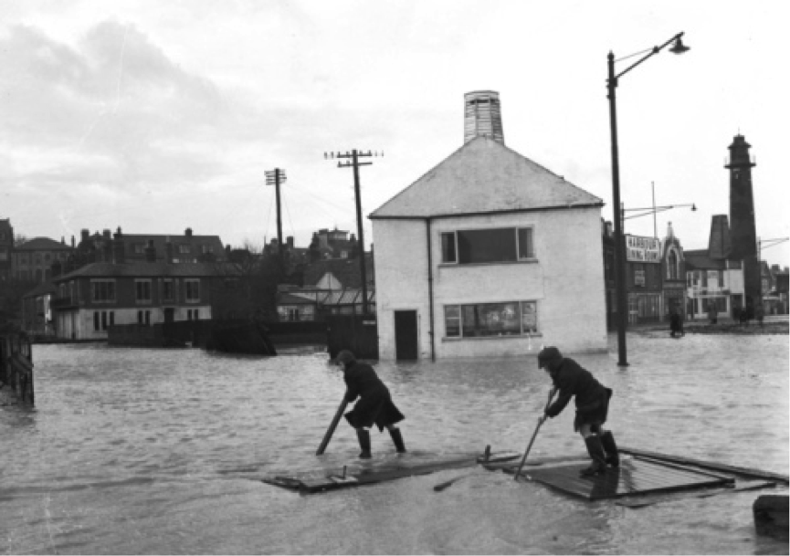
An ancestral time of flooding: the phylogenetic memory of the species
“Our ancestors must have lived through many great floods, particularly at the end of ice ages. Seas that had shrunk during hundreds of years of ice (which takes up less room than water) melted and overbrimmed their new coastlines. Stone tools and house-beams have been discovered far out in the Black Sea; no wonder we have myths of drowned worlds such as Atlantis, lost beneath the waves. Now we ourselves live in a time of melting ice-caps and climatic turbulence.”
Maggie Gee, “Drowned Worlds,” The Guardian, 20 December 2007
The damaging floods of 1953 at Gorleston, Norfolk.
Image credit: The East Anglian Daily Times.

Slide 15
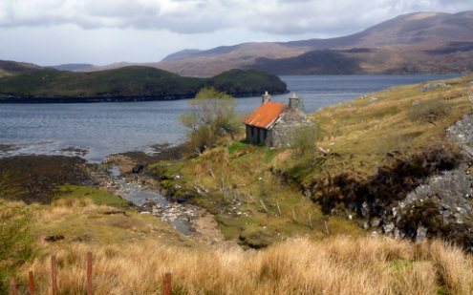
The remote island as the beginning and the end of time
“The otherworld will be beneath the ocean, forty thousand fathoms below. In that place, there will be no pain, nor death, nor mourning.” (TE 71)
“In that place, honey-sweet fruit will touch your lips with gold. Sunshine will lay you down and bless you, and moonlight will fill your bones.” (TE 73)
“After the six days and nights of fire all was still, the sea returned to liquid, the earth lying silent beneath the water.” (TE 95)
“We live at the site of exponential material meaning where embodiment meets water. Given the various interconnected and anthropogenically exacerbated water crises that our planet currently faces – from drought and freshwater shortage to wild weather, floods, and chronic contamination – this meaningful mattering of our bodies is also an urgent question of worldly survival.”
Astrida Neimanis, Bodies of Water: Posthumanism Feminist Phenomenology (2017)

Slide 16
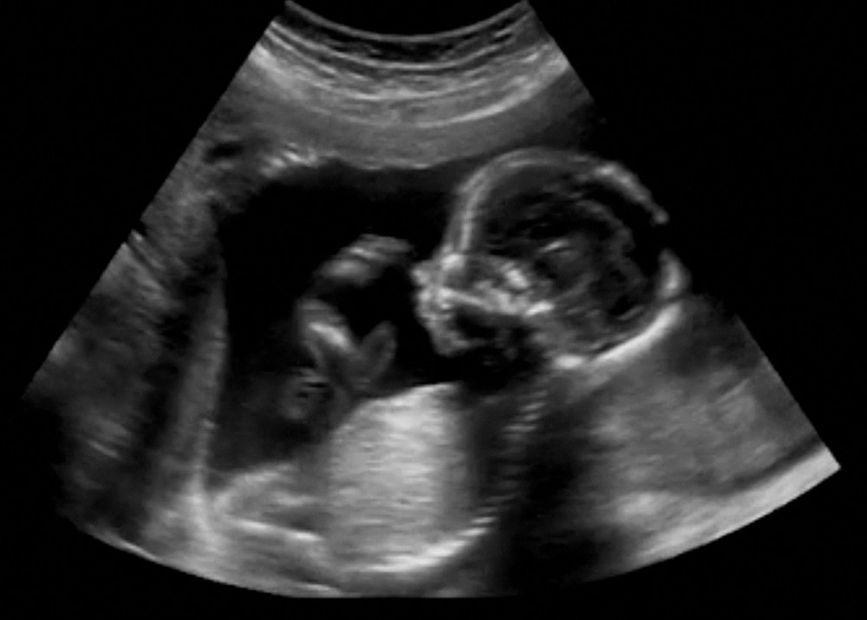
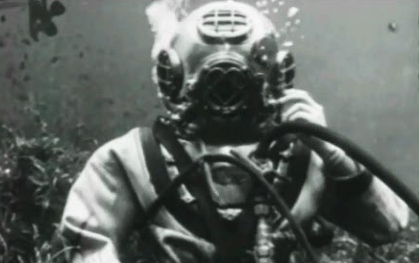
A feminist phenomenology of watery intersubjectivity
“The floodwaters remind Z of where he came from.” (TE 70)
“The baby moves more and more; its touches are like bubbles popping. She looks at it from time to time on the sonogram. It is both deep sea diver and astronaut, approaching her as if from a great distance of water or space, coming slowly into focus.” (Abi Curtis, Water & Glass, p. 197)

Slide 17
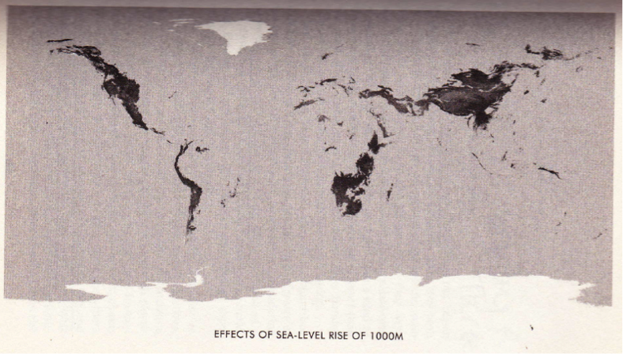
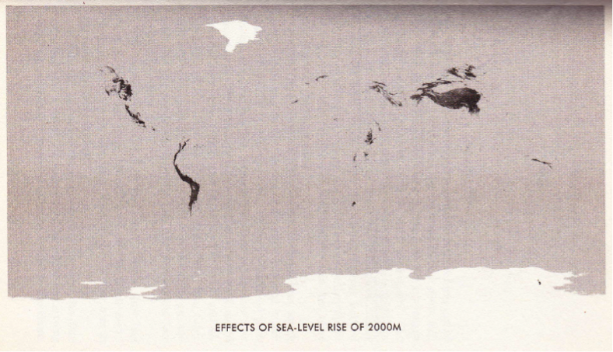
From islands to ocean worlds in Stephen Baxter’s Flood
“All this Gary saw from above, from the warmth and comfort of his helicopter cabin. There was no human noise, no screams or cries; it was all drowned by the storm’s roar and the thrum of the chopper’s engine. […] The flooded estate was reduced to an abstraction, a mélange of water and land.” (F 65)

Slide 18
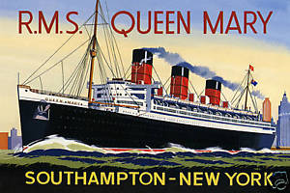
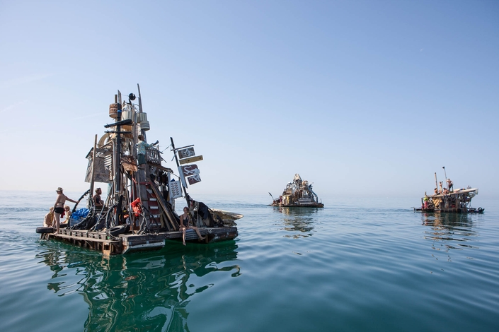
High-tech arks and garbage islands
Lily looked at the children playing in the sea. ‘Our civilisation is gone. Everything we built. But look at those kids swimming. They don’t care that the Smithsonian is drowned, or that we’re all offline for ever.’
Gary murmured, ‘Yes. And even if we pass away, you know, it’s a happy ending of a kind. “One generation passeth away, and another generation cometh: but the Earth abideth for ever.” Ecclesiastes 1,4.’ He grinned. (F 531)

Slide 19
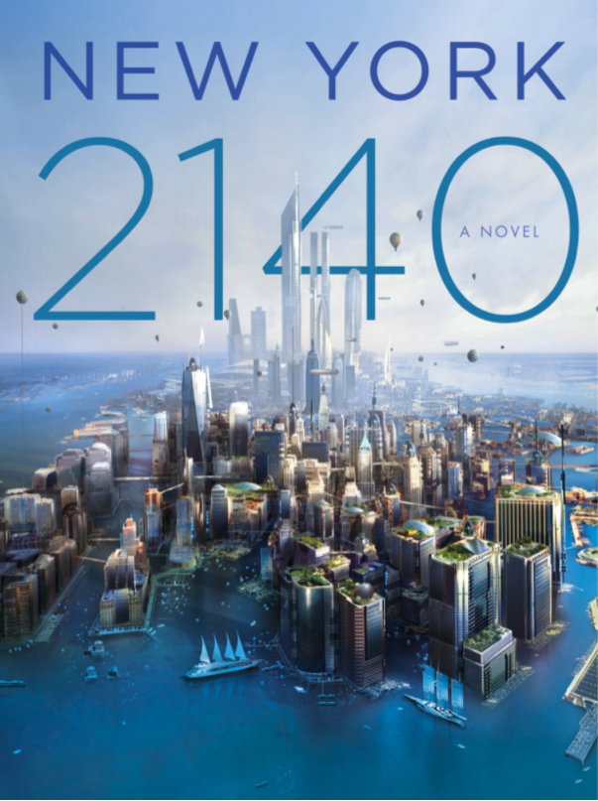
An archipelagic consciousness: Kim Stanley Robinson’s New York: 2140
“All that happened very quickly, in the very last few years of the twenty-first century. Apocalyptic, Armageddonesque, pick your adjective of choice. Anthropogenic could be one. Extinctional another. Anthropogenic mass extinction event, the term often used. End of an era. Geologically speaking it might rather be the end of an age, period, epoch, or eon, but that can’t be decided until it has run its full course, so the common phrase “end of an era” is acceptable for the next billion years or so, after whjich we can revise the name appropriately.
But hey. An end is a beginning!” (NY 144)

Slide 20
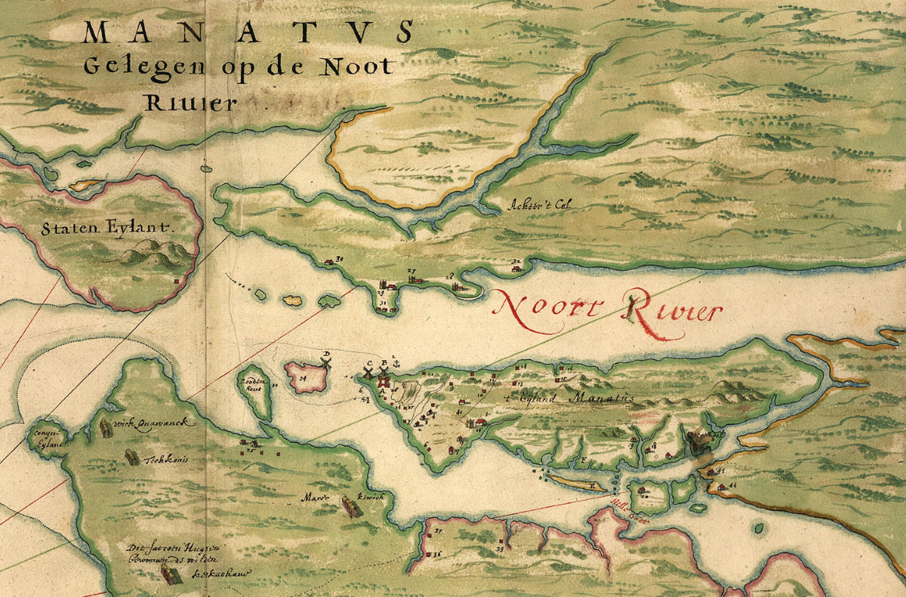
Mannahatta: New York’s longue durée
The Manatus Map, from 1639, is the first depiction of Manhattan as an island

Slide 21
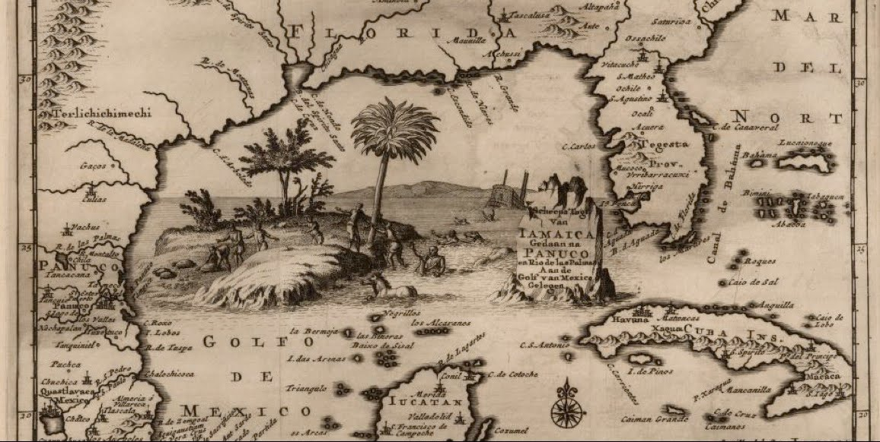
Islands: from before, or for after, humankind
Pieter van der Aa’s map of the Caribbean (Leiden, 1707)
“… that an island is deserted must appear philosophically normal to us. Humans cannot live, nor live in security, unless they assume that the active struggle between earth and water is over, or at least contained. […] humans can live on an island only by forgetting what an island represents. Islands are either from before or for after humankind. […] Dreaming of islands – whether in joy or in fear, it doesn’t matter – is dreaming of pulling away, of being already separate, far from any continent, of being lost and lone – or it is dreaming of starting from scratch, recreating, beginning anew.”
Gilles Deleuze, “Desert Islands” (written early 1950s)

